Slide 1
Looking Outside Core Facilities as Regional Hubs
The Entrepreneurial Core Director
Ben Myers, PhD
Director of Research Cores
Yale University - Office of the Provost

Slide 2
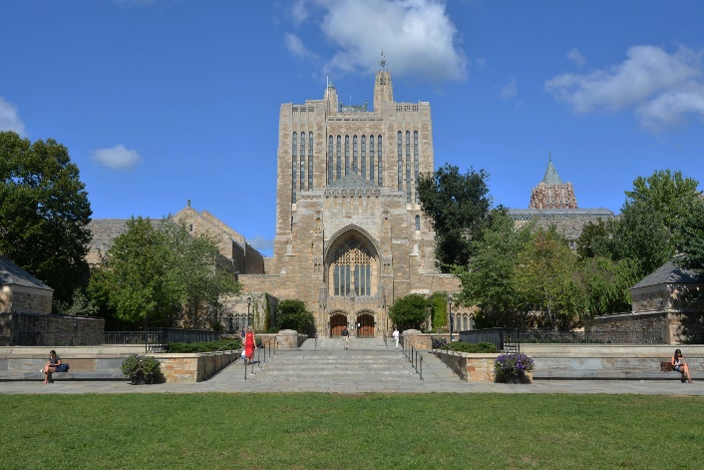
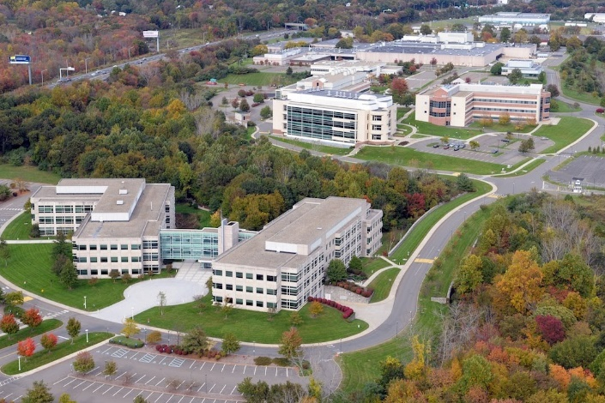
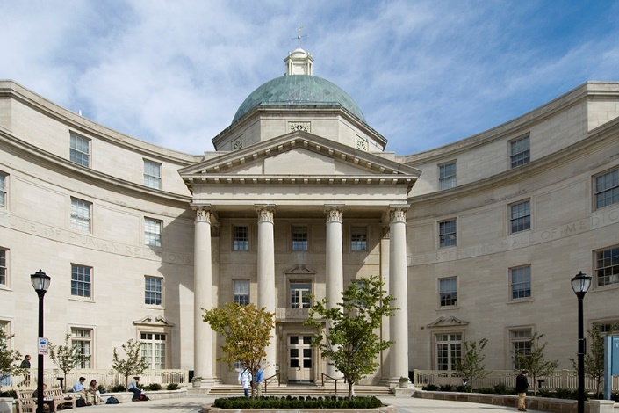
Research Core Facilities at Yale
Yale Central Campus
Yale West Campus
Yale School of Medicine
Imaging
Analytical
Fabrication
Animal Technology
Computational
Biomedical
Light microscopy
Electron microscopy
MRI
Mass Spectrometry
NMR
Optical Spectroscopy
Machine Shops
Glass Blowing
Cleanroom Microfab
Laboratory Animals
Gene Editing
Phenotyping
Bioinformatics
Research Computing
Drug Discovery
Flow Cytometry
Neurotech
Notes:
CryoEM

Slide 3
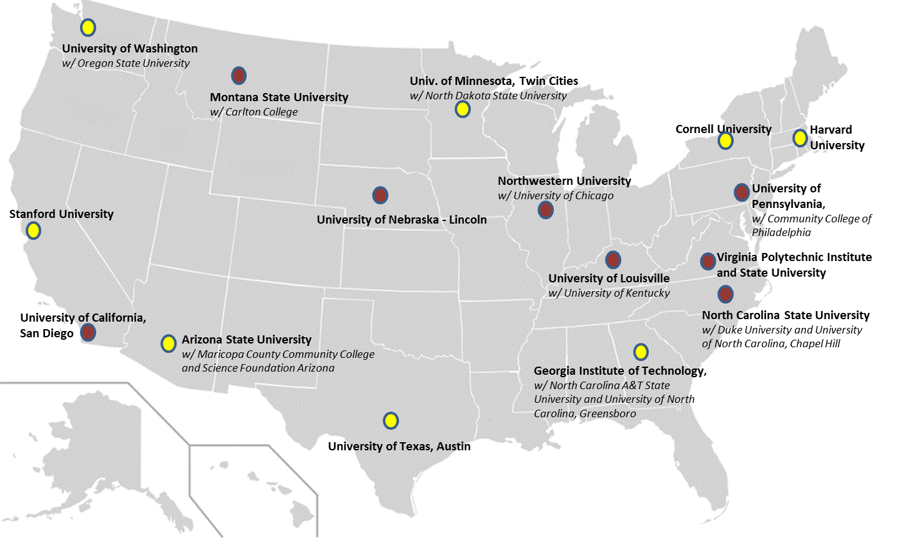
National Nanotechnology Coordinated Infrastructure
16 Sites (29 Institutions)
$81M over 5 years
2,000+ tools in 69 facilities
>13,000 users in 2018-2019
>3,800 external users
>1.1M facility hours in 2018-2019

Slide 4
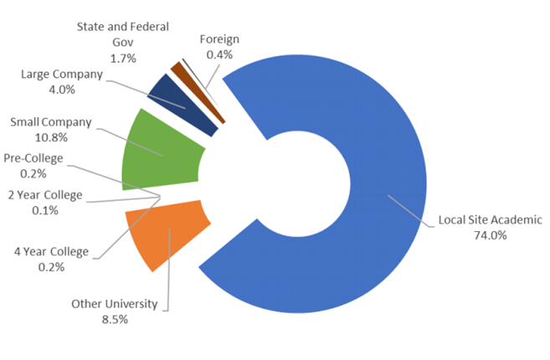
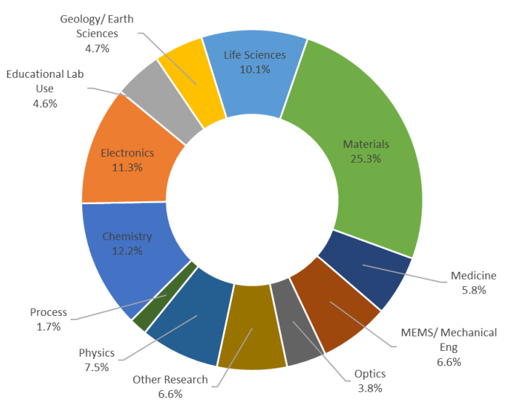
NNCI Userbase and Discipline Diversity
www.nnci.net

Slide 5
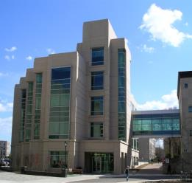
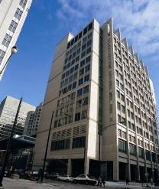
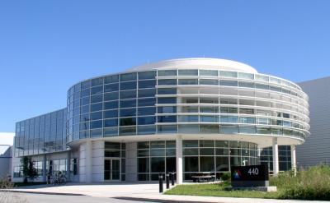
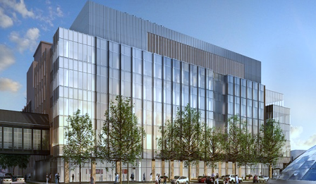
Soft and Hybrid Nanotechnology Experimental Resource
NU Center for Nanofabrication
and Molecular Self-Assembly
Simpson Querrey Institute
Argonne National Laboratory
Center for Nanoscale Materials
Pritzker Nanofabrication Facility
Uniting over $800 million in nanotechnology research, education, infrastructure & facilities
Regional Coordination
Global Partnerships
Prof Vinayak Dravid - Director
Prof Andrew Cleland – Co-Director

Slide 6
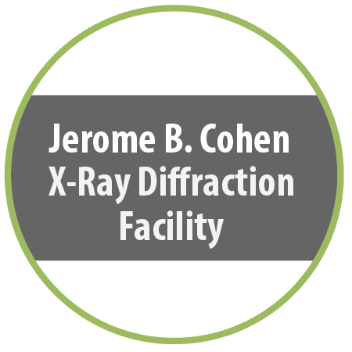
SHyNE – Core Facilities
Electron microscopy, nanopatterning, surface analysis, scanned probe, bio-cryo
Peptide synthesis
Bio/nano analytical
Mass spec, NMR, XRD, Polymer characterization
Atom-probe
Tomography
Micro/Nanofabrication
X-ray scattering
Pulsed Laser Deposition
Micro/Nanofabrication

Slide 7
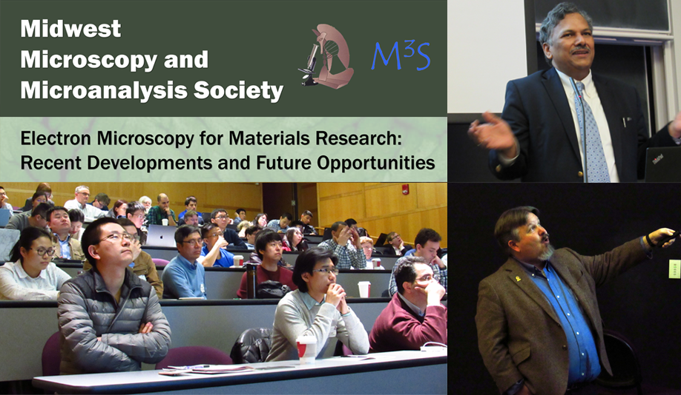
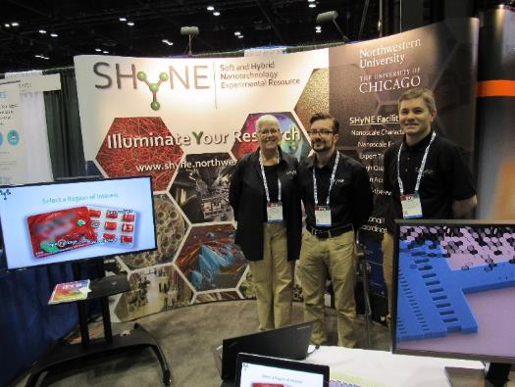
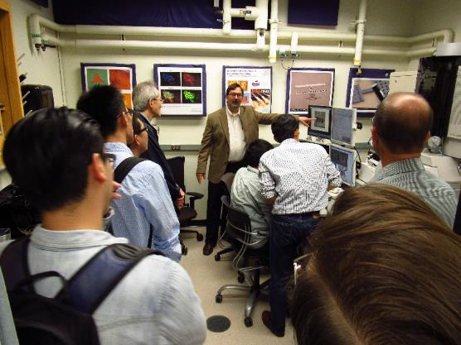
User engagement and marketing
SEED funding
Trade shows
Regional professional organizations
University corporate engagement offices
Startup incubators/tech parks
Customer-site presentations
Vendor workshops
Tours coupled to events
Brochure/website/social media

Slide 8
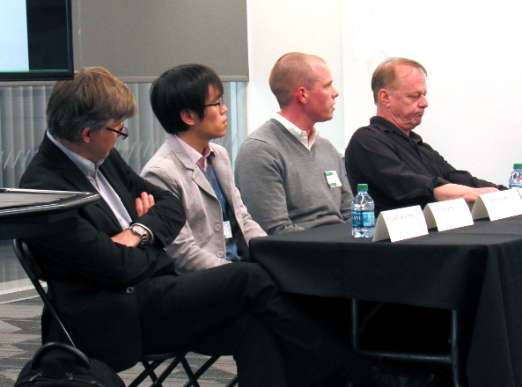
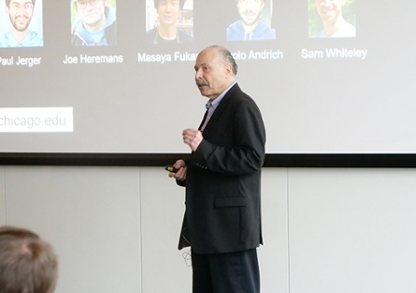
Regional facilities networks - iNANO
Coordinated effort to bridge institutions at the research core facility level
United by research themes
Focus on networking
Engage facility staff and users
Plans to expand regionally

Slide 9
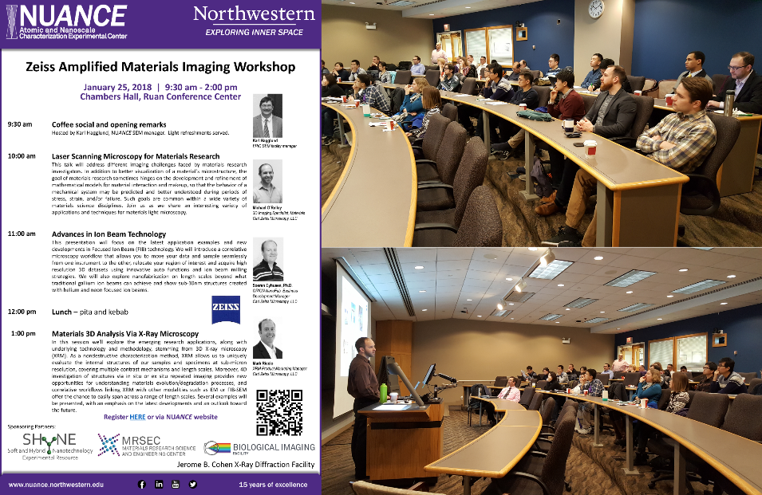
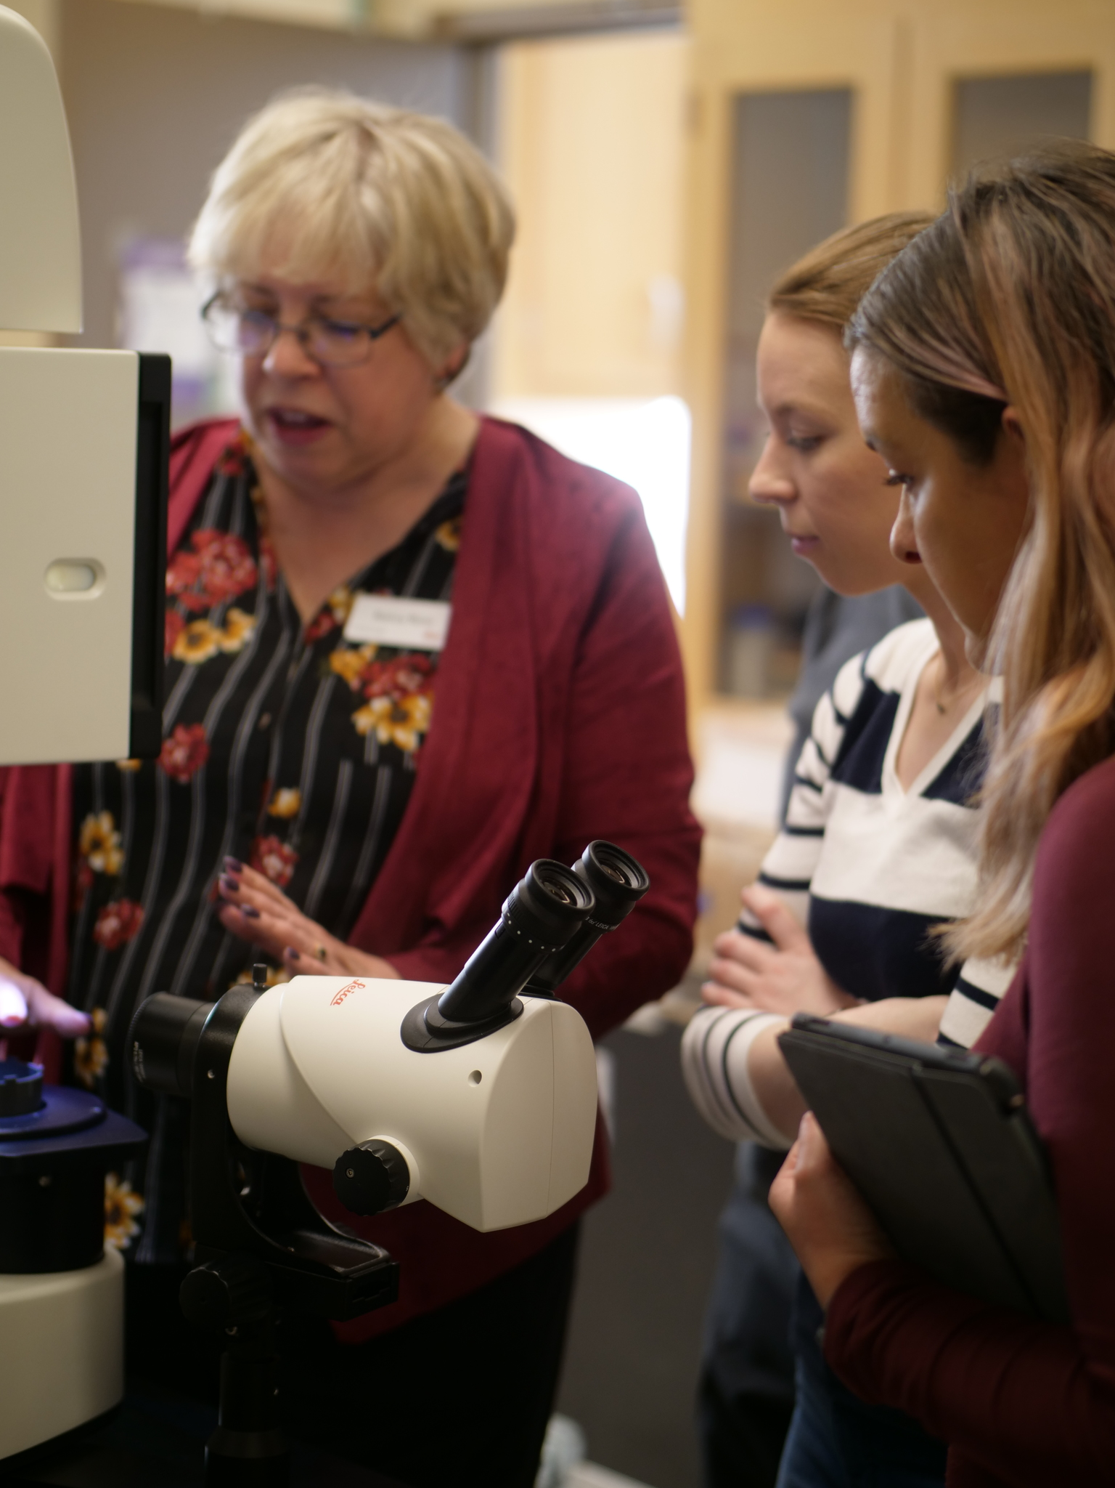
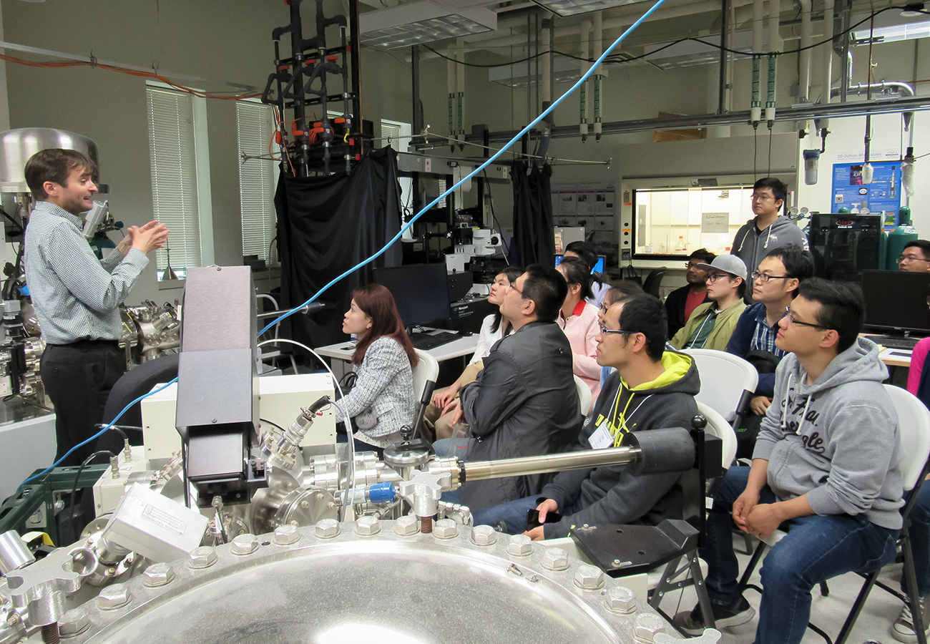
Vendor engagement
Workshops/symposia
Short courses
Hands on demos
Zeiss Materials Imaging Symposium
Thermo Scientific XPS Workshop
Leica Cryo-SEM Workshop

Slide 10
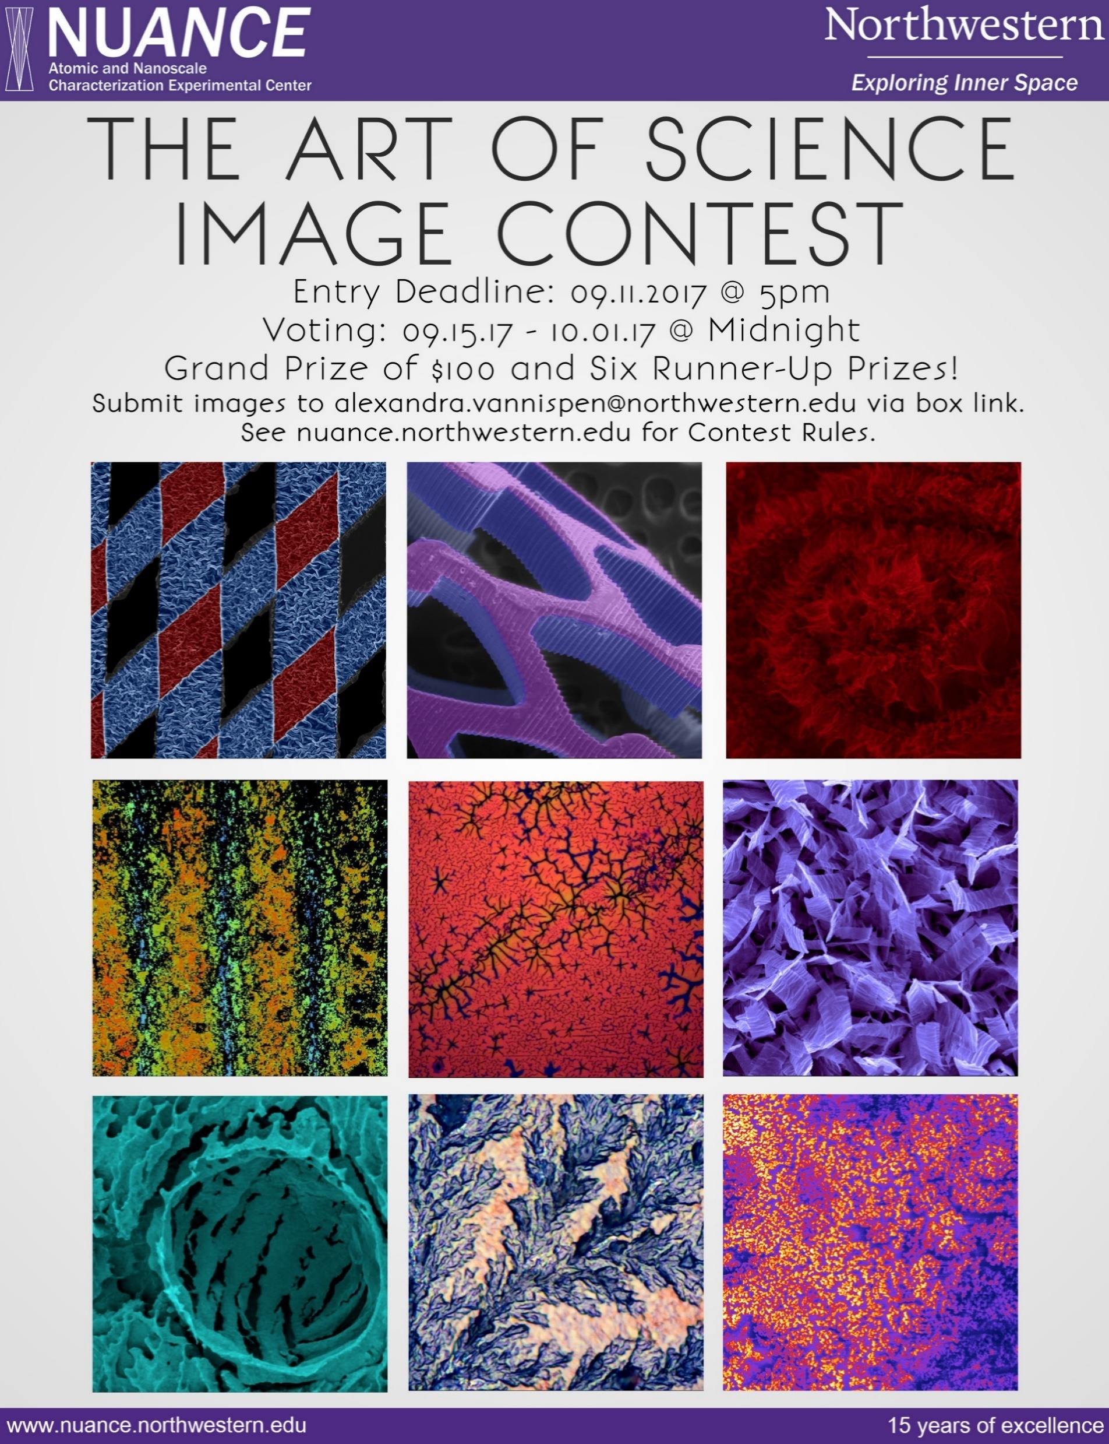
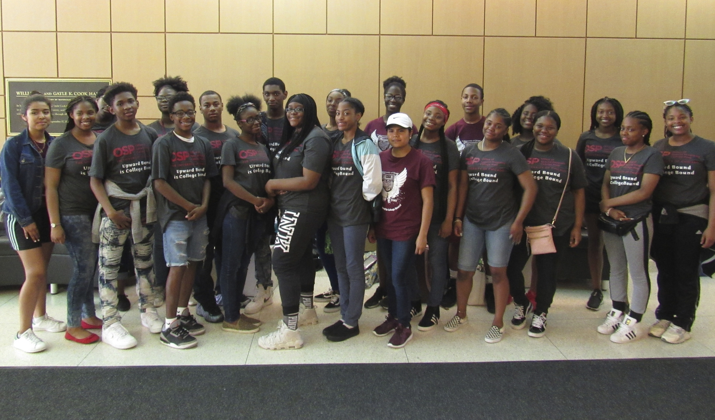
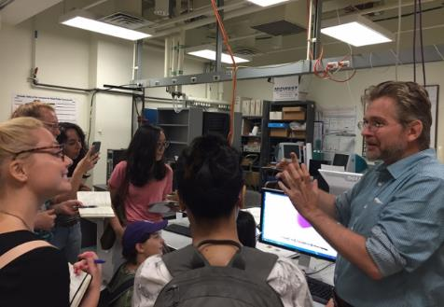
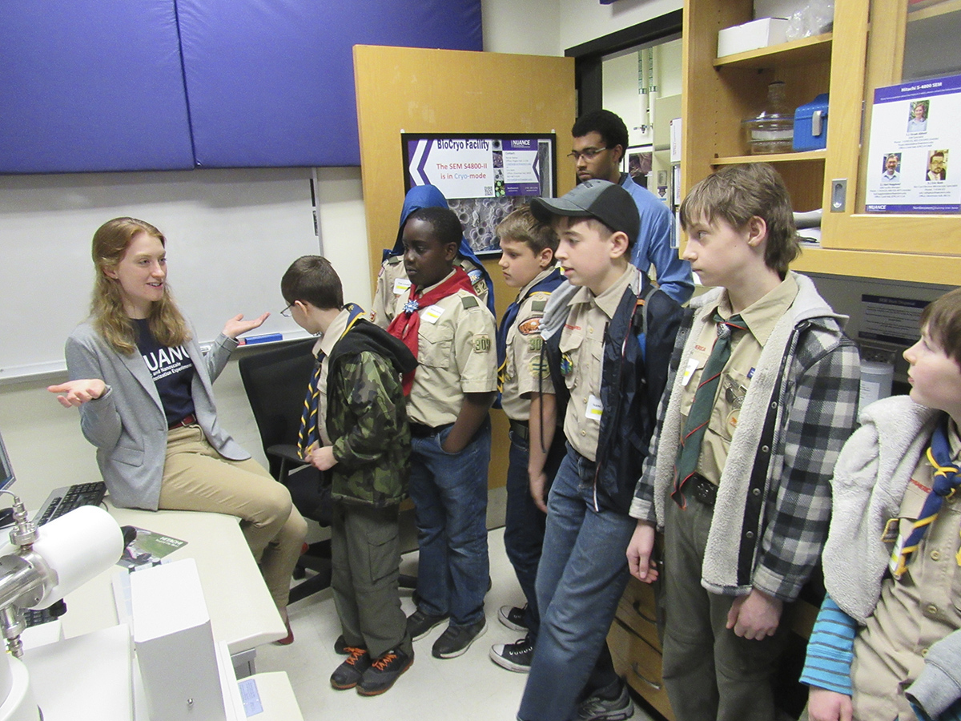
Community engagement
Targeted outreach
Tours and demos
Image contests
K-12 Outreach – Upward Bound
Nano-Journalism
K-12 Outreach – All Scouts Nano Day

Slide 11
External users – benefits, constraints and lessons learned
Benefits
Enhances corporate engagement efforts
Sponsored research, recruiting, purchasing..
Revenue resiliency
Increased internal visibility
Staff professional development
Constraints
Time
Regional variation
Administrative burden
Mission alignment
Key focus areas
Visibility
Ease of access
Customer service
Don’t bother
Trade shows
Brochures
Social media

