Slide 1
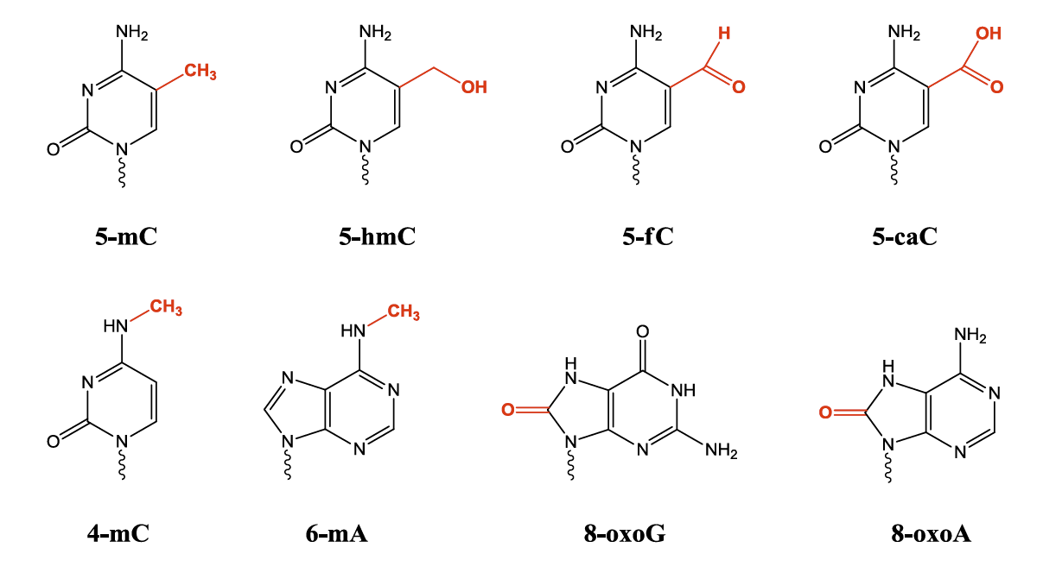
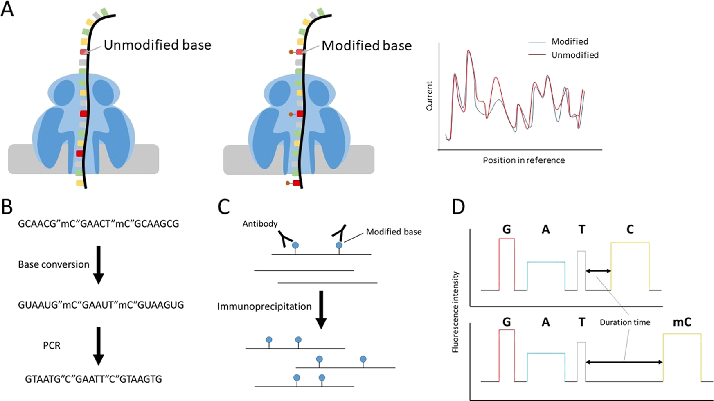

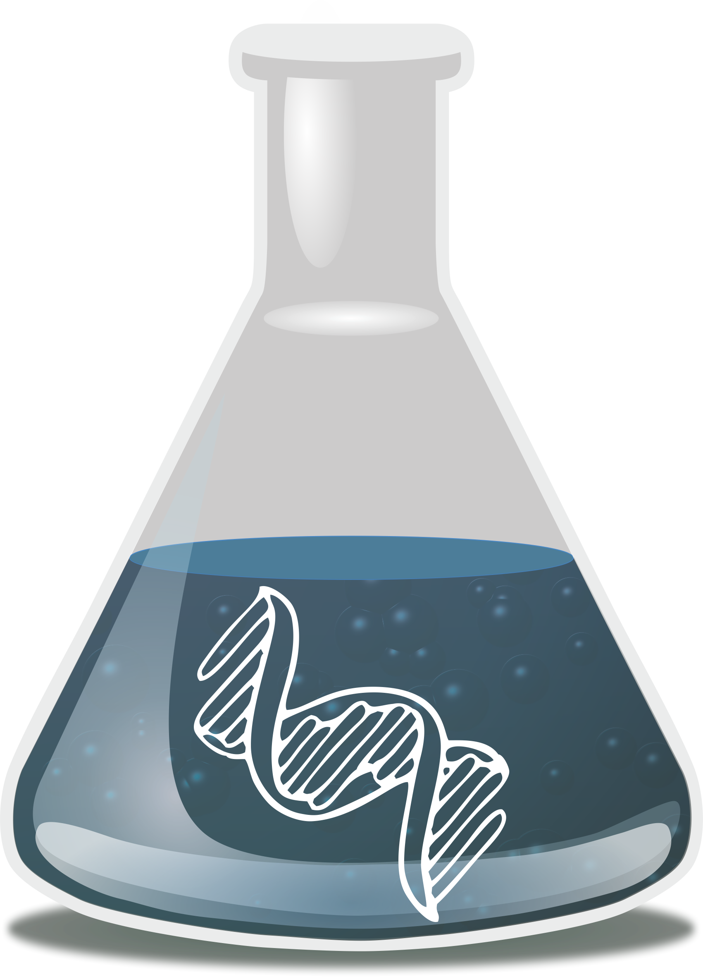

Detection of Base Modifications using
Nanopore Sequencing
Jonathan Foox
Postdoctoral Associate
Institute for Computational Biomedicine

Slide 2
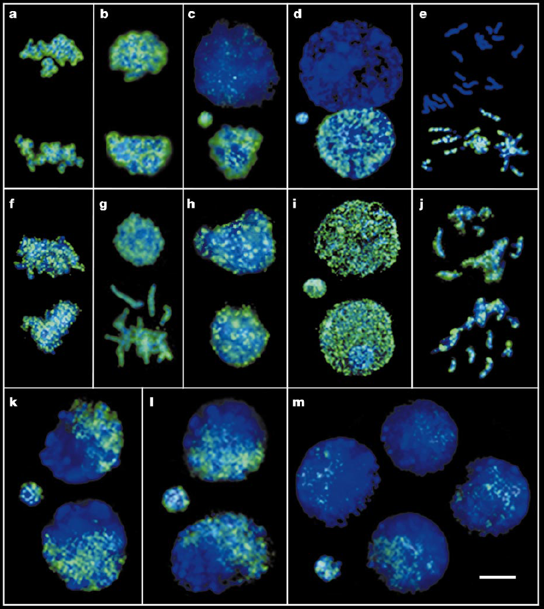
mC is important on day one
3h
6h
8h
8h - aphidicolin
metaphase
sperm
Anti-mC
egg
Anti-DNA
22h
32h
45h
Anti-mC
Mayer et al, 2000
Notes:
Development
Aphidicolin is a reversible inhibitor of eukaryotic nuclear DNA replication. It blocks the cell cycle at early S phase. It is a specific inhibitor of DNA polymerase A,D in eukaryotic cells and in some viruses and an apoptosis inducer in HeLa cells

Slide 3
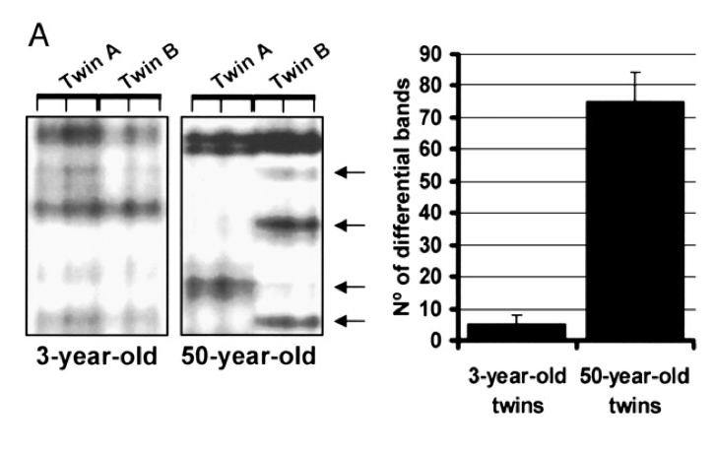
Divergence in identical twins
Mario F. Fraga et al. PNAS 2005;102:10604-10609

Slide 4
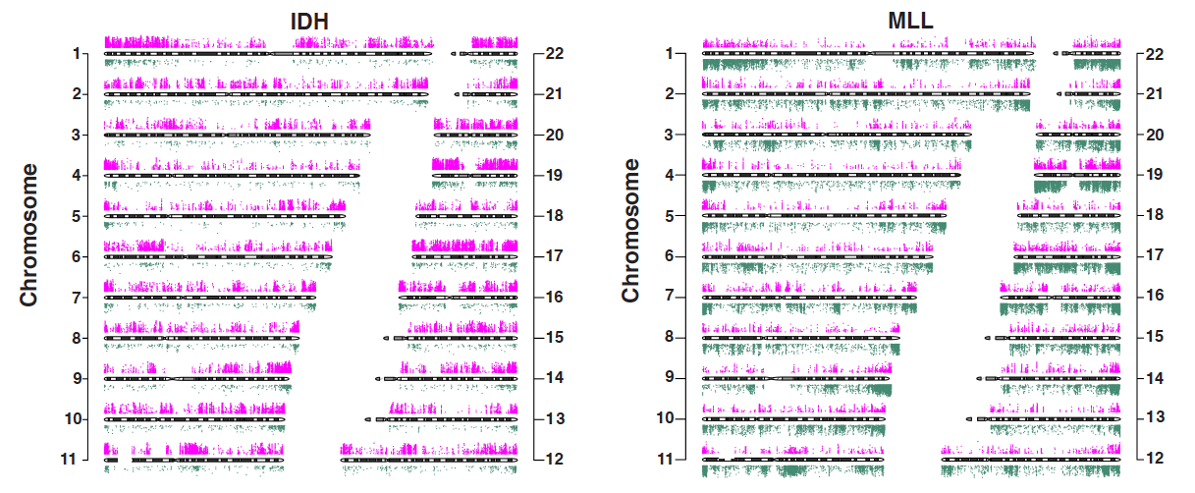
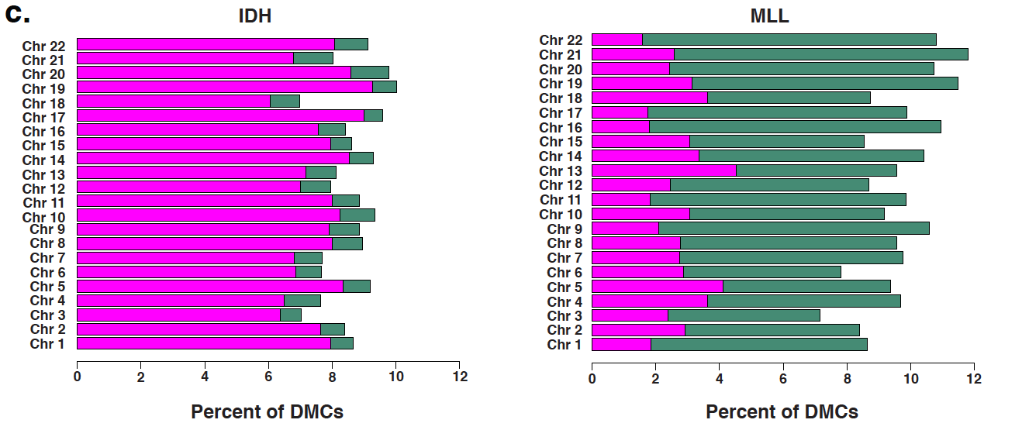
Two AML subtypes; highly different global methylation
Hyper-methylation
Hypo-methylation
Akalin et al. ,PLoS Genetics, 2012
Notes:
Disease onset
Differential methylation in IDH-mutated AMLs vs. normal bone marrow (left) and rearranged Mixed Lineage Leukemi AMLs vs NBM (right)

Slide 5
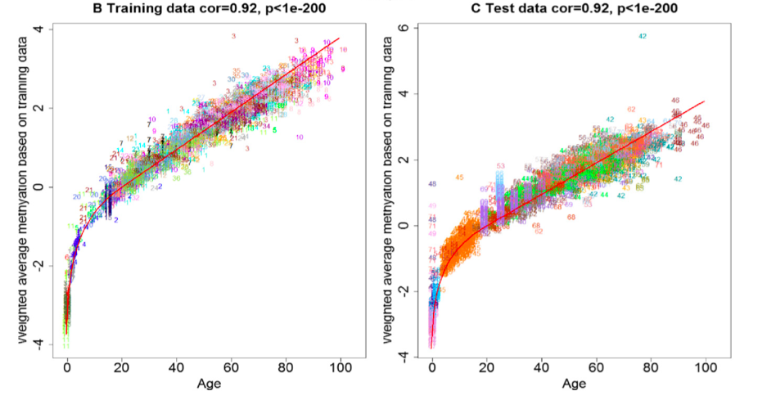
DNA methylation can predict age
Horvath S. “DNA methylation age of human tissues and cell types.” Genome Biology. 2013;14(10):R115.

Slide 6
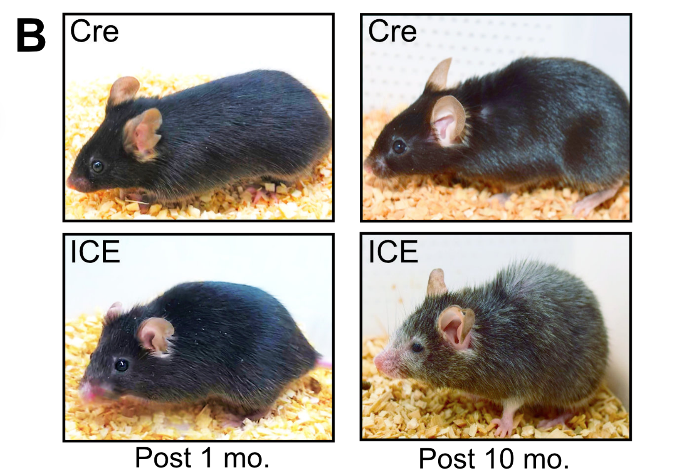
Epigenetic disruption accelerates aging
Adapted from: DNA Break-Induced Epigenetic Drift as a Cause of Mammalian Aging. Motoshi Hayano, Jae-Hyun Yang, Michael S. Bonkowski, Joao A. Amorim, […], David A. Sinclair. bioRxiv 808659; doi: https://doi.org/10.1101/808659
Notes:
DNA damage sites lead to disrupted epigenome regulation - these disrupted cellular pathways can lead to faster aging. Shown in inducible changes in the epigenome (ICE)

Slide 7
Detecting nucleobase modifications
Bisulfite/enzymatic
treatment
Immunoprecipitation
Xu, L., Seki, M. Recent advances in the detection of base modifications using the Nanopore sequencer. J Hum Genet 65, 25–33 (2020). https://doi.org/10.1038/s10038-019-0679-0

Slide 8
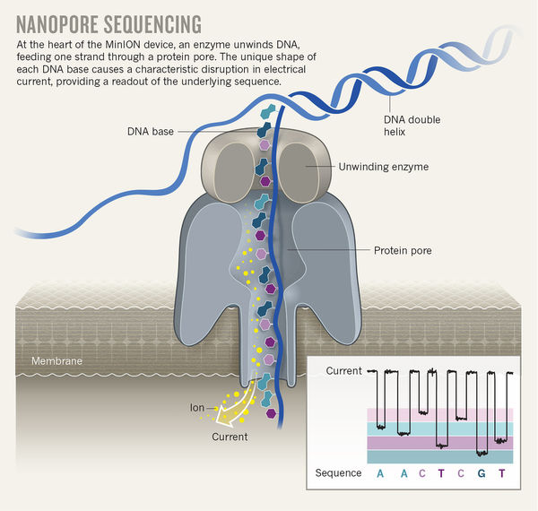
Detecting nucleobase modifications
http://blogs.nature.com/naturejobs/2017/10/16/techblog-the-nanopore-toolbox/

Slide 9
Detecting nucleobase modifications
Adapted figure from: Xu, L., Seki, M. Recent advances in the detection of base modifications using the Nanopore sequencer. J Hum Genet 65, 25–33 (2020). https://doi.org/10.1038/s10038-019-0679-0
Notes:
Pioneering experiments in PNAS in 2013: “5-Methyl cytosine would give you slightly different current signal than cytosine”

Slide 10
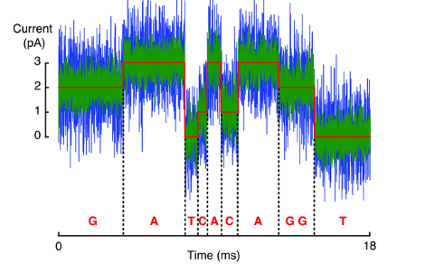
Electrical Current Data
Notes:
Current is sampled over time at around 4 kilohertz
Changes in picoampere current over time reflect different nucleotides passing through the pore
At the heart of the matter is examining this electrical current data and interpreting it for nucleic acids

Slide 11
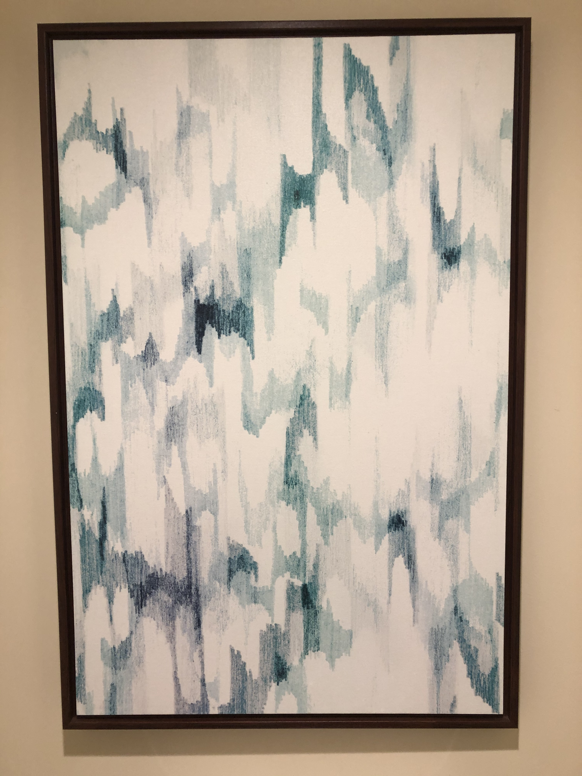
Electrical Current Data

Slide 12
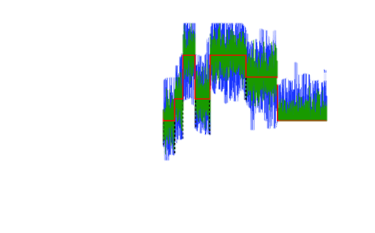
Electrical Current Data
Notes:
Mutated methyltransferase

Slide 13
(Some) Common Nanopore Tools
Tool Name | Signal to sequence | Base modification | Variant calling | Consensus calling
albacore | ✓
scrappie | ✓
flappie | ✓
guppy | ✓ | ✓
bonito | ✓ | ✓ |  | ✓
nanopolish | ✓ | ✓ | ✓ | ✓
tombo |  | ✓
deepsignal |  | ✓
nanoraw |  | ✓ |  | ✓
signalalign |  | ✓ |  | ✓
megalodon | ✓ | ✓ | ✓ | ✓
racon |  |  |  | ✓
medaka |  |  | ✓ | ✓
[ … ]

Slide 14
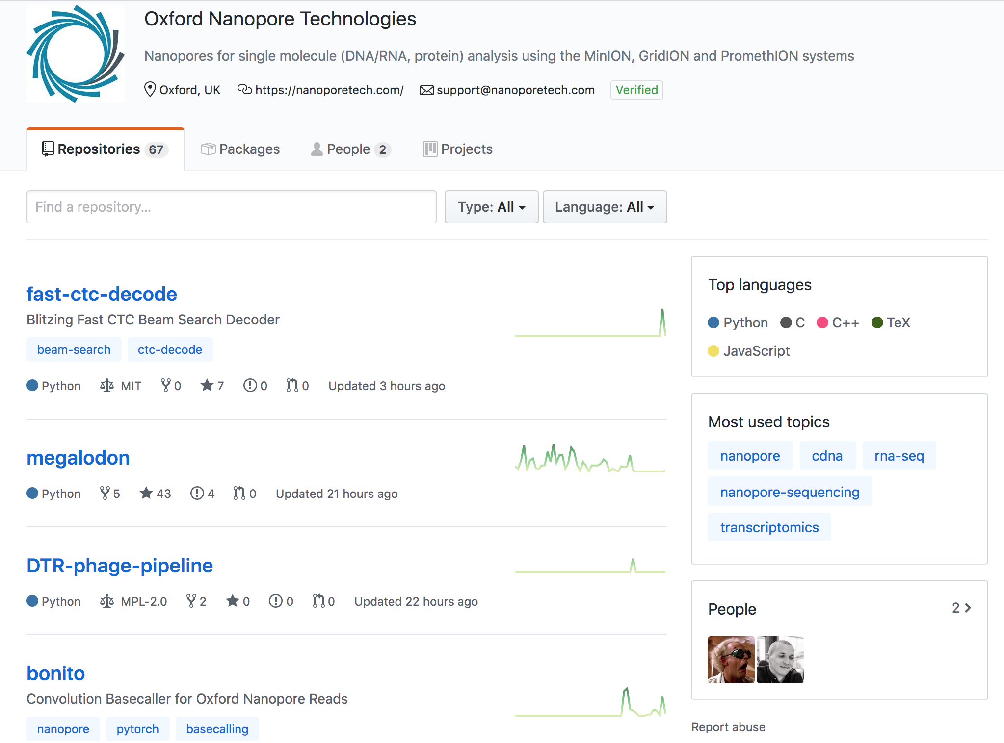
Rapidly changing software, but very collaborative community
https://github.com/nanoporetech

Slide 15
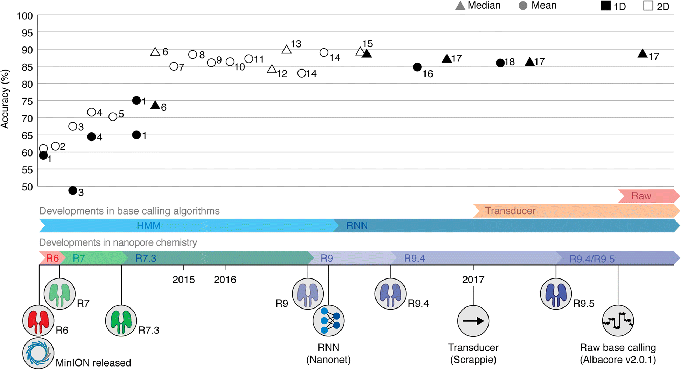
Keeping up with the chemistry
Rang, F.J., Kloosterman, W.P. & de Ridder, J. From squiggle to basepair: computational approaches for improving nanopore sequencing read accuracy. Genome Biol 19, 90 (2018). https://doi.org/10.1186/s13059-018-1462-9

Slide 16
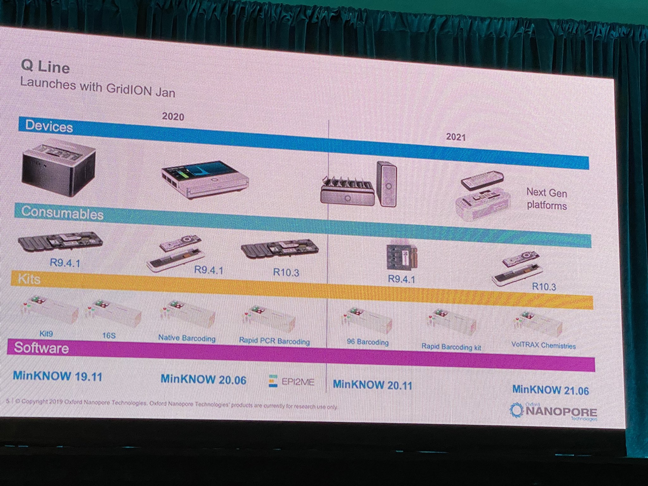

Slide 17

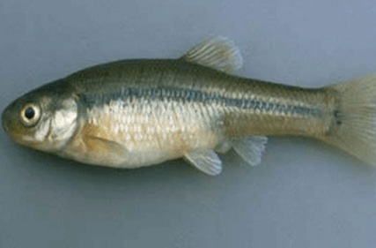
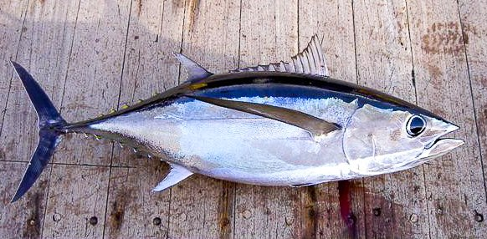
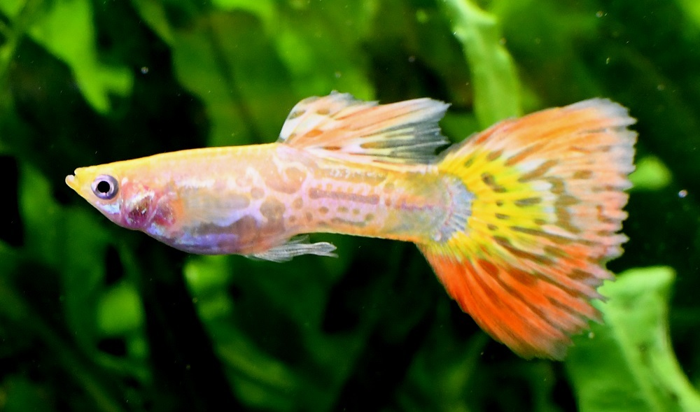
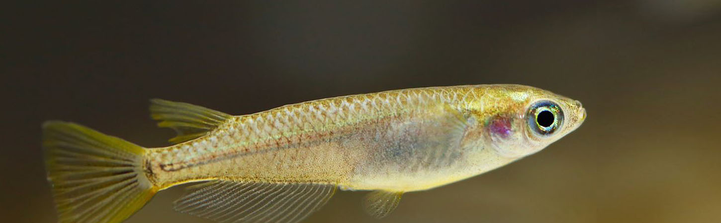

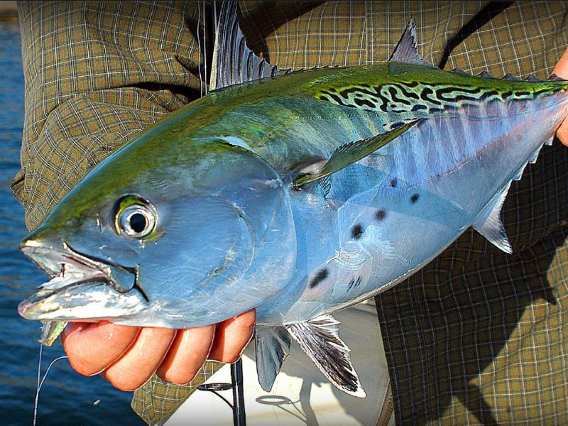
Fish
Megalodon
-Base caller
-Consensus caller
-Variant caller
-Reference mapper
-Mod detector
MinKNOW
Albacore
Guppy
Tombo
Medaka
Taiyaki
Bonito

Slide 18
Calling nucleotides

Slide 19
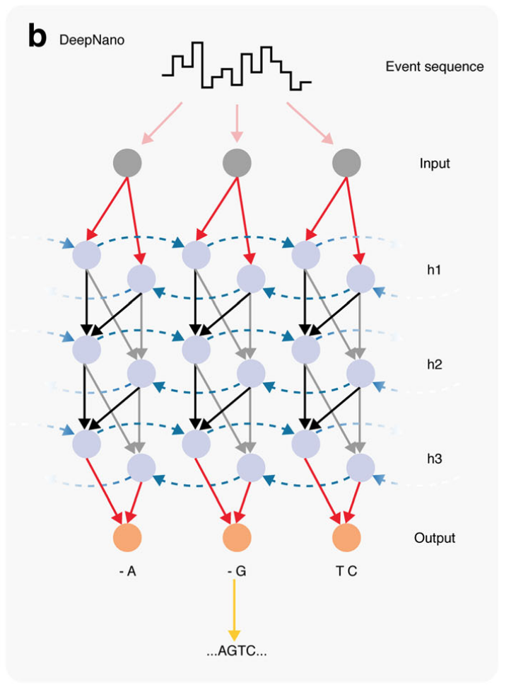
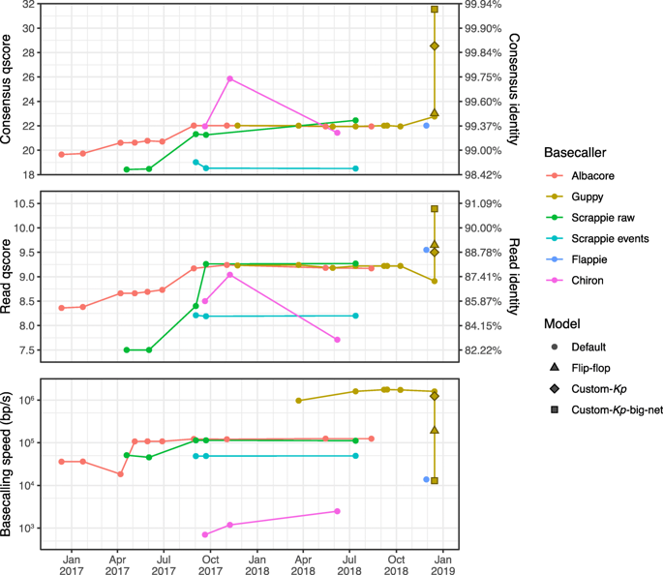
Guppy to call standard bases with RNNs
Rang, F.J., Kloosterman, W.P. & de Ridder, J. From squiggle to basepair: computational approaches for improving nanopore sequencing read accuracy. Genome Biol 19, 90 (2018). https://doi.org/10.1186/s13059-018-1462-9
Adapted from: Wick, R.R., Judd, L.M. & Holt, K.E. Performance of neural network basecalling tools for Oxford Nanopore sequencing. Genome Biol 20, 129 (2019). https://doi.org/10.1186/s13059-019-1727-y
Notes:
Recurrent Neural Networks (RNNs) (Table 1), which do not explicitly rely on k-mer length and are able to take longer range information (i.e., >k bp) into account. Since information about the DNA sequence is contained in events both upstream and downstream of the current event, DeepNano uses a bidirectional RNN that makes predictions for events in each direction and combines the two predictions for each event in the next layer of the neural network

Slide 20
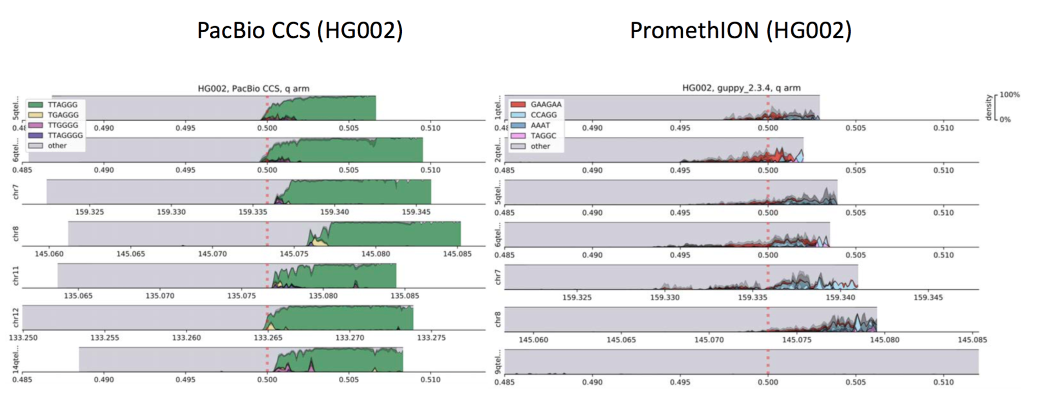
What you get is what you train on
Haplotype Diversity and Sequence Heterogeneity of Human Telomeres.
Kirill Grigorev*, Jonathan Foox*, Daniela Bezdan, Daniel Butler, Jared J. Luxton, Jake Reed, Cem Meydan, Susan M. Bailey, Christopher E. Mason. doi: https://doi.org/10.1101/2020.01.31.929307
https://github.com/LankyCyril/edgecase/

Slide 21
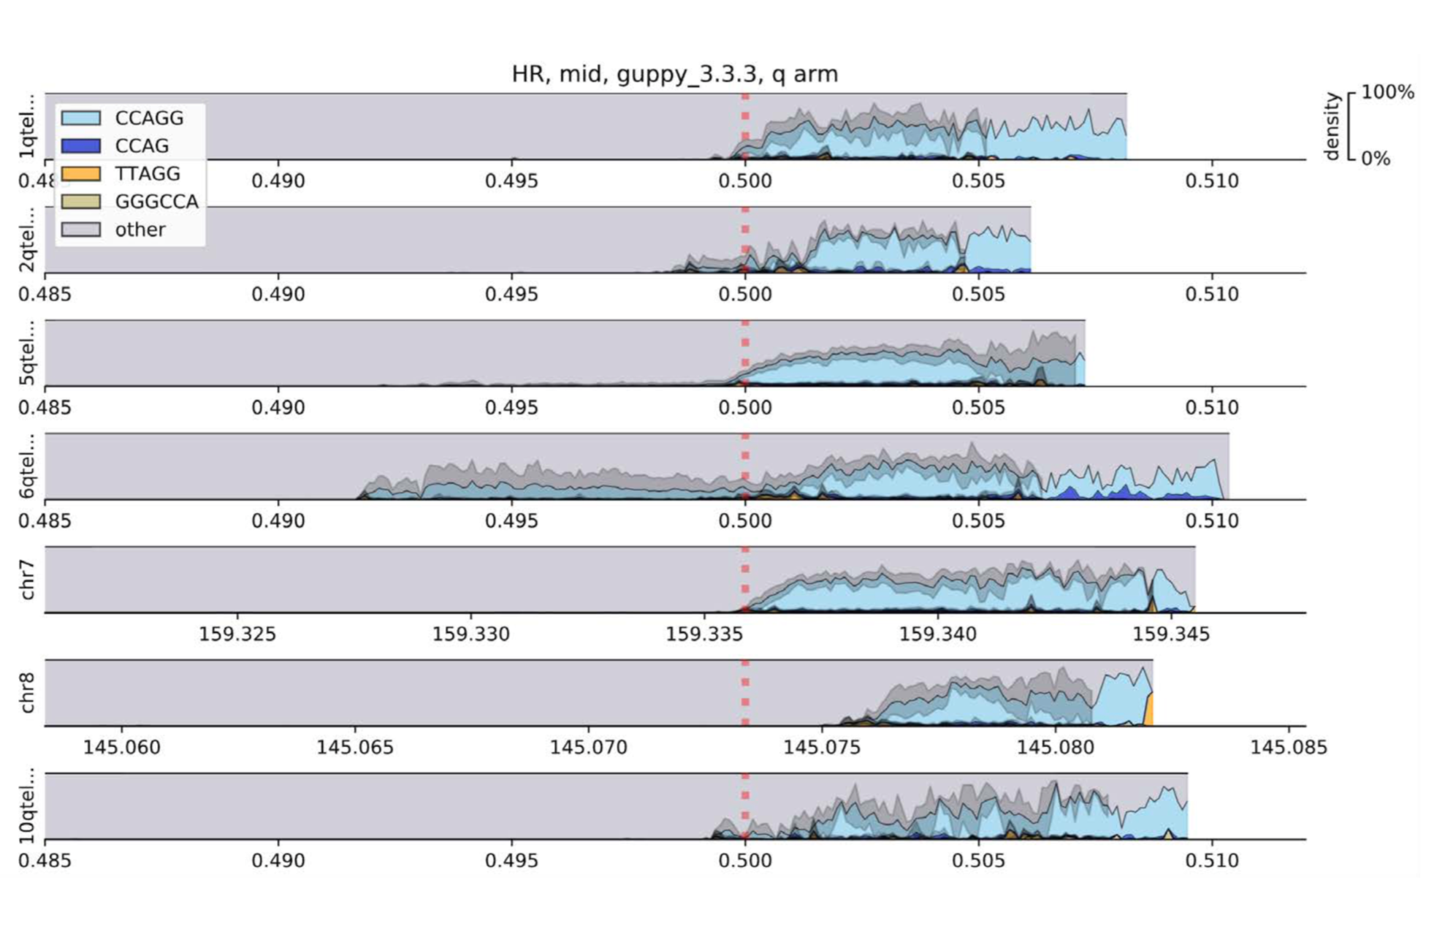
What you get is what you train on

Slide 22
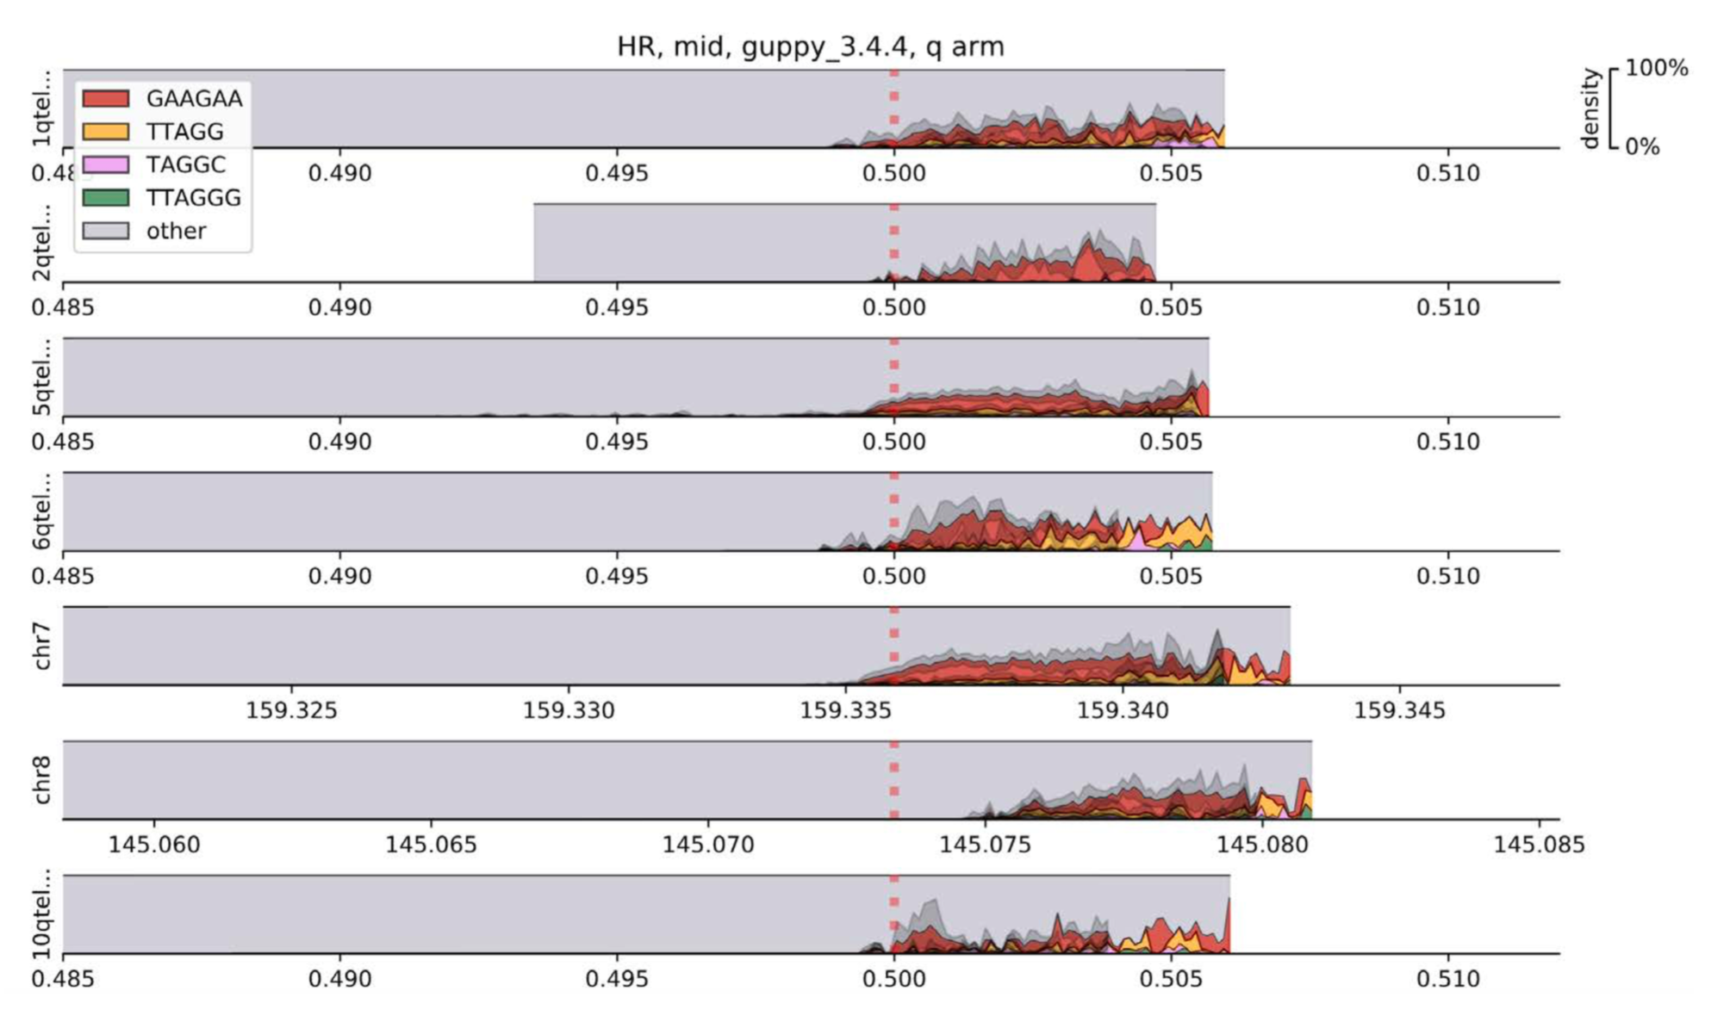
What you get is what you train on

Slide 23
Some regions are “easier” than others
Multi-Platform Assessment of DNA Sequencing Performance using Human and Bacterial Reference Genomes in the ABRF Next-Generation Sequencing Study.
Jonathan Foox, Scott W Tighe, Charles M Nicolet, Justin M. Zook, Zachary T. Herbert, Derek Warner, George S Grills, Shawn Levy, Jenny Xiang, Alicia Alonszo, Gary P. Schroth, William Farmerie, Don A. Baldwin, Christopher E. Mason

Slide 24
Calling base mods!

Slide 25
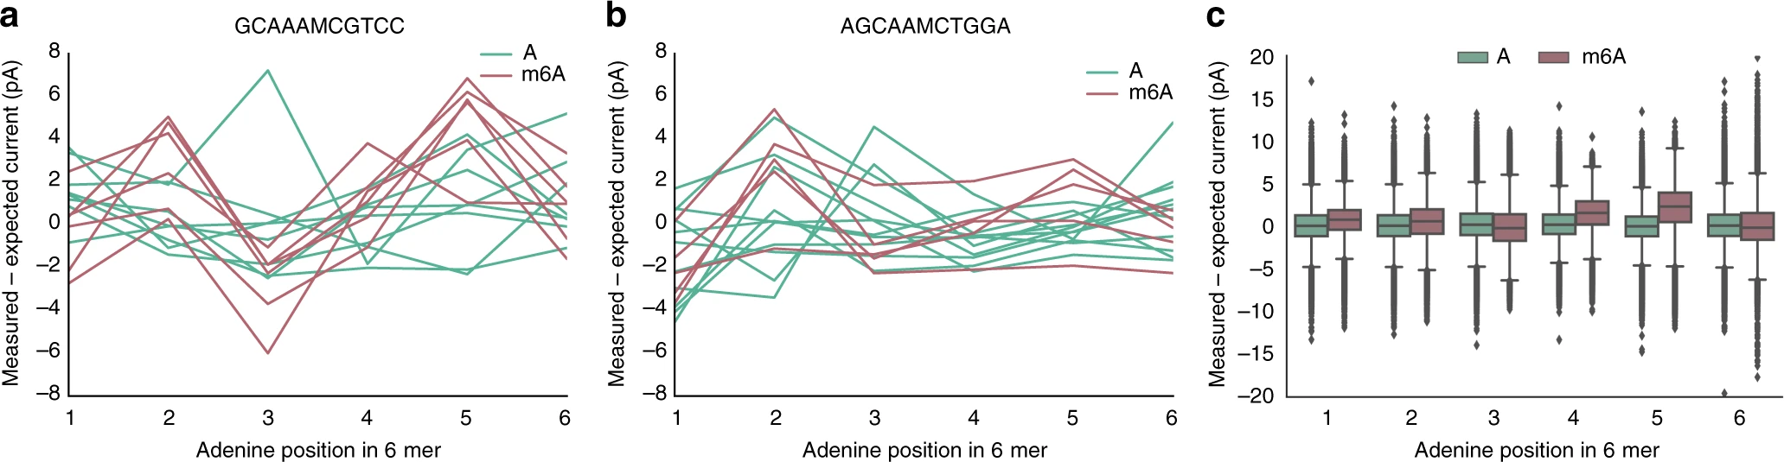
mCaller for m6A
McIntyre, A.B.R., Alexander, N., Grigorev, K. et al. Single-molecule sequencing detection of N6-methyladenine in microbial reference materials. Nat Commun 10, 579 (2019). https://doi.org/10.1038/s41467-019-08289-9
https://github.com/al-mcintyre/mCaller

Slide 26
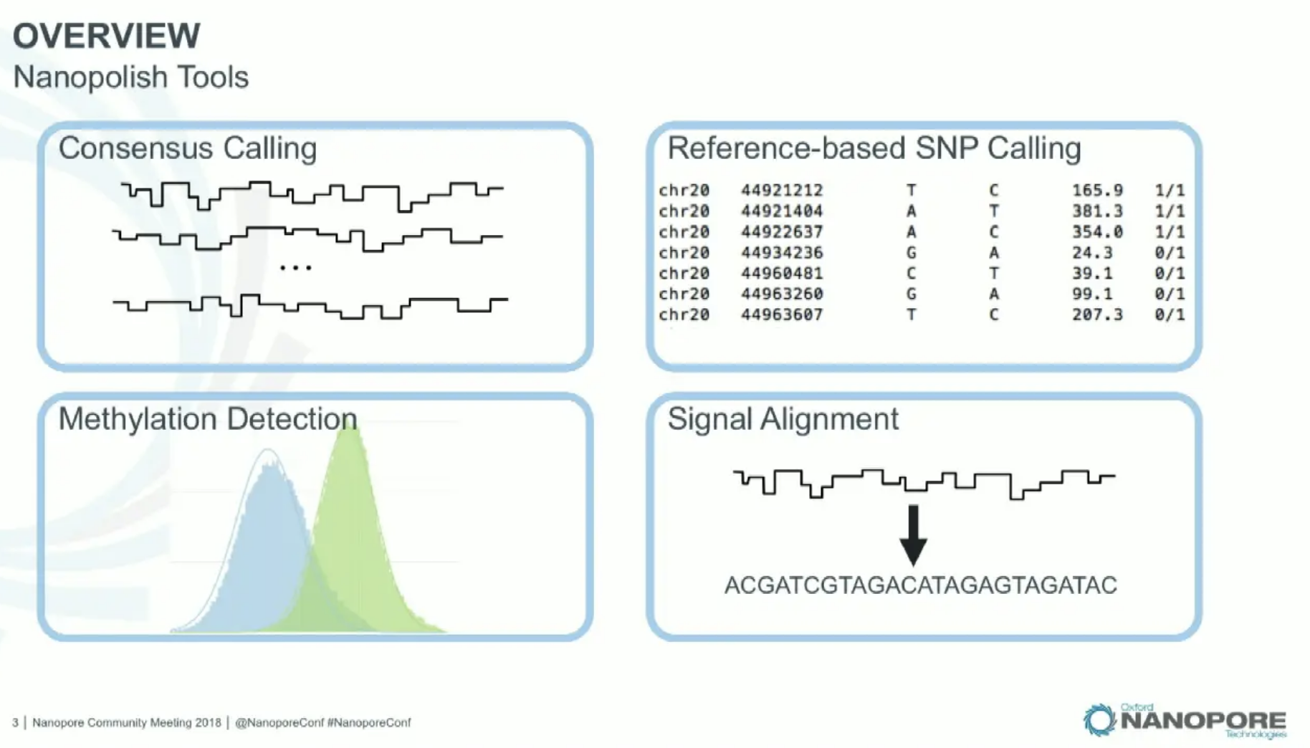
Nanopolish
https://nanopolish.readthedocs.io/en/latest/index.html
Notes:
Jared Simpson // Pioneering experiments in PNAS in 2013: “5-Methyl cytosine would give you slightly different current signal than cytosine”
Winston Timp and Simpson published proof of principle in 2017 published in Nature Methods on detecting methylation in Nanopore data
Trained on E. coli and used methyltransferase to methylate DNA and fit distrubtions for methylated and unmethylated sequences

Slide 27
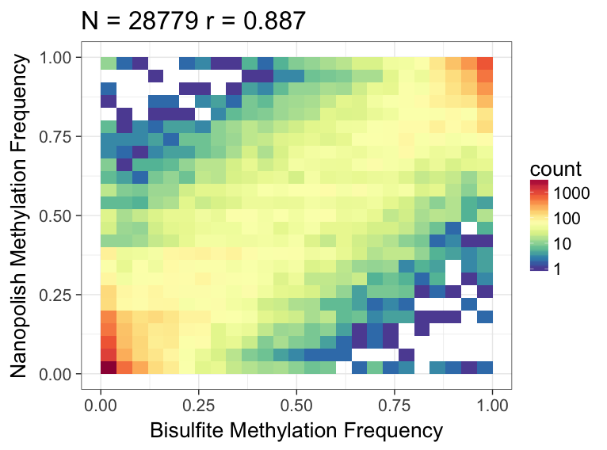
Nanopolish
https://nanopolish.readthedocs.io/en/latest/index.html
Notes:
In 2018, Jain et al. with NA12878 Sequencing Consortium sequenced genome at 30x just with Nanopore
Simpson calculated methylation using previous method and showed concordance to ENCODE bisulfite data

Slide 28
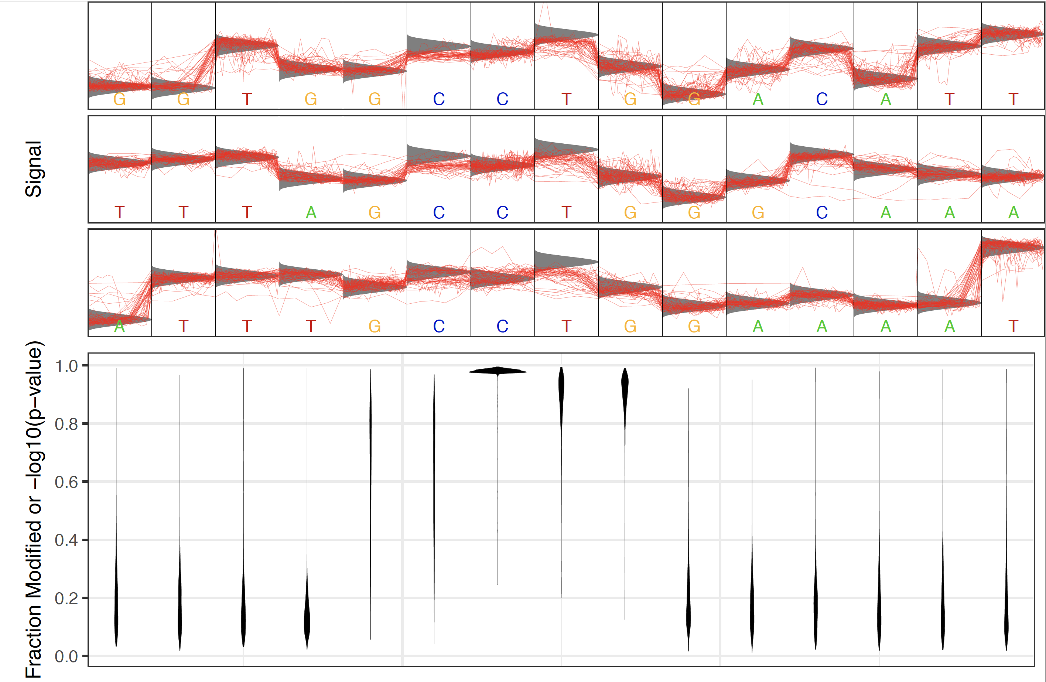
Tombo
https://nanoporetech.github.io/tombo
Notes:
Tombo takes raw signal and matches to genomic ref, trusts the reference is correct
Resquiggle: lay signal data over called bases
Once you have mapping, there are 3 ways to detect base mods
Alternative model: look for signal that matches the profile of a particular base mod
Requires alt. model estimation; currently only 5mC and 6mA available (no RNA) and dam/dcm for bacteria
De novo model: identifies sites where signal deviates from expected
High error rate, but useful for motif discovery
Compare to control: say you have a known sequence from PCR (which loses base mod info), you can compare PCR sample to native sample
Most robust / highest AUC, but requires second set of reads for comparison
Tombo allows you to train on de novo discovery of modified motifs

Slide 29
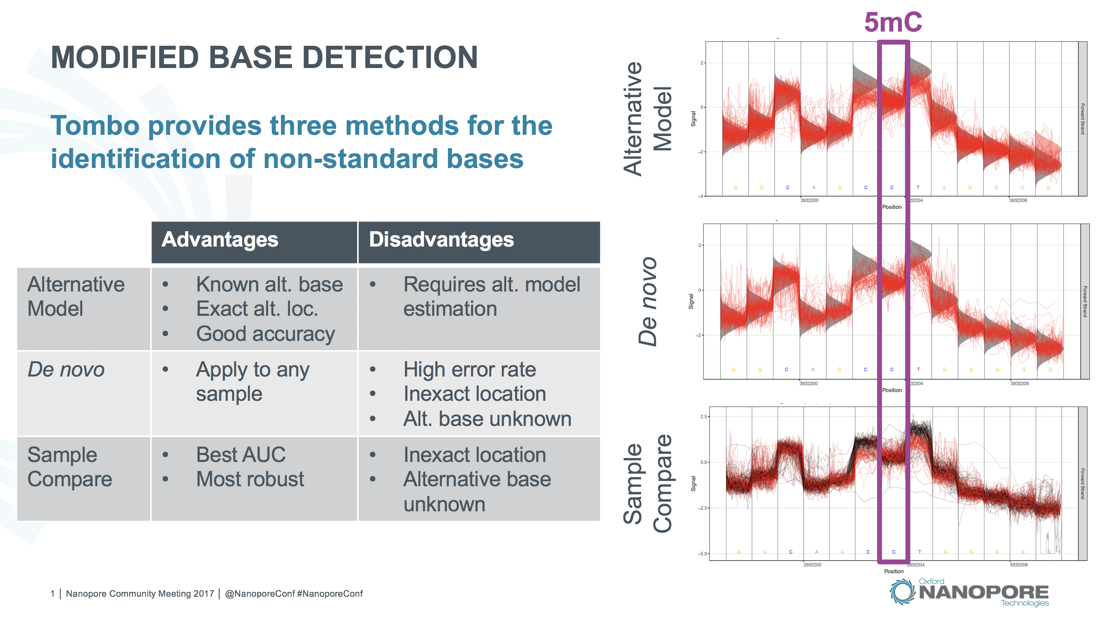
Tombo
https://nanoporetech.github.io/tombo
Notes:
Tombo takes raw signal and matches to genomic ref, trusts the reference is correct
Resquiggle: lay signal data over called bases
Once you have mapping, there are 3 ways to detect base mods
Alternative model: look for signal that matches the profile of a particular base mod
Requires alt. model estimation; currently only 5mC and 6mA available (no RNA) and dam/dcm for bacteria
De novo model: identifies sites where signal deviates from expected
High error rate, but useful for motif discovery
Compare to control: say you have a known sequence from PCR (which loses base mod info), you can compare PCR sample to native sample
Most robust / highest AUC, but requires second set of reads for comparison
Tombo allows you to train on de novo discovery of modified motifs

Slide 30
Megalodon
Basecalls (FASTA)
Basecall-anchored modified base scores (HDF5)
Mappings (SAM/BAM/CRAM)
Modified Base Calls (per-read and aggregated)
Sequence Variant Calls (per-read and aggregated)
https://github.com/nanoporetech/megalodon

Slide 31
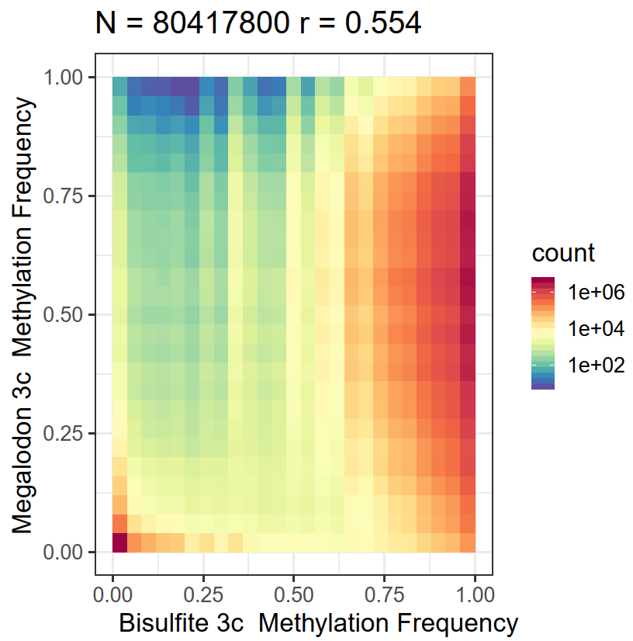
Megalodon not yet trained for PromethION
https://github.com/nanoporetech/megalodon/issues/8

Slide 32
Epigenomics Quality Control (“EpiQC”) Study
Multi-platform, multi-site resource for epigenetics research
Base modification
Platform / Assay / Location
Sample (DNA/RNA) | m⁶A | m⁴C | m⁵C | hm⁵C | PACB | ONT | Illumina 450/850K Methyl Array | ATAC | WGBS | MeRIP, miCLIP, ONT | Earth /Space
HG001 | + | - | + | + | + | + | +/+ | + | + | + | +/-
HG002,3,4 | + | - | + | + | + | + | +/+ | + | + | + | +/-
HG005,6,7 | + | - | + | + | + | + | +/+ | + | + | + | +/-
Chinese Quartet | + | - | + | + | + | + | +/+ | - | + | + | +/-
IMR90 | + | - | + | + | - | - | +/+ | - | + | + | +/-
HCC1395/BL | + | - | + | + | + | - | +/+ | + | + | - | +/-
Mouse / E. coli / Lamda | + | - | + | + | + | + | NA | - | + | + | +/+
Zymo BioOMICs | + | + | + | + | + | + | NA | - | + | - | +/+

Slide 33
Good correlation with EpiQC Data

Slide 34
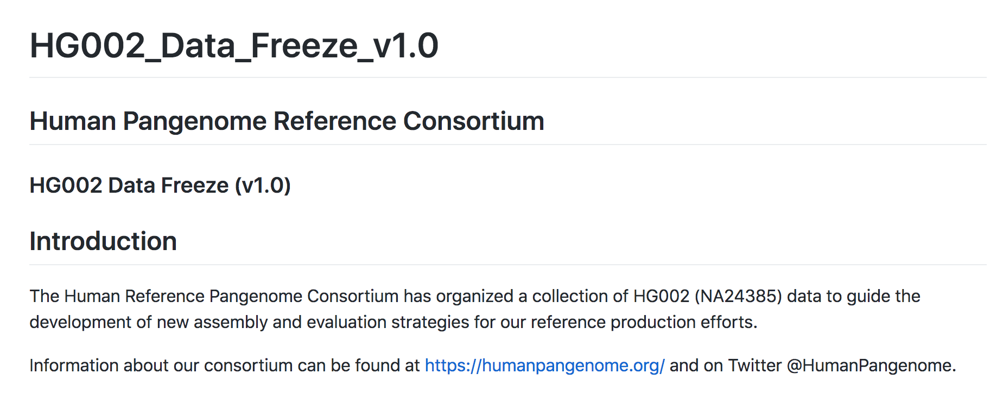
Human Pangenome Project
https://github.com/human-pangenomics/HG002_Data_Freeze_v1.0
Notes:
PacBio HiFi
PacBio CLR
Oxford Nanopore (Unsheared PromethION data)
Oxford Nanopore (Ultra-long GridION data)
Hi-C
Strand-seq
10X Genomics
BioNano Maps DLE1 Data collected (Molecules >150 kbp)
Illumina: Whole genome data, 300x PCR-free Illumina 150bp + 40x PCR-free 250bp, from GIAB

Slide 35
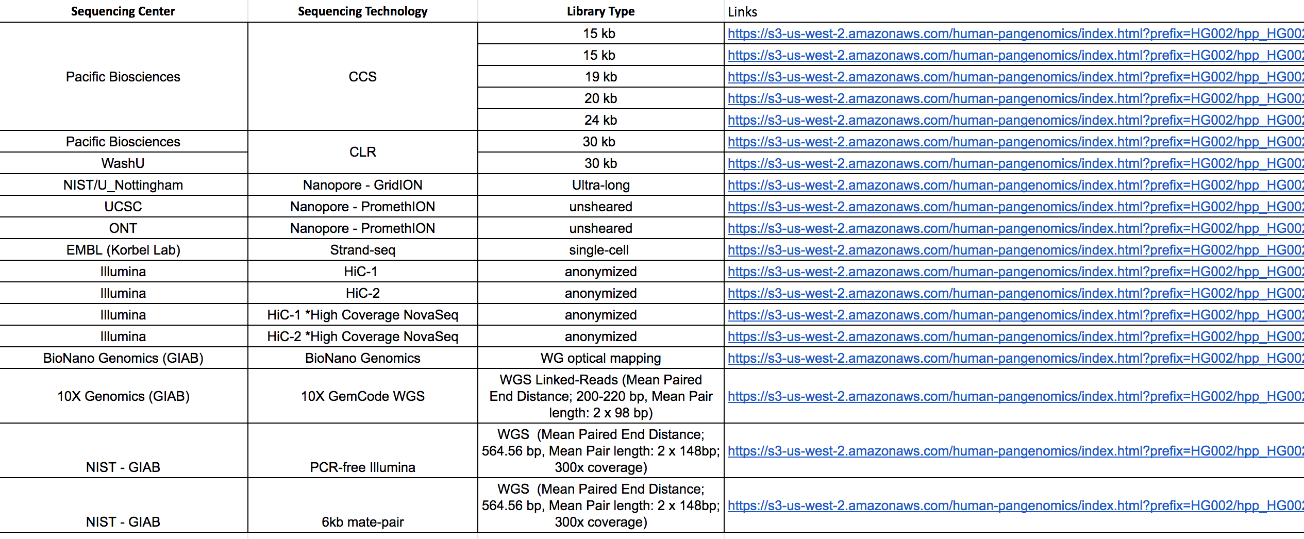
Human Pangenome Project
https://github.com/human-pangenomics/HG002_Data_Freeze_v1.0
Notes:
PacBio HiFi
PacBio CLR
Oxford Nanopore (Unsheared PromethION data)
Oxford Nanopore (Ultra-long GridION data)
Hi-C
Strand-seq
10X Genomics
BioNano Maps DLE1 Data collected (Molecules >150 kbp)
Illumina: Whole genome data, 300x PCR-free Illumina 150bp + 40x PCR-free 250bp, from GIAB

Slide 36

A final thought: Data Deluge
Millions or billions of FAST5 files are a burden on file storage systems
One 30x human genome = 2TB of raw FAST5 data
Modified FAST5 files requires 10-fold increase = 20TB raw data
Just ten samples can easily enter petabyte range
At current pace we may reach yottabyte scale

Slide 37
Deep Gratitude to Many People
Mason Lab
Ebrahim Afshinnekoo
Noah Alexander
Pradeep Ambrose
Daniela Bezdan
Daniel Butler
Eugene Carragee
Chou Chou
David Danko
Tim Donahoe
Matthew MacKay
Christopher E. Mason
Alexa McIntyre
Cem Meyden
Jake Reed
Heba Shabaan
Delia Tomoiaga
David Westfall
Craig Westover
WorldQuant Fellows
Cornell/WCM
Selina Chen-Kiang
Iwijn De Vlaminck
Olivier Elemento
Samie Jaffrey
Iman Hajirasouliha
Ari Melnick
Margaret Ross
Epigenomics Core
NASA/JPL/Ames
Kate Rubins
David Smith
Kasthuri Venkateswaran
Icahn/MSSM
Eric Schadt,
Joel Dudley,
Bobby Sebra
UCSF
Charles Chiu
Illumina
Gary Schroth
Marc Van Oene
OICR
Tak Mak
Duke
Stacy Horner
Nandan Gokhale
Biotia
Niamh O’Hara
Rachid Ounit
MIT Media Lab
Kevin Slavin
Joi Ito
Jackson Labs
Sheng Li
NYU
Martin Blaser
Jane Carlton
Chris Park
Elizabeth Hénaff
Garvan Institute
John Mattick
Eva Maria Novoa Pardo
Baylor
Jeff Rogers
Fritz Sedlazcek
FDA/SEQC/Fudan.
Leming Shi
MSKCC
Alex Kentsis
Christina Leslie
Ross Levine
ABRF/Vermont
George Grills
Scott Tighe
Don Baldwin
Rockefeller
Jeanne Garbarino
Charles Rice
AMNH
George Amato
Mark Siddall
Univ. Chicago
Yoav Gilad

Slide 38
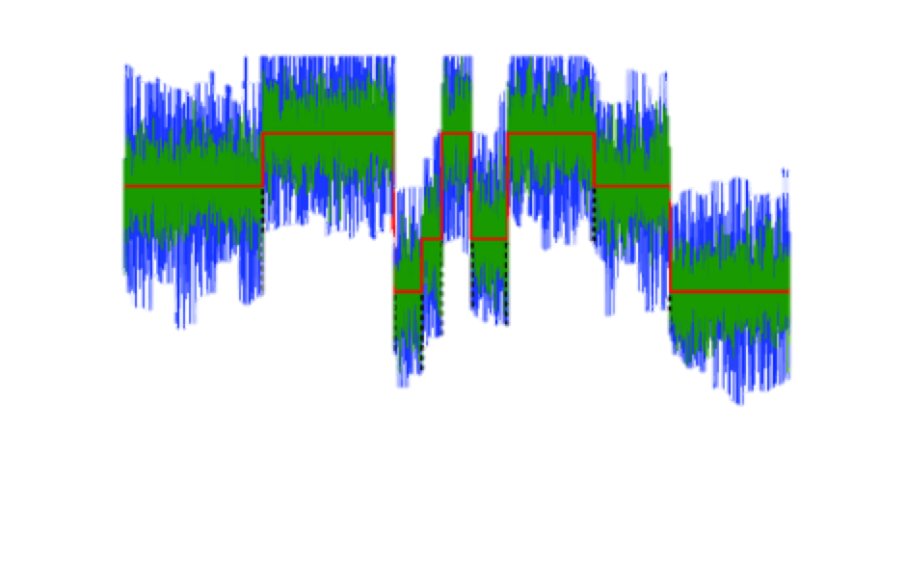
Thank you

Slide 39
Guppy to call standard bases
 | HG001 | HG002 | HG003
Basecaller | guppy 3.4.4 | guppy 3.4.4 | guppy 3.4.4
Total reads | 5,912,677 | 13,183,031 | 13,475,208
Total pass quality bases | 26,719,563,134 | 50,828,090,839 | 51,868,476,541
Mean depth | 8.62x | 16.40x | 16.73x
Mean read length (bp) | 4,519 | 3,855 | 2,066
Read length N50 (bp) | 8,678 | 8,144 | 7,200
Longest read (bp) | 571,931 | 139,939 | 389,128
Mean read quality | 10.2 | 11.0 | 10.7
Notes:
Recurrent Neural Networks (RNNs) (Table 1), which do not explicitly rely on k-mer length and are able to take longer range information (i.e., >k bp) into account. Since information about the DNA sequence is contained in events both upstream and downstream of the current event, DeepNano uses a bidirectional RNN that makes predictions for events in each direction and combines the two predictions for each event in the next layer of the neural network

Slide 40
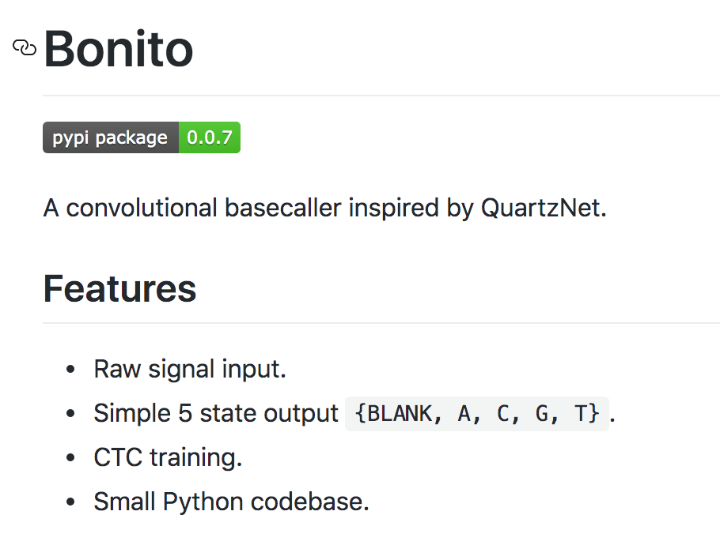
bonito
https://github.com/nanoporetech/bonito

Slide 41
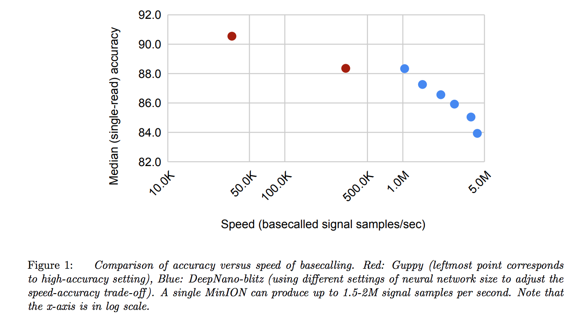
Built on CTC caller “DeepNano-blitz”
Vladimir Boza, Peter Peresini, Brona Brejova, Tomas Vinar. "DeepNano-blitz: A Fast Base Caller for MinION Nanopore Sequencers." bioRxiv 2020.02.11.944223; doi: https://doi.org/10.1101/2020.02.11.944223
Notes:
Connectionist Temporal Classification, an algorithm used to train deep neural networks in speech recognition, handwriting recognition and other sequence problems.

Slide 42
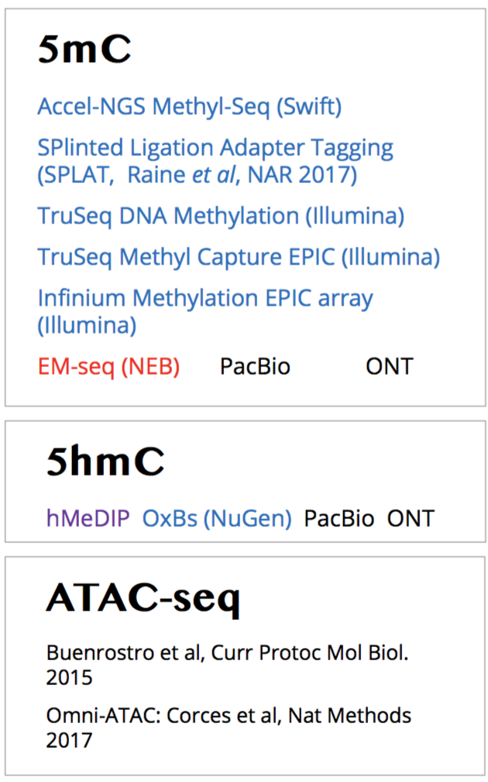
Epigenomics Quality Control (“EpiQC”) Study
Multi-platform, multi-site assessment and global resource for epigenetics research
  Baseline epigenetic variation on well-defined samples
  DNA modification detection algorithms
  Computational assessment of methods for epigenetic variation

