Slide 1
Planning for Core Sustainability
COBRE in Matrix Biology
Julia Thom Oxford, Ph.D. Distinguished Professor, Department of Biological Sciences; PD/PI, Center of Biomedical Research Excellence in Matrix Biology [COBRE]; Idaho INBRE; Boise State University
Sunday, March 1 3:30

Slide 2
Sustainability Challenges for Core Research Facilities
Seeded by NIH IDeA Funding
Center of Biomedical Research Excellence in Matrix Biology
Thematic
Multi disciplinary
Strengthen Research Infrastructure
Biomolecular Research Center, a shared core facility
Established in 2002 under INBRE & Idaho State Board of Education
COBRE in Matrix Biology 2014
Boise State University, ‘PUI’ -- distinct challenges
Lessons learned/Strategies for sustainability
Ongoing challenges
Managing/maintaining shared core facilities

Slide 3
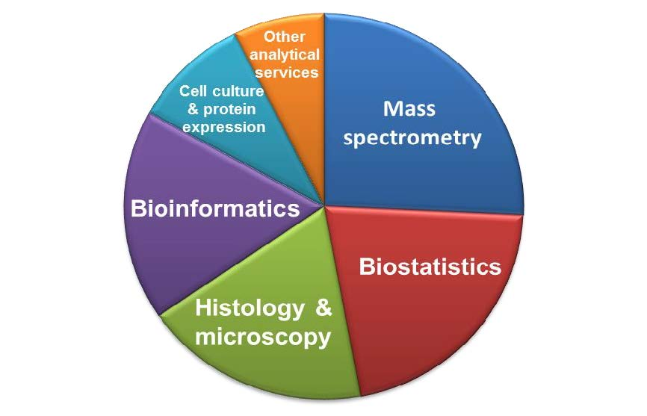
Choose Core Facilities Wisely
Core Facilities Should
Fulfill a need for many existing investigators
Promote advancement of research on campus
Structure core facility so that all researchers on campus have access
Broader Impact Research as a Result of NIH Funding and Core Facilities at Boise State University (BSU)
Fibrosis
Wound Healing
Drug Discovery/Development
Breast and Prostate Cancer
Joint Disorders and Replacement
Musculoskeletal Repair & Regeneration
Cardiovascular Disease
Neuroinflammatory Disease
Osteoarthritis
Rare Diseases
Demand for services and examples of research supported by users of the Biomolecular Research Center (BRC)

Slide 4
Choose Core Facilities Wisely
Fulfill a need for many existing investigators
Core works with many academic departments -- contributes to sustainability
Departments of Biological Sciences,
Physics
Chemistry
Mechanical and Biomedical Engineering
Micron School of Materials Science and Engineering
Community and Environmental Health, and Kinesiology
Direct and indirect support for biomedical and biomolecular research efforts across campus

Slide 5
Choose Core Facilities Wisely
2) Promote advancement of research on campus:
Grant writing workshops (faculty, postdocs, and students)
Assistance with grant components
Facilities and Equipment pages
Biosketch training and assistance
Budget development
Grant proposal pre-review
Page charges for publications utilizing the core
Mentoring for early stage investigators
Networking (Research Grand Rounds)

Slide 6
Choose Core Facilities Wisely
3) Structure core facility so that all researchers on campus have access:
Centrally located facility
Investigators apply for access – approved after safety training, university ID badge
Consultation with core scientists to initiate project
Advanced training provided on instrumentation
Agilent iLab Solutions accounts for scheduling and billing

Slide 7
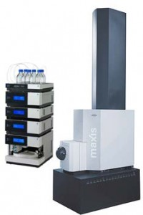
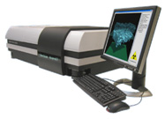
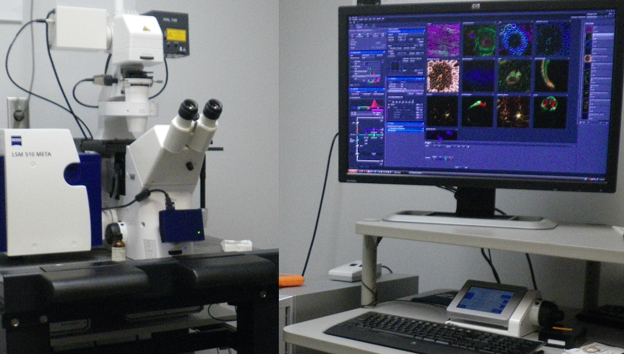
Don’t Duplicate Cores within a Statewide Network
Duplicating cores within a network can result in:
Not enough users
Difficulty keeping costs down
Dilution of expertise

Slide 8
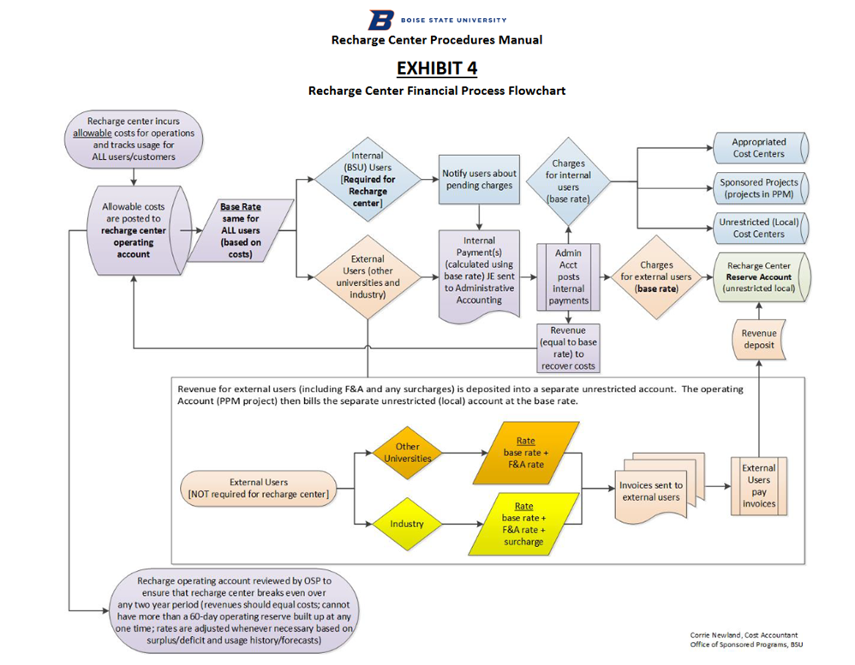
Establishment of Recharge Center within the University
“As a recipient of federal funding, the University must comply with the Office of Management and Budget’s Uniform Administrative Requirements, Cost Principles, and Audit Requirements for Federal Awards in 2 CFR Part 200. In particular, these regulations require that all charges (no matter the source of funding) for Recharge Center activities must be charged according to actual usage, only recover costs and not make a profit. Like other sponsored project costs, in the event of an audit, documentation must exist to support the costs.”
BSU Recharge Center Policy 5110 https://www.boisestate.edu/policy/research/recharge-centers/
Boise State Recharge Financial Process Flowchart

Slide 9
What Are the True Costs of Running a Core?
This will be institution dependent
Need to know how and if your intuition is going to cover any costs
This may include:
Infrastructure costs
Salaries
Costs associated with courses
Service contracts
Replacement of old equipment, etc.

Slide 10
Setting Rates
Use a Recharge Center Rate Study to calculate costs.
Once you know your true cost, rates can be set. This leads to questions of affordability.
Can researchers at your institution afford these rates? If not, how are you going to address this? Hopefully, a short-term problem.
A) Seed grant program, Tech Access grants
B) Pilot grant program (voucher programs)
As a shared core facility, should give researchers the added benefit of having accessibility to the infrastructure needed to be competitive with grant submissions.

Slide 11
Service Contracts
What to do about service contracts? Service contracts are an expense that increase rates significantly. Possible solutions:
Subsidize
Don’t carry service contracts and work repair costs into rates.
Investigate lease options
Bundle service contracts to reduce overall rates of service contracts.

Slide 12
How Will Equipment Be Replaced?
The Biomolecular Research Center at Boise State submits federal and private equipment grants as a mechanism for obtaining and replacing major equipment.
M.J. Murdock Charitable Trust
National Science Foundation Major Research Instrumentation Program (NSF-MRI)
Maintain a focus within the core, resist adding too many services.

Slide 13
Who Should Be the Core Customer Base?
In order to be sustainable, customers are needed.
First and foremost, we serve the needs of campus investigators
Researcher from surrounding university’s and institutions are encouraged to utilize facilities
Student customers receive education, internship experience, career development
This may include:
One-on-one training
Course offerings
Workshops
Paid internships in a core lab
4) Industry Partners

Slide 14
Who Should be the Core Customer Base?
BSU partnerships with other programs
Idaho INBRE summer undergraduate fellows
Clinical & Translational Research Infrastructure Network (CTR-IN) investigator’s
Institute of Translational Health Sciences (ITHS) investigators
State of Idaho Transition Trainees summer program
American Chemical Society (ACS) Project SEED
NIH Bridges to Baccalaureate summer program
Ralph R. Jones Pre-Med summer program
National Science Foundations (NSF) S-STEM Scholars

Slide 15
Document how core contributes to the research mission of the institution
Annual reporting, assessment, & evaluation includes:
Publications
Presentations
Grants submitted
Grants awarded
Co-authorship networks
Institutional research growth over time
Impact on student learning beyond the classroom

Slide 16
Lessons Learned
Develop a core that serves the need of many
Find creative ways to keep costs competitive
Lean on Advisory Committees for expertise in best management practices
Keep core focused
Know when to retire under and/or non-used equipment
Stay relevant
Marketing efforts within the institution and outside the institution
Inform new/existing researchers of core capabilities –growth and diversification of users.

Slide 17
Acknowledgements
Institutional Development Awards (IDeA), National Institute of General Medical Sciences, National Institutes of Health Grants #P20GM103408 and P20GM109095.
The Biomolecular Research Center is supported by funding from the National Science Foundation, Grants #0619793 and #0923535, the M. J. Murdock Charitable Trust; Lori and Duane Stueckle, and the Idaho State Board of Education.
Diane B. Smith, Program Reporting, Assessment, and Evaluation

