Slide 1

An Overview of the Flow Cytometry Research Group (FCRG):
Past and Current Studies

Slide 2
Focus of the FCRG: Sorting
Recent Studies
Effect of sorting on gene expression
Determining cleanliness of cell sorters
Fixation and sorting cells for RNA isolation
Single cell sorting optimization
Notes:
From its inception the focus of the FCRG has been on the sorting aspect of flow cytometry mainly because sorted cells are quite often used in downstream applications that can be found in other core facilities such as RNAseq, PCR and DNAseq.
My plan for this talk is to discuss briefly, some of the studies the group has been involved in as well as our current initiative.

Slide 3
1. Effect of sorting on gene expression
Study Goal
Determine if cell sorting induces significant or severe gene expression changes by studying several model cell types.
1. Human Jurkat Cell Line
2. Mouse Splenic B cells
3. Mouse V6.5 Embryonic Stem Cell Line

Slide 4
1. Effect of sorting on gene expression
Experimental Conditions:
1. Nozzle size/pressure
2. Time after sorting that cells were analyzed
3. Exposure to UV laser

Slide 5
1. Effect of sorting on gene expression
Results with Jurkat cell line:
1. Viability – no decrease
2. Cell Cycle – no change
3. RNA Microarray – minimal changes that went away after incubating the sorting cells
4. UV Laser – no effect on transcriptome

Slide 6
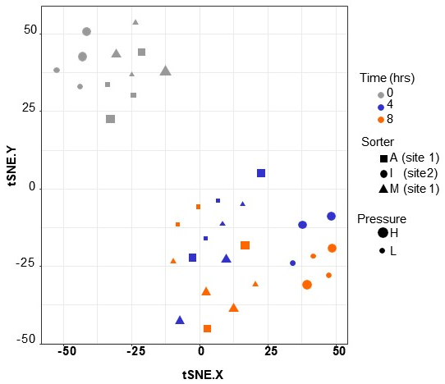
1. Effect of sorting on gene expression
Results with Mouse Splenic B cells:
1. RNA Microarray – sorting had minor effects
Notes:
tSNE plots show clustering of the time 0 regardless of instrument, nozzle size or pressure. No specific pathway indicated by the differentially expressed genes.
40, 87 and 48 gene changes between time 0h high vs 0h low pressure.

Slide 7
1. Effect of sorting on gene expression
Results with Mouse Splenic B cells:
2. QuantiGene Plex Assay for validation of microarray
using a custom 60-plex
Notes:
For this a 3rd site was added. Similar to microarray data, time 0h clustered. Clustering by site.
Site had a greater influence then pressure or instrument.

Slide 8
1. Effect of sorting on gene expression
Results with Human V6.5 ES cell line:
Sorting had minimal effect on V6.5 transcriptome
RNASeq – 6 DEGs
QGP – 4 DEGs
Notes:
ES cells are known to be extremely sensitive to culture conditions. Cells were sorted and sorted cells were analyzed using RNAseq and QuantiGene Plex.
Not many Degs and not any agreement between methods suggesting that the DEGs may nothing more than assay variability/background noise.

Slide 9
1. Effect of sorting on gene expression
Overall Conclusions:
1. Nozzle size/pressure, UV exposure and instrument type have minimal effects on gene expression
2. Any changes to gene expression can be mitigated by incubating the cells a few hours after sorting.

Slide 10
2. Determining cleanliness of cell sorters
Study Goal
1. Poll SRLs on how they maintain their sorters
2. Test sorters from various SRLs for common contaminants including RNAse, Endotoxin and Bacteria
3. Evaluate the effectiveness of an endotoxin cleaning procedure

Slide 11
2. Determining cleanliness of cell sorters
Survey Results
Testing Frequency | Number of Respondents | Percentage
Daily | 2 | 4%
Weekly | 11 | 21%
Monthly | 7 | 13%
Never | 8 | 15%
When Contamination Reported | 25 | 47%

Slide 12
2. Determining cleanliness of cell sorters

Slide 13
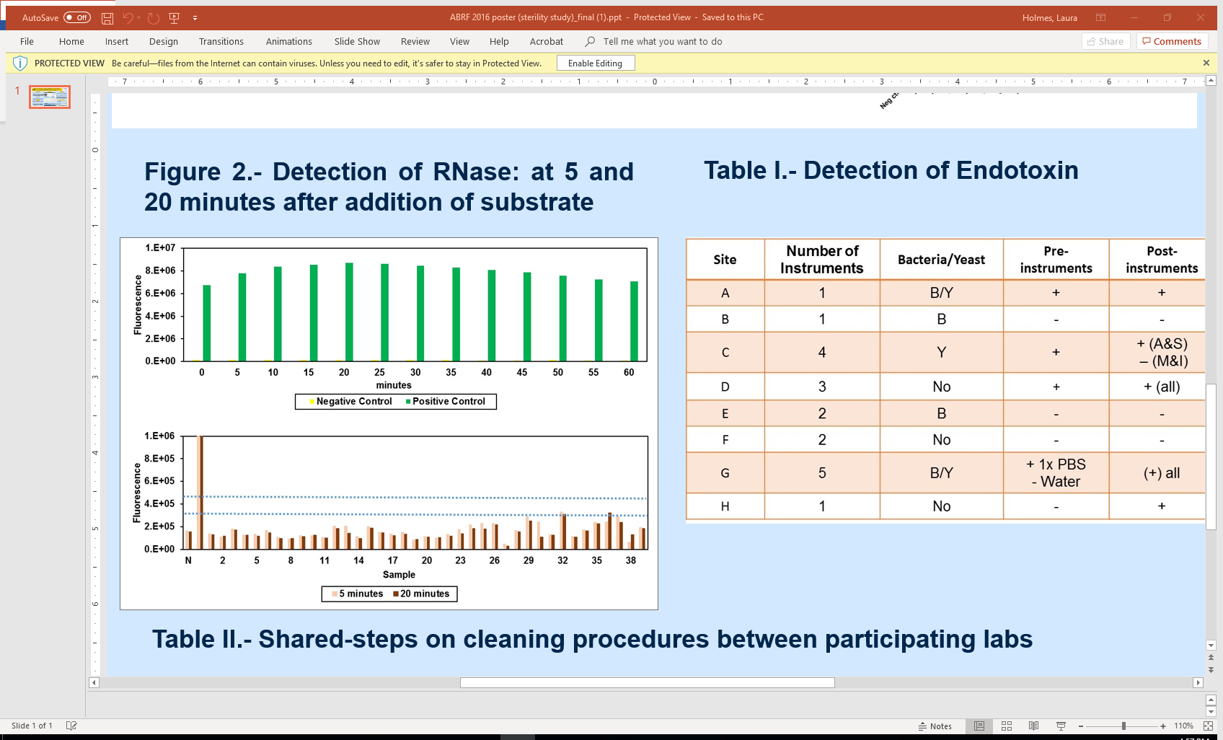
2. Determining cleanliness of cell sorters
RNase Activity Results

Slide 14
2. Determining cleanliness of cell sorters
Endotoxin:
1. Found in the majority of instruments tested
2. Recommended way to remove endotoxin is hydrogen peroxide
3. Three sorters at two sites were cleaned using hydrogen peroxide
4. Endotoxin was detected within a week of hydrogen peroxide cleaning

Slide 15
3. Fixation and sorting cells for RNA isolation
Study Goal
1. Flow Cytometry SRLs are asked to sort fixed cells for RNA isolation either in bulk or at the single cell level.
2. Systematic analysis of reported fixation methods to determine the effect of different fixatives on the quality of RNA isolated from sorted cells.
3. Comparison of RNA collected from unsorted vs. sorted cells.

Slide 16
Fixation Method | Fix | Sort
Paraformaldehyde | No | No
(Methanol-free) | No | Yes
 | 2% fix RT | No
 | 2% fix RT | Yes
 | 2% fix ice | No
 | 2% fix ice | Yes
 | 4% fix RT | No
 | 4% fix RT | Yes
 | 4% fix ice | No
 | 4% fix ice | Yes
Fixation Method | Fix | Sort
Commercial Kits | No | No
 | No | Yes
 | CytoFix CytoPerm BD | No
 | CytoFix CytoPerm BD | Yes
 | eBio Intracellular Fix | No
 | eBio Intracellular Fix | Yes
 | BD FACSLyse | No
 | BD FACSLyse | Yes
Alcohol | No | No
 | No | Yes
 | Methanol | No
 | Methanol | Yes
 | Ethanol | No
 | Ethanol | Yes
 | Ethanol/Acetic Acid | No
 | Ethanol/Acetic Acid | Yes
Zinc | No | No
 | No | Yes
 | ZBFB | No
 | ZBFB | Yes
Notes:
HL-60 cells were chosen as the model cell line – promyeloctic leukemia cells get a lot of RNA from minimal number of cells

Slide 17
3. Fixation and sorting cells for RNA isolation
Study Outline
1. HL60 cells – promyelocytic cell line
2. Cells were sorted into RTL Plus then frozen at -80 degrees
3. Sorted cells were sent to University of Rochester Genomics Core
4. RNeasy Plus Micro Kit was used to isolate the RNA
5. RNA purity testing was performed using a NanoDrop
6. RNA quality and yield testing was performed using an Agilent Bioanalyzer 2100 system
Notes:
z

Slide 18
3. Fixation and sorting cells for RNA isolation
RNA Quality: RIN 8.0-10.0 Degraded RNA No RNA
Notes:
Bioanalyzer was used to quantify the RNA

Slide 19
3. Fixation and sorting cells for RNA isolation
RNA Quality: RIN 8.0-10.0 Degraded RNA No RNA

Slide 20
3. Fixation and sorting cells for RNA isolation
Conclusions:
1. All the fixation methods tested had an affect on the quality and yield of the samples whether sorted or non-sorted.
2. Sorted cells yield significantly lower RNA then unsorted cells.
3. Recommendation of the FCRG is to test your cell type with different fixatives and method used to isolate RNA.

Slide 21
4. Single cell sorting optimization
Overall Study Goal
To provide the flow cytometry community a list of parameters setting that will yield a successful single cell sort.
Study Design
1. A survey of the flow cytometry community to determine what variables that users consider essential for efficient and accurate single cell sorting.
2. Test the parameters to determine the best settings.

Slide 22
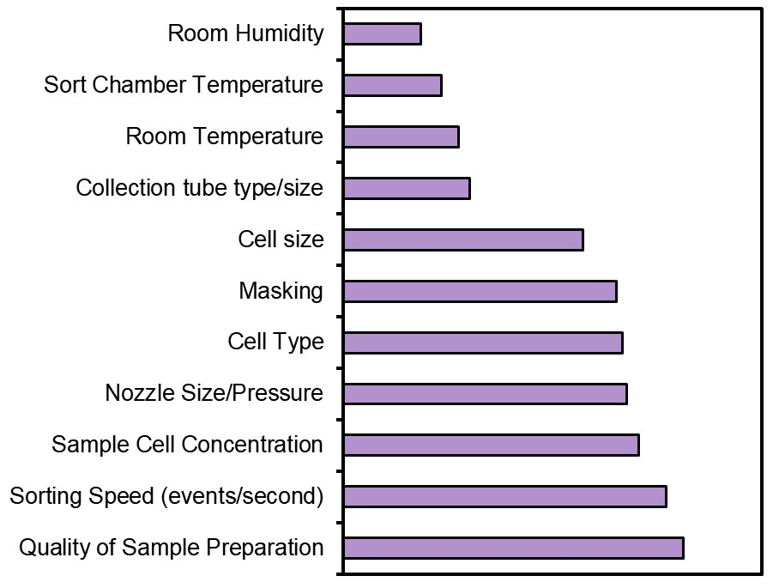
4. Single cell sorting optimization
What variables do you believe influence your yield (percentage of wells containing exactly one cell)?
These are the parameters that we will be testing in the coming year

Slide 23
4. Single cell sorting optimization
Stop by Poster #120 for the complete survey results

Slide 24
Current and Past FCFRG Members
Current
Dave Adams, University of Michigan (co-Chair)
Sherry Thornton, Cincinnati Children’s Hospital and University of Cincinnati (co-Chair)
Mehrnoosh Abshari, National Institute of Dental and Craniofacial Research
Claudia Bispo, University of California San Francisco
Sara Bowen, St Joseph’s Hospital & Medical Center
Kathleen Brundage, West Virginia University
Matthew Cochran, University of Rochester Medical Center
Regina Harley, University of Maryland
Christiane Hassel, Indiana University
Felicia Heyward, University of North Carolina
Avinash Kollipara, University of North Carolina
Nicolas Loof, UT Southwestern
Zachary Niziolek, Harvard University
Past
Alan Bergeron, Dartmouth School of Medicine
Andrew Box, Stowers Institute
Sridar V. Chittur, University at Albany, SUNY
Monica DeLay, Cytek previous Cincinnati Children’s Hospital
Roxana del Rio-Guerra, University of Vermont
Karen Dwyer, MD Anderson
Maris Handley, Massachusetts General Hospital
Laura Holmes, Stowers Institute
Peter Lopez, NYU Langone Medical Center
E. Mike Meyer, University of Pittsburgh Cancer Center
Alan Saluk, Scripps Research Institute
Scott Tighe, University of Vermont Cancer Center

Slide 25
Acknowledgements
Becton Dickinson - Cytofix/Cytoperm and FACSLyse kits
Cincinnati Children’s Flow Core – Luminex
eBioscience Affymetrix - Quantigene Plex gene expression assays
intracellular fix/perm buffer set
Efluoro660-CD19 antibody
Mouse Gene ST2.0 Microarrays
Miltenyi Biotech – Viobility Fixable Dye
NuGen – Ovation Pico WTA reagents
Qiagen – RNeasy Micro columns
Rochester Genomics Research Core - RNA isolation and testing
Stowers Institute Tissue Culture Core
SUNY Albany Genomics Core – Marcy Kuentzel, RNA isolation and Microarray

