Slide 1
SESSION
Building Robust Quality Management Systems in Core Labs
(GLP, GMP and QA Best Practices)
Rebecca L. Davies, PhD – University of Minnesota
David L. Blum, PhD – University of Georgia
Christopher W. Gregory, PhD – UNC Chapel Hill

Slide 2
OVERVIEW
Improving Sample Quality: QA Best Practices for the Research (and Core) Laboratory - Davies
Implementation of a Quality Management System in an Academic Core Facility - Blum
Building a Quality Management System in a Core Facility: A Genomics Core Case Study - Gregory
Slido login info: www.slido.com – enter code: P413
  Please answer the polls and submit your questions during the talks

Slide 3

Improving Sample Quality: QA Best Practices for the Research (and Core) Laboratory
Building Robust Quality Management Systems in
Core Laboratories
(GLP, GMP and QA Best Practices)
Rebecca Davies, PhD
University Of Minnesota
Veterinary Diagnostic Laboratory
1 March, 2020
Palm Springs, California

Slide 4

Topics
Quality connections between research and core laboratories
  The Total Testing Process
  Laboratory Error Analyses
  Importance of Pre-Analytical Error
  QA as a tool for improving pre-analytical error rates
  QA as a collaborative strategy for addressing risk to data reliability and research reproducibility
Collaborative Best Practices

Slide 5
The Importance of Laboratory Data
The Importance of Laboratory Data
Why is the laboratory an afterthought for managed care organizations?
Forsman R. Clin Chem 42:813. 1996.
Clinical Practice
  Major clinical management decisions are made based on small changes in lab data
  60-70% of the most important decisions on admission, discharge and medication are based on lab results
Research Investigation
  Prospective
  Retrospective
  Inclusion/Exclusion criteria
  Data and meta data

Slide 6
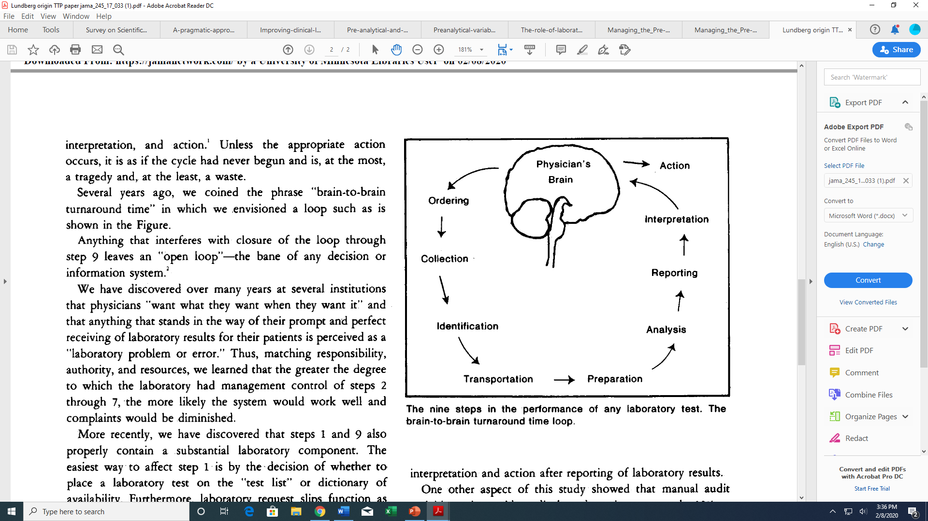
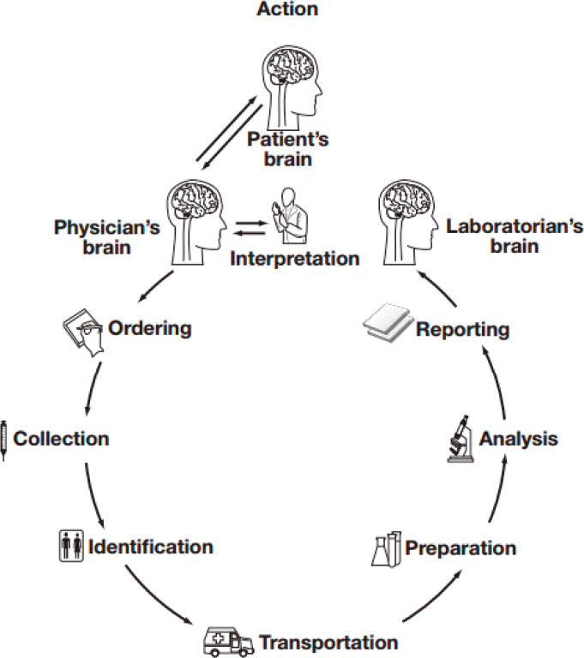
1. Acting on significant laboratory results.
Lundberg GD. JAMA 1981;245: 1762-3.
2. The brain-to-brain loop concept for laboratory testing 40 years after its introduction.
Plebani, M. et al. 2011.
American Journal of Clinical Pathology 136(6):829-833.
The interval between the time a sample is drawn until the data are reported can be divided into:
Preanalytical Phase
Analytical Phase
Postanalytical Phase
G Lundberg,1981
The Total Testing Process
Research Network
Scientist

Slide 7
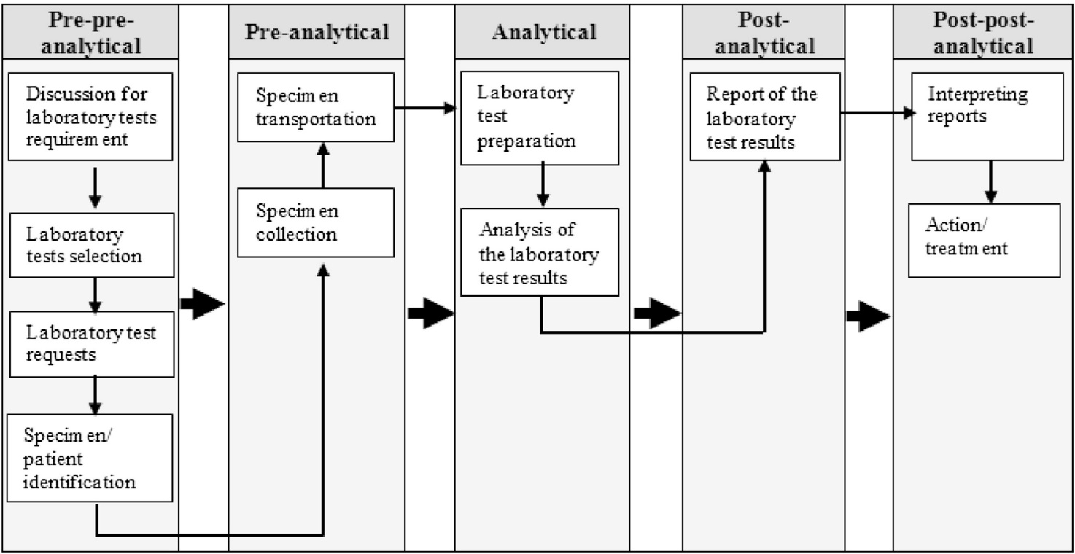
The Total Testing Process
Framework for analyzing and minimizing risk
Encompasses internal and external laboratory activities
Requires interaction between internal and external laboratory staff
Core labs can have an impact on quality here.
Core Lab Consultation
Yusof,M, et al. Towards an evaluation framework for Laboratory Information Systems. Journal of Infection and Public Health (2016) 9, 766—773
Notes:
This is where core laboratories can be involved in the work flow and have an impact. Collaboration and shared adoption and use of best practices
Expands the TTP to include Pre-Pre and Post-Post
Towards an evaluation framework for Laboratory Information Systems
Yusof,M, et al
Journal of Infection and Public Health (2016) 9, 766—773
https://doi.org/10.1016/j.jiph.2016.08.014

Slide 8
Examples of potential errors across the TTP
Pre-analytical | Analytical | Post-analytical
Inappropriate test order | QC failure | Results review
Sample collection procedure | Pipetting error | Interpretation
Submission form information gaps | Equipment failure | Reporting Results
Storage/ Transport of Sample | Contamination | Transmitting results
Packing, labeling, unpacking | Air bubbles | Invoicing
Entering Information into LIMS | Calibration errors | Validation
Preparation of Sample for Analysis | Interferents | Confidentiality
Leakage, Breakage, Contamination | Data entry-LIMS | Reference intervals

Slide 9
Lab errors throughout the Total Testing Process
Three Studies

Slide 10
Study 1 [1997]
Mistakes in a stat laboratory: Types and Frequency.
40,490 stat results over 3 months
Plebani M et al.
Clin Chem. 43, 1997.
Department of Lab Medicine
  Nephrology
  Internal medicine
  Surgery
  ICU
Post-
An
Pre-
Pre-Analytical | Analytical | Post Analytical
Specimen collection | Unacceptable performance | Physician not notified of error
Order missed or misinterpreted | Instrument malfunction | Correction of erroneous finding overlooked
Erroneous specification of department | Lack of method specificity | Turn around time exceeded Keyboard entry
Notes:
Identified 189 laboratory errors (0.47%)

Slide 11
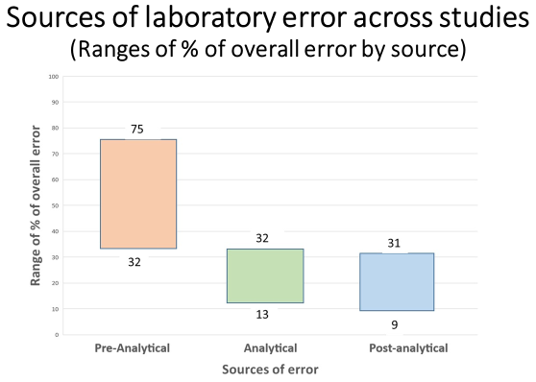
Study 2 [2002]
Errors in Laboratory Medicine
8 years of literature
Bonini P, et al. Clin Chem 48:5, 2002.
Searched for lab “mistakes, blunders, errors, problem or defect
“even when different study designs, patient numbers, and discovery techniques were used, the distribution of errors was very similar”
Most errors occur at the transitions
100
32-75
13-32
9-31
0
Pre-Analytical
P0st-Analytical
Analytical
Notes:
Error: “any defect from ordering tests to reporting results and appropriately interpreting and reacting on these”
“all studies demonstrated that a large percentage of laboratory errors occur in the pre-and postanalytical phases, with fewer mistakes (13-32%) occurring during the analytical phase”
Transcription- patient id

Slide 12
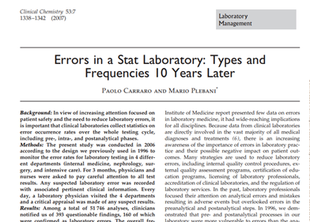
Study 3 [2007]
High frequency of errors attributable to processes external to the laboratory stresses the need for a closer control of all processes
Proper specimen identification, appropriateness of test requests, accuracy in blood drawing, specimen handling, and transportation strongly affect total quality and many errors are preventable.
Carraro P, Plebani M.
Clin Chem 2007 July;53(7):1338
Notes:
73% of errors deemed preventable

Slide 13
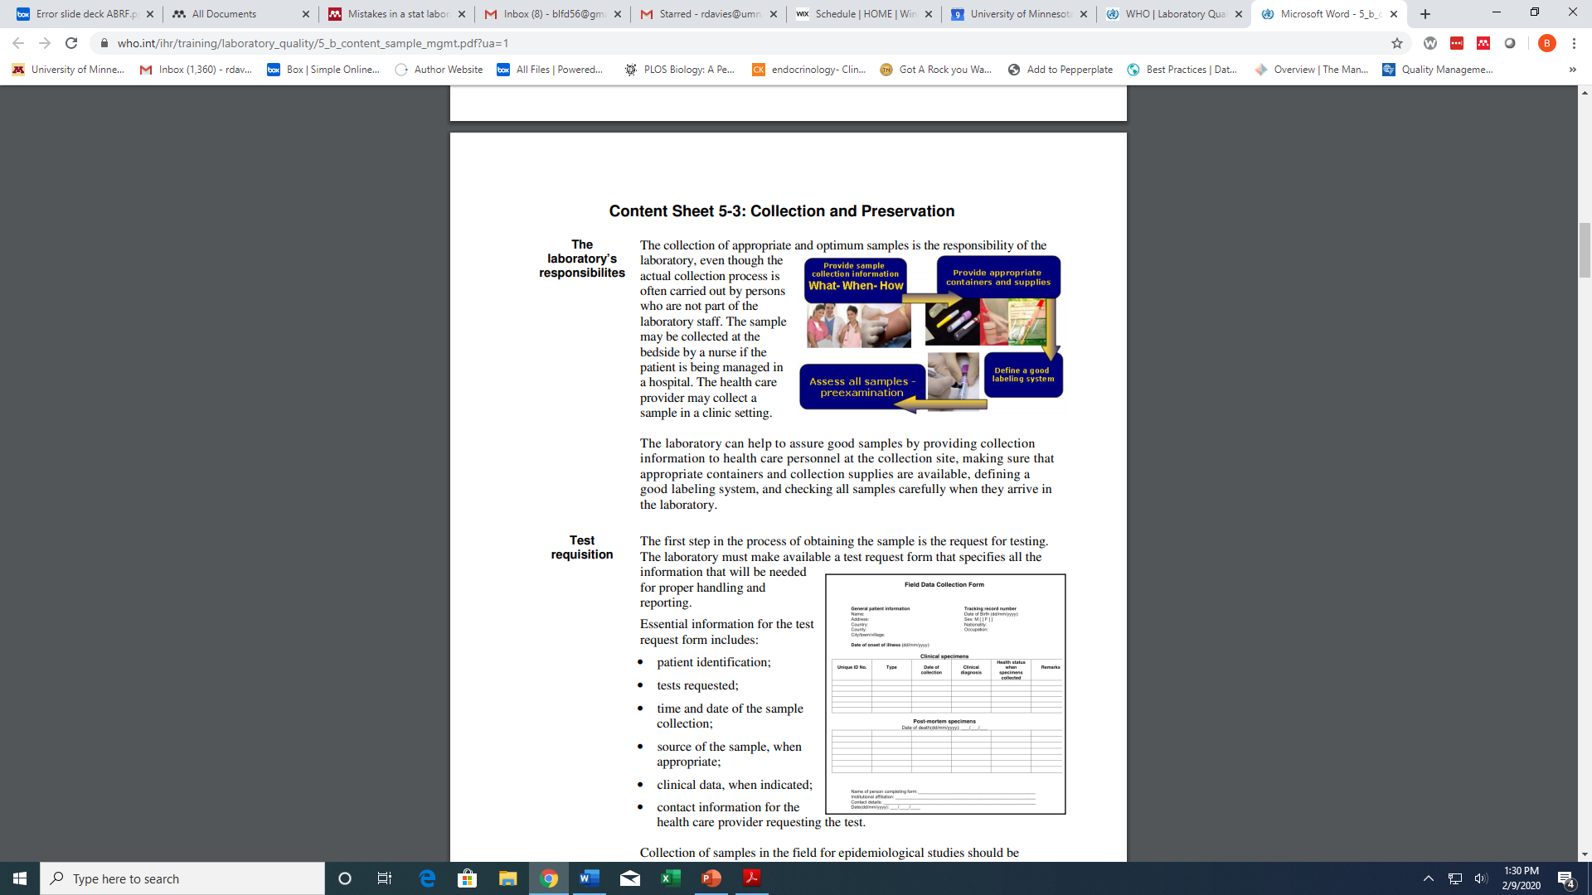
Quality connections between research and core laboratories
‘The collection of appropriate and optimum samples is the responsibility of the laboratory, even though the actual collection process is often carried out by persons who are not part of the laboratory staff’
Laboratory Quality Management System, World Health Organization, 2009
https://www.who.int/ihr/training/laboratory_quality/sample/en/

Slide 14
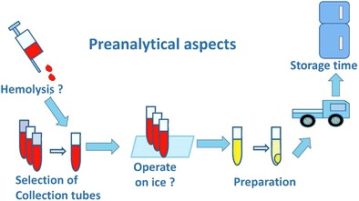
The Importance of
Preanalytical Errors
Effects of pre-analytical processes on blood samples used in metabolomics studies
Peiyuan Yin, et al. Anal Bioanal Chem (2015) 407:4879-4892
The procedures and potential problems in preanalytical aspects of metabolomics studies using blood samples.
Bias in the preanalytical phase may lead to unwanted results in the subsequential studies

Slide 15
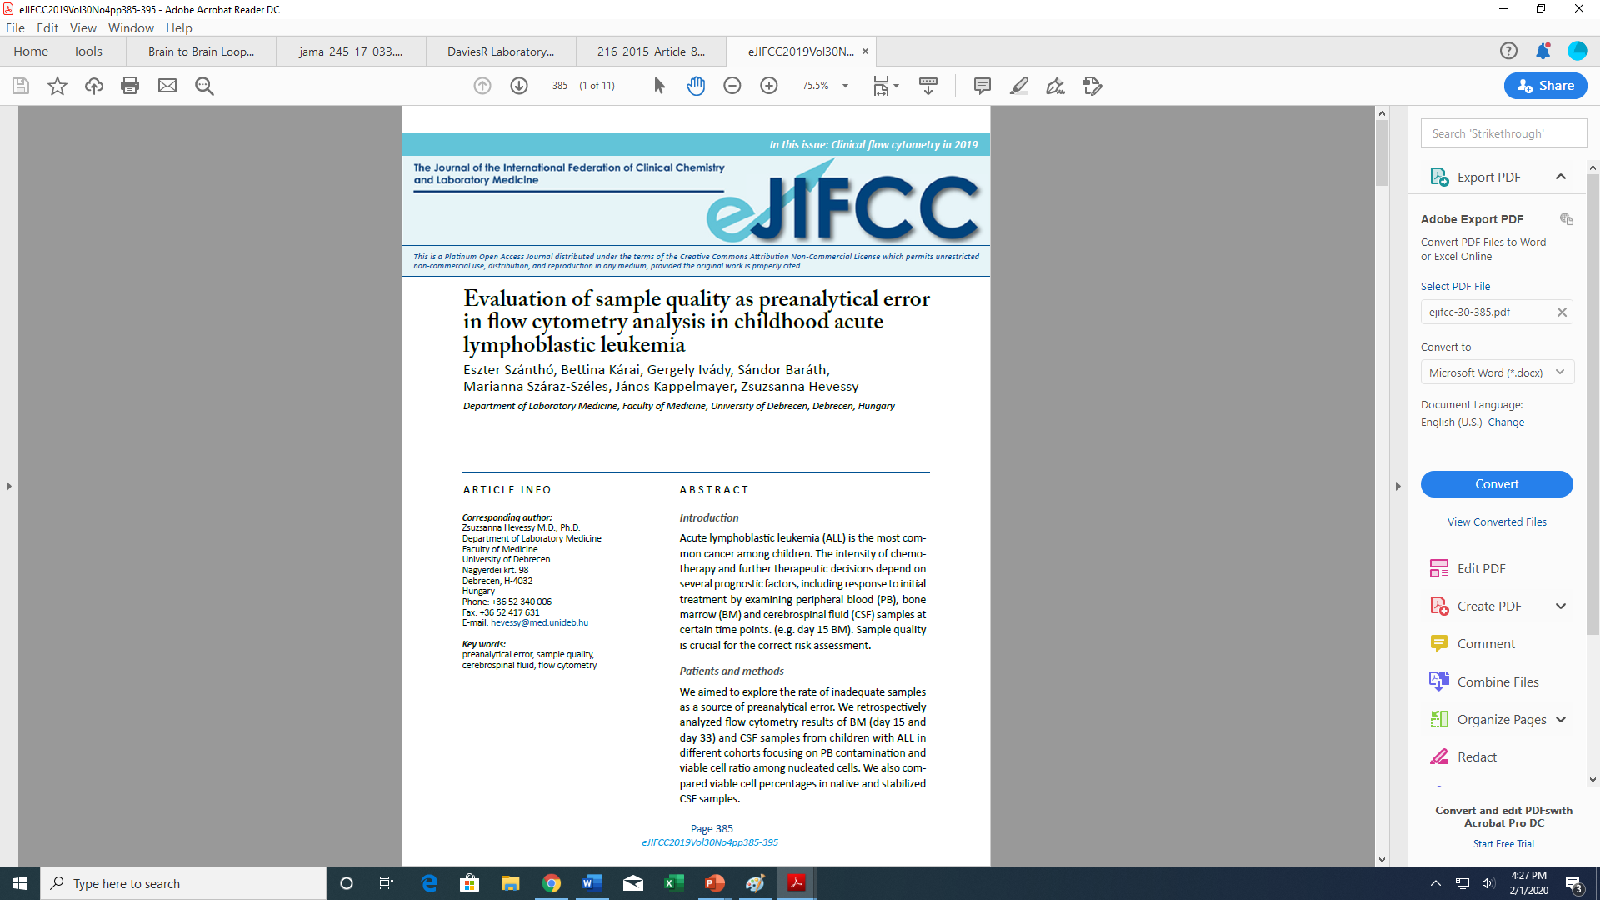
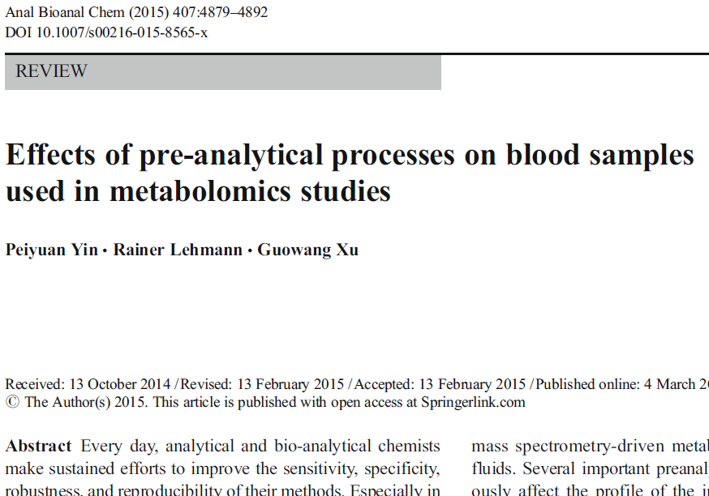
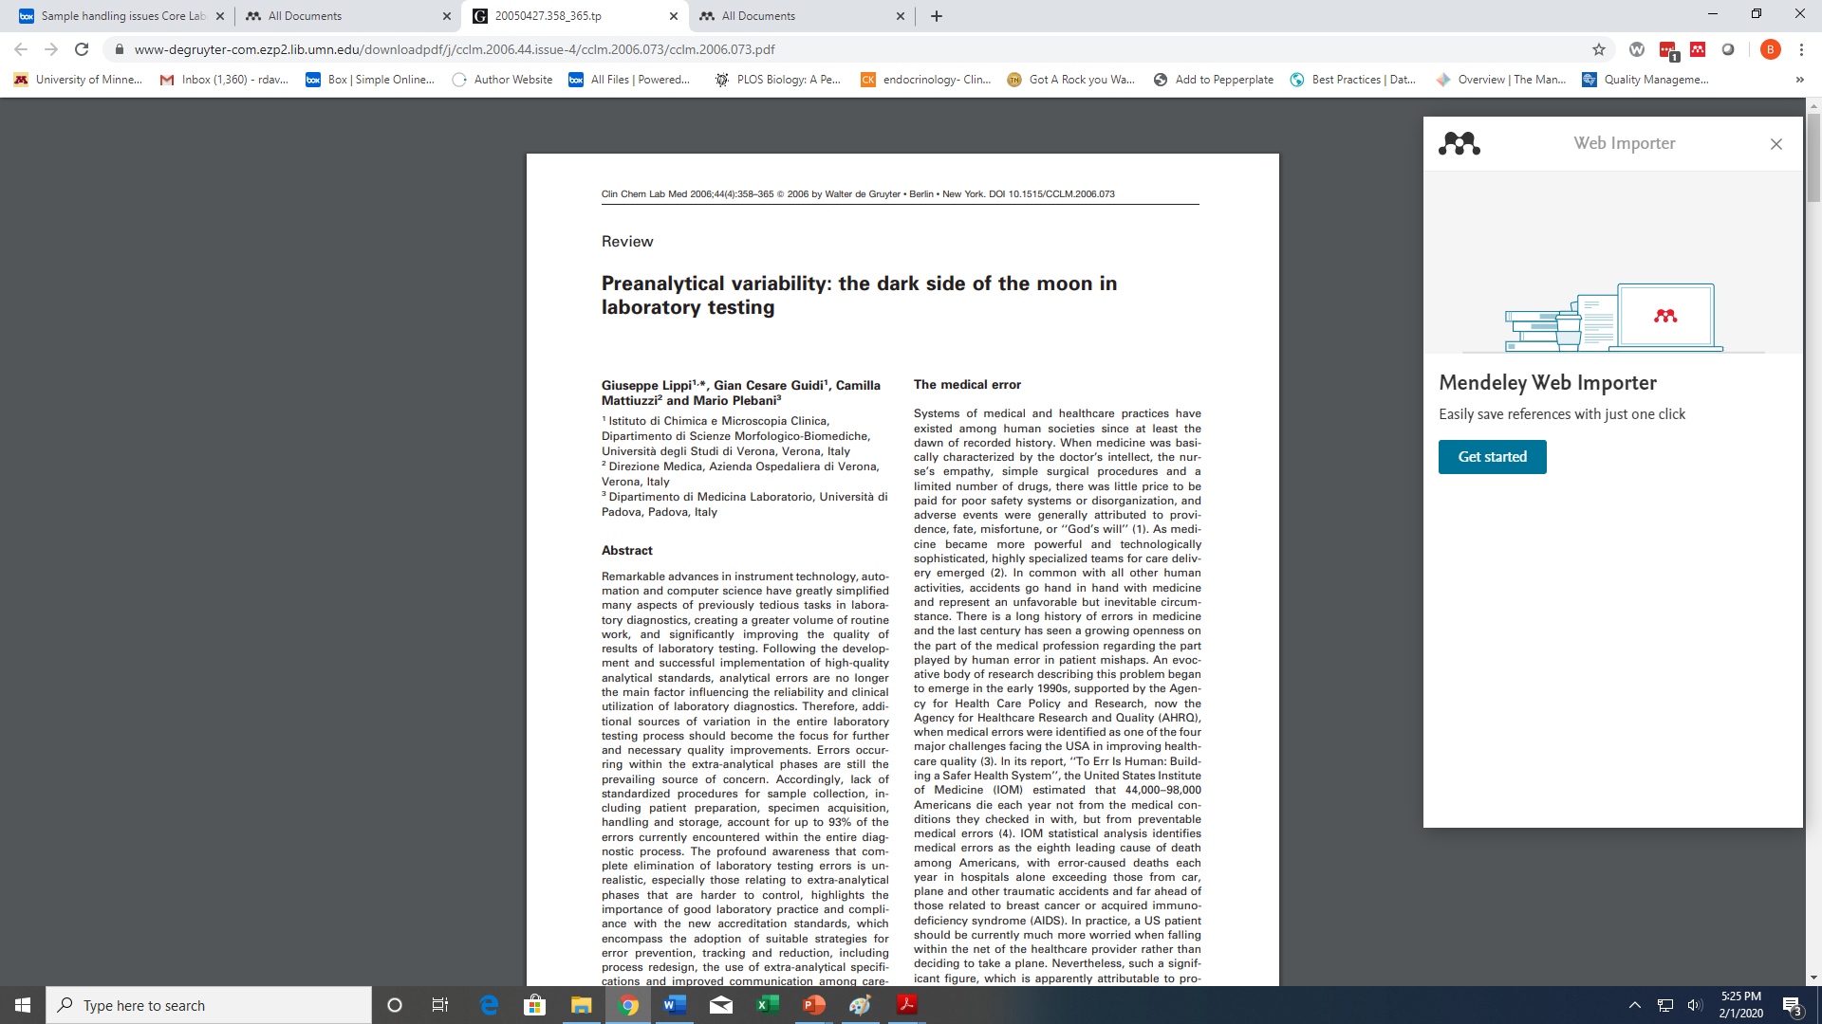
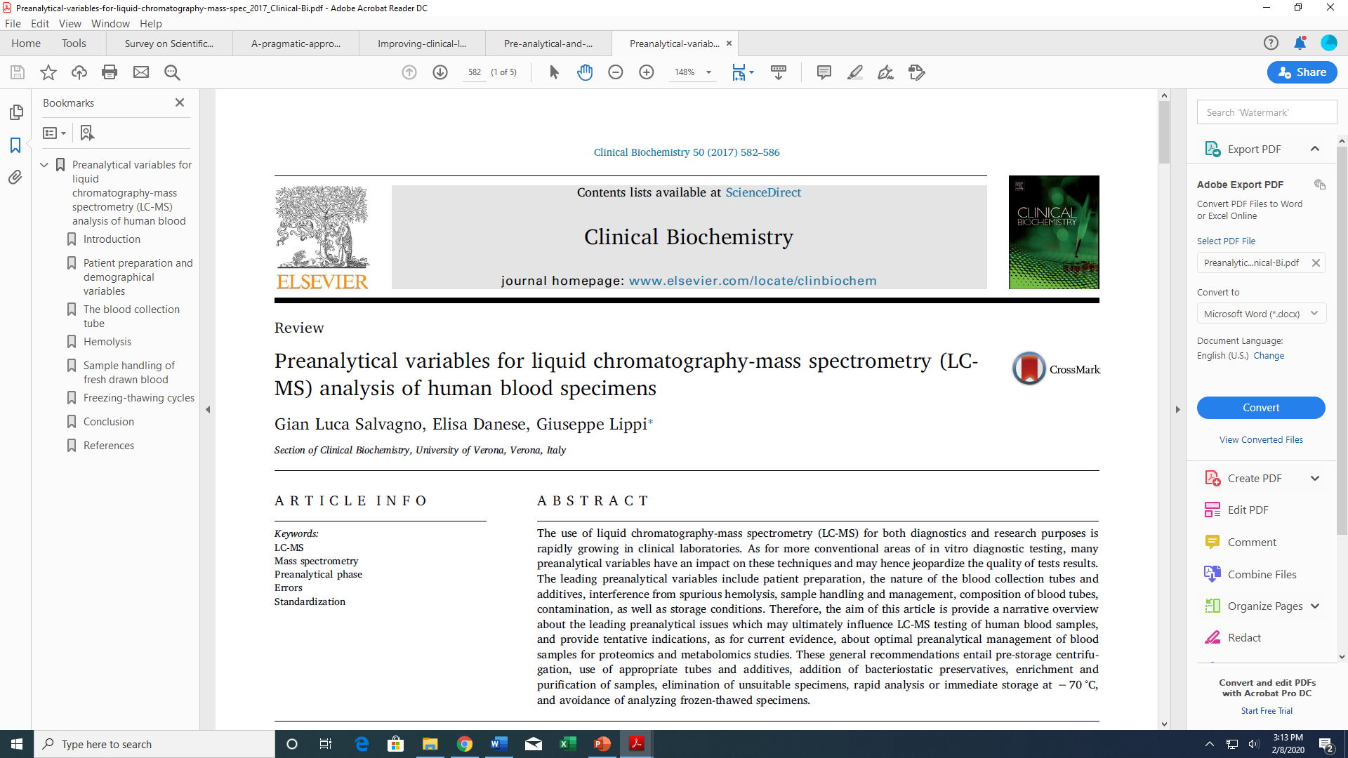
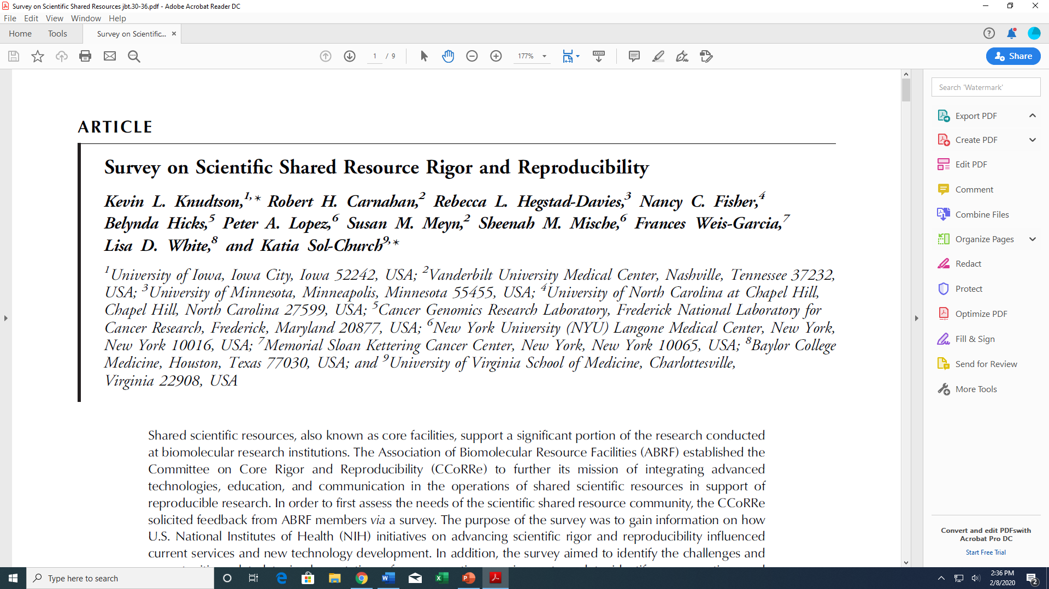
The importance of preanalytical error to core laboratories and to research scientists

Slide 16
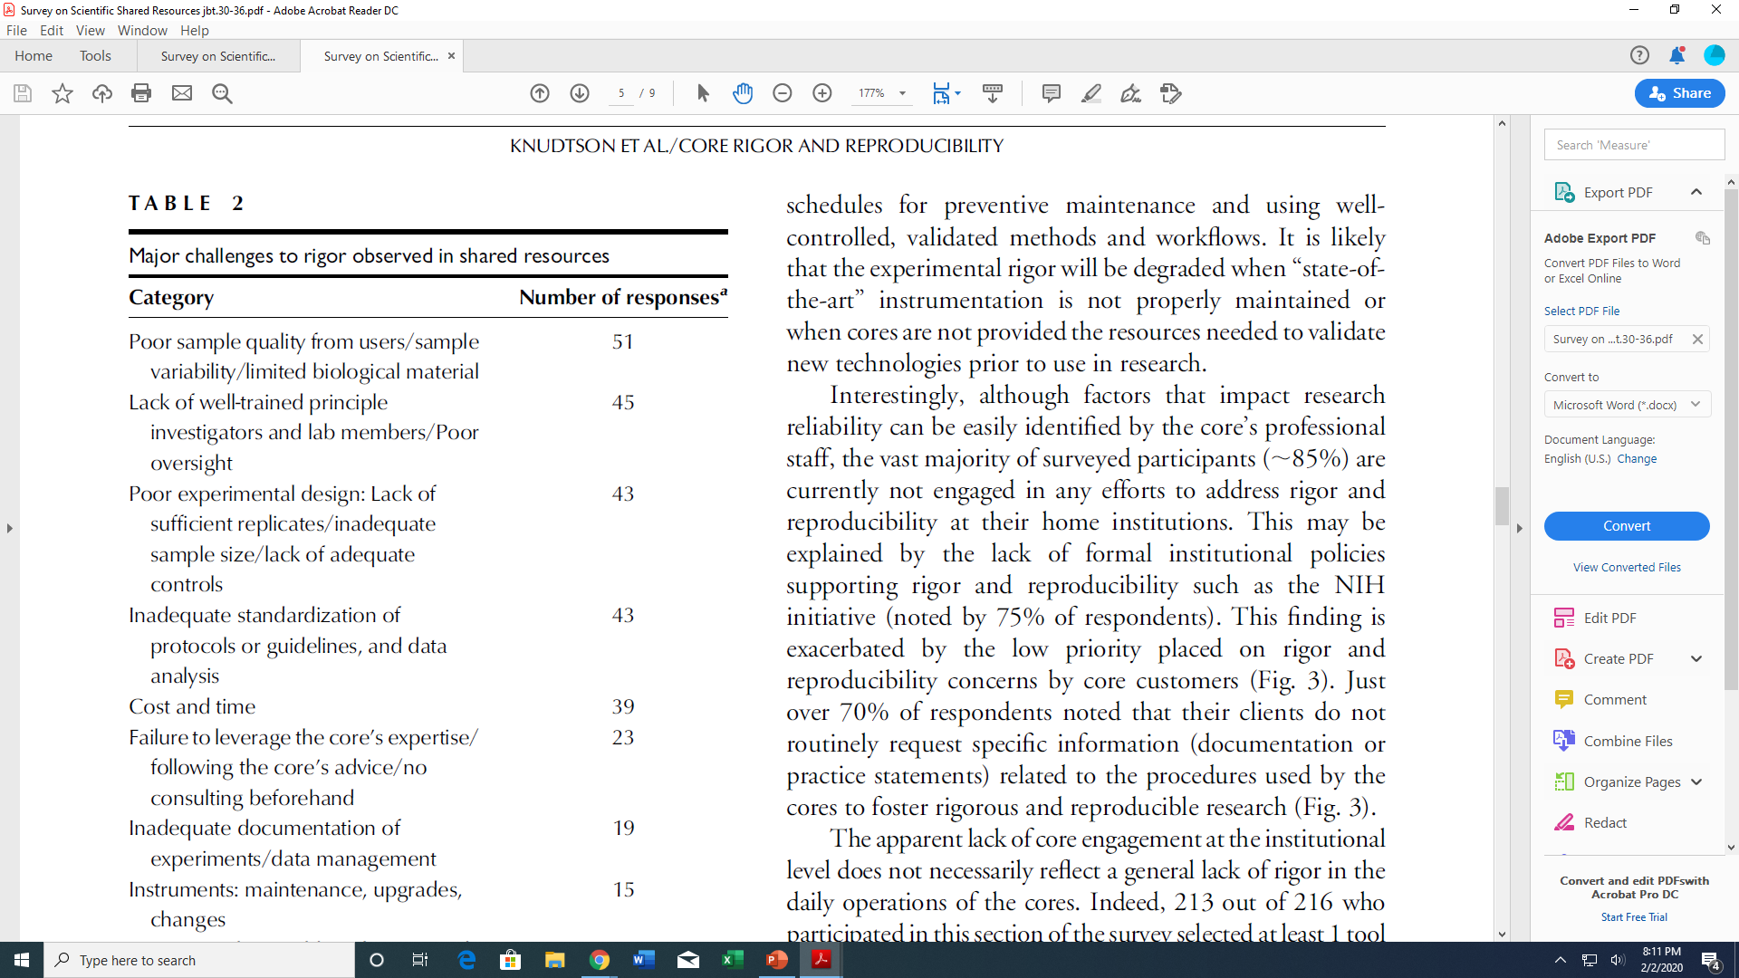

Survey on Scientific Shared Resource Rigor and Reproducibility
Knudtson et al; JBT, Volume 30, ISSUE 3, September 2019

Slide 17
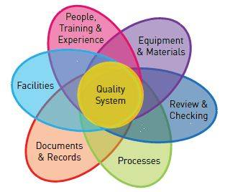
Table 2
Prevention and recovery from the most frequent preanalytical problems
Risk management in the preanalytical phase of laboratory testing.
Lippi et al. Clin Chem Lab 2007;45 (6):720-7
Disseminate guidelines or best practices for sample collection and handling
Educate and train operators
Introduce policies and objective acceptance criteria for unsuitable samples
Reduce error-prone activities
Introduce checks
Monitor rejection rates
Do not report doubtful results
Risk Management
Control of variables and unintended variation
Notes:
Link to upcoming talks

Slide 18
Quality Management System as a tool
Establishes the standards (requirements) that you will work to and how you are going to meet them
Defines what people, actions and documents are going to be employed in order to carry out the work in a consistent manner, leaving evidence of what happened
May include manuals, handbooks, procedures, policies, records and templates
‘Ensure that data are fit for purpose and to give assurance that the processes under which the data have been generated are completely accountable and transparent’
Guidelines for Quality in Non-Regulated Scientific Research, RQA 2014.
Quality Systems Workbook. Handy, L. et al., 2103 Research Quality Association

Slide 19
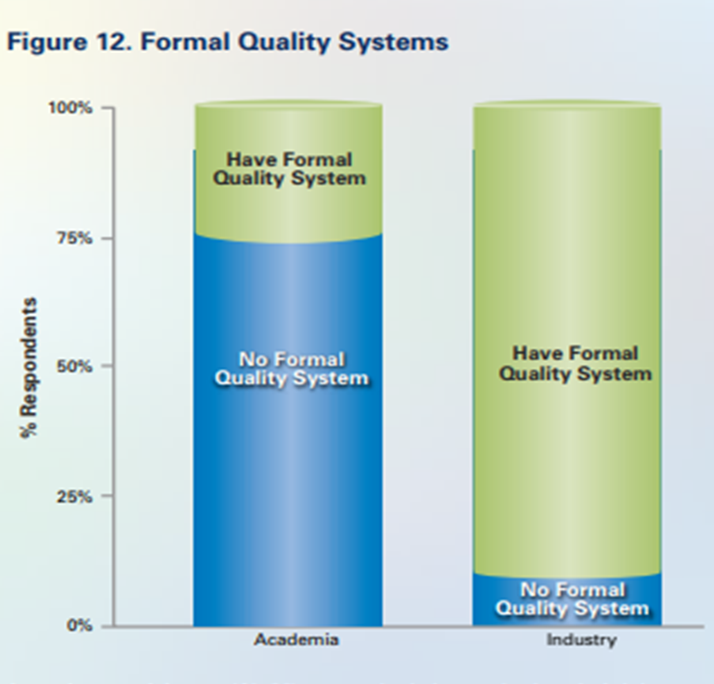
  QMS/QA as a tool for improving sample processes at the client/service provider interface
Promote QA Best Practices within research lab environments
Introduce the benefits of QA best practices
  Communication
  Training
  Resources
  Engage where the risks are greatest
    Sample handling
    Sample quality
Formal QA System
No Formal QA System
Academia Industry
GBSI, The Case for Standards in Life Science Research

Slide 20
Applicable best practices
Sample Quality as an entry point
Quality Management System
Establish and promote Best Practices/Expectations/Guidelines
  Written policies for sample management
  SOPS or Lab Handbook for use at collection site
  Training resources
  Good Documentation Practices (labeling, traceability)
    Patient/subject preparation
    Sample Handling and Submission
    Safety
    Sample Quality and Evaluation
    Sample Evaluation (quality, leaks, broken tubes, contamination)
    Retention and Disposal
  Quality Checks for compliance with sample requirements upon arrival at the lab.
  Process monitoring and error management

Slide 21
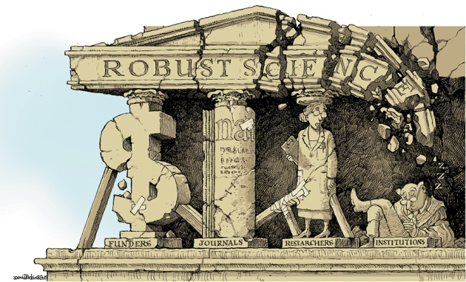
Robust research: Institutions must do their part for reproducibility
Nature | Comment
01 Sep 2015
Begley CG, et al
GIP

Slide 22
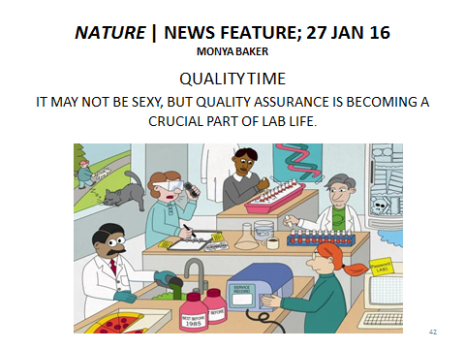
Summary
Thank You!
Questions? rdavies@umn.edu
  Much of lab error is preventable, and occurs before the sample is tested in the lab.
  Shared QMS/QA best practices will benefit research and core laboratories
‘The quality of the work a lab generates is only as good as the quality of the samples it tests’.
World Health Organization; Laboratory Quality Management System Training Toolkit; 2009.

Slide 23
Implementation of a Quality Management System in an Academic Core Facility
David Blum
University of Georgia
www.slido.com, enter code P413

Slide 24
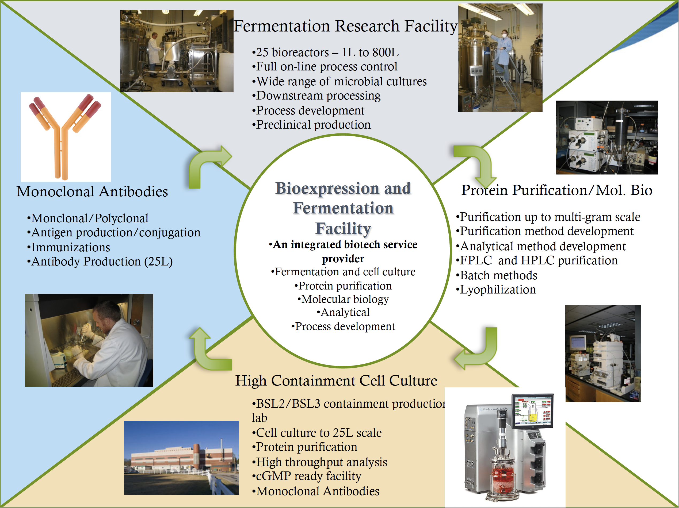
BFF

Slide 25

Why do I need a quality management system?
Standardize practices
Reduce errors
Ensure safety
Ensure quality of the work (traceability)
Training new staff
Create an easy to share record of the work performed
Meet FDA or other regulations/guidelines

Slide 26
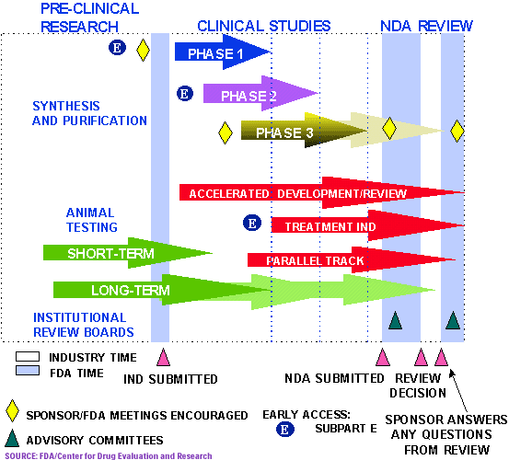
Terms
FDA - Food and Drug Administration
  Guidelines
ICH - International Council for Harmonization
  Q X Guidelines
IND - Investigational New Drug
NDA new drug application
Notes:
ICH - International Committee and Harmonization - brings together the regulatory authorities and pharmaceutical industry to discuss scientific and technical aspects of drug registration
FDA (Food and Drug Administration) - Regulatory Agency responsible for providing guidelines for the manufacture of drugs and biologics and is also responsible for approving drugs
IND - Investigational New Drug) - Means by which a company obtains permission to start clinical trials for a new drug.
NDA (new drug application) - final step in getting approval for a new drug; can also be a Biologics Liscense application (BLA) for protein drugs

Slide 27
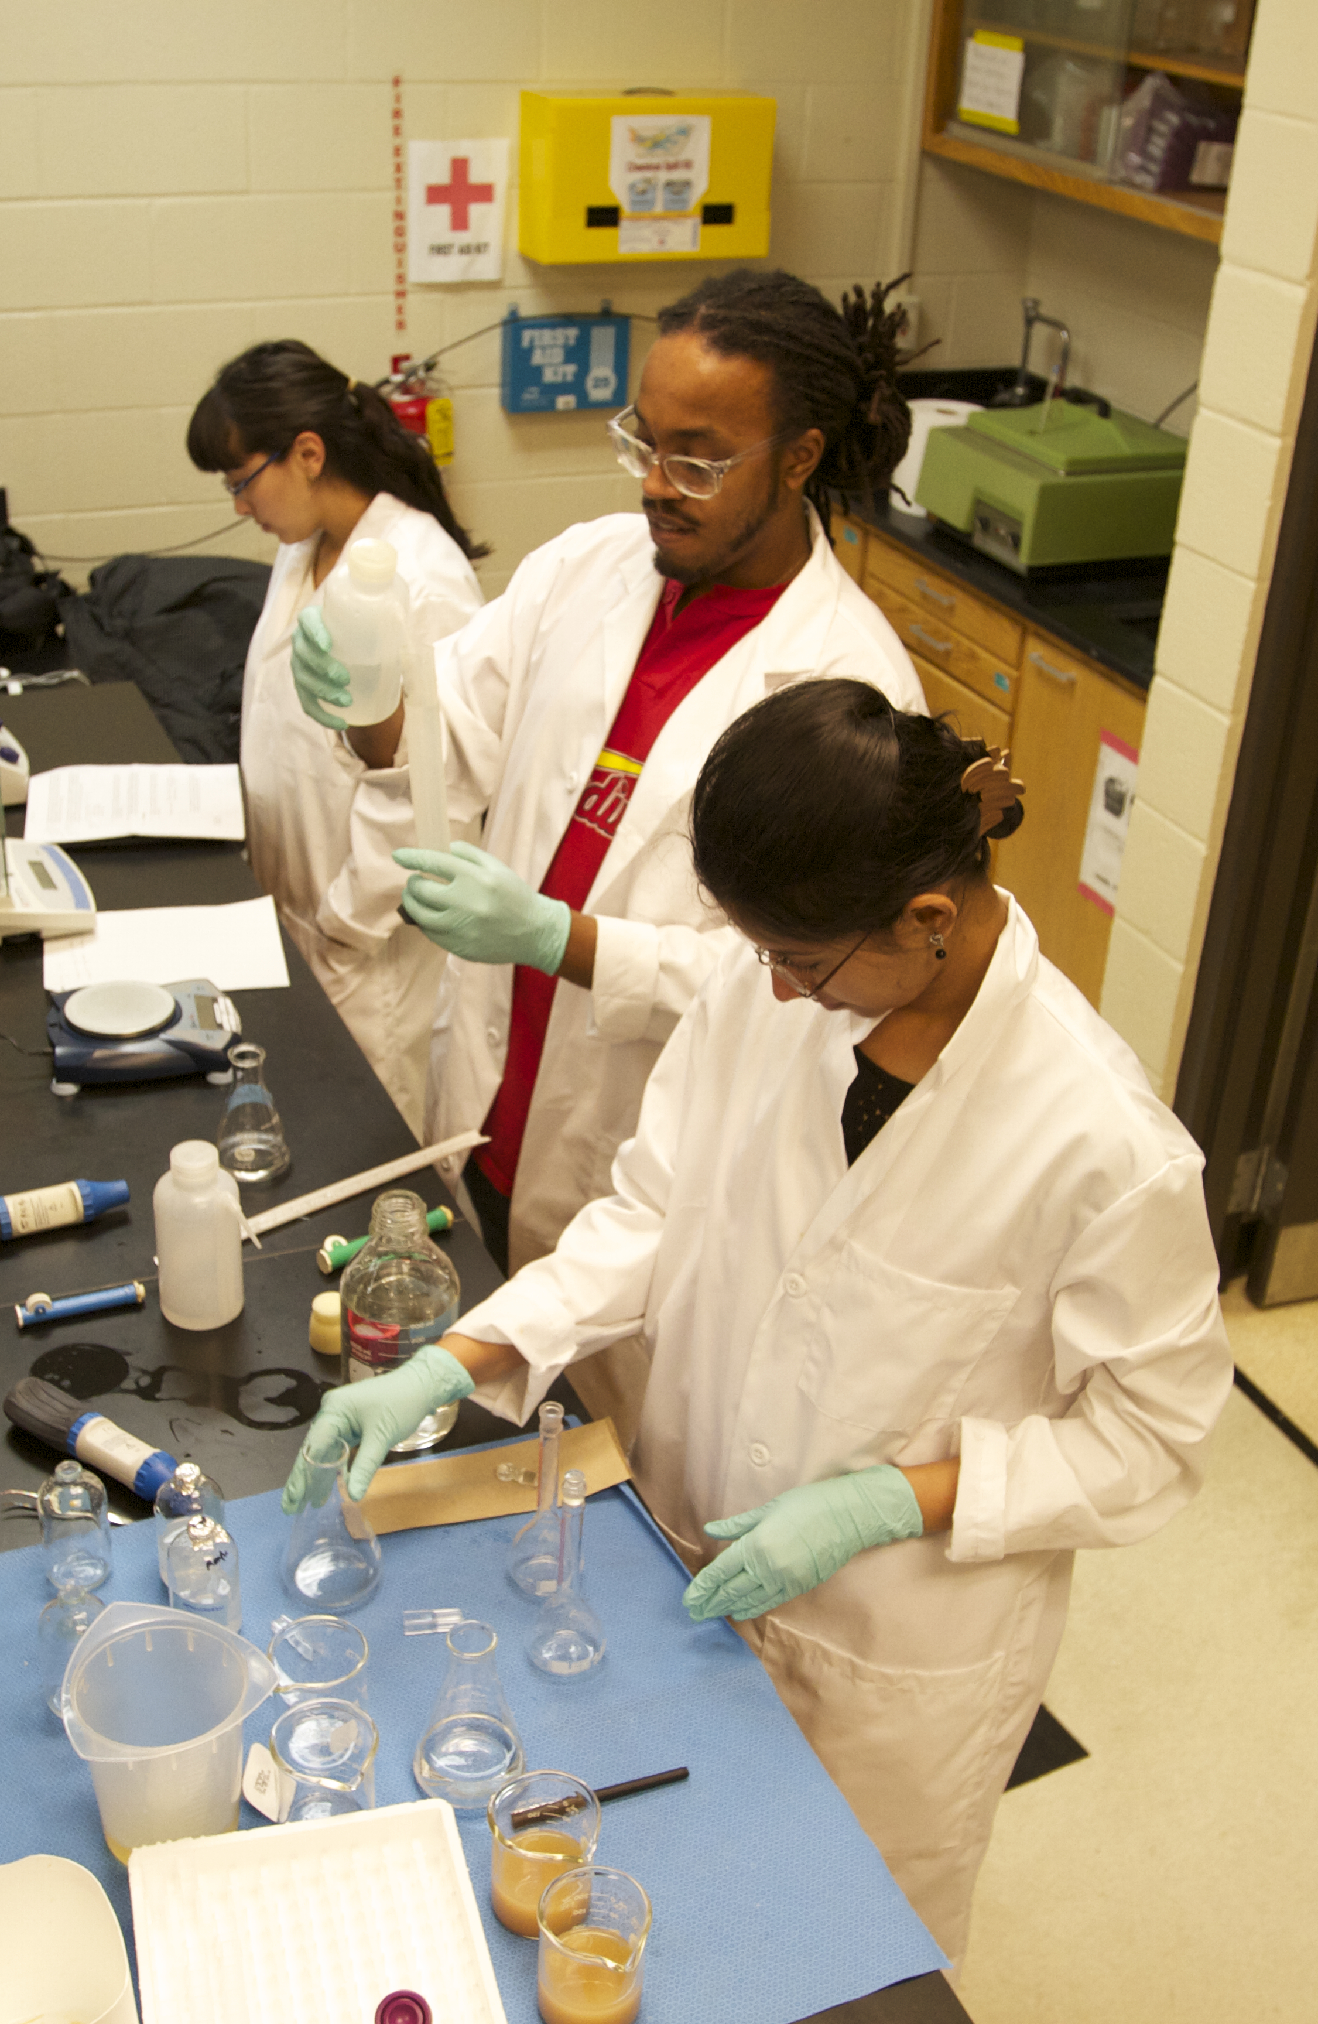
Good practices
GLP (Good Laboratory Practice) - quality system of management controls for research laboratories and organizations typically for animal toxicology studies
GCP (Good Clinical Practice) - quality system for clinical trials
GDP (Good Documentation Practice - quality system for documentation
GMP (Good Manufacturing Practice) - quality system for manufacturing drugs for clinical trials and commerce

Slide 28
GMP
Common GMP Principles (21 CFR Part 211-drug; 606-blood)
Organization & Personnel (Part 211, 606)
Buildings/Plant and Facilities (Part 211, 606)
Equipment (Part 211, 606)
Control of components including product container/closures (Part 211)
Production and Process Controls (Part 211, 606)
Packaging and Labeling Controls including standards for label language (Part 211, 606)
Holding and Distribution (Part 211)
Laboratory Controls (Part 211, 606)
Records and Reports (Part 211, 606)

Slide 29
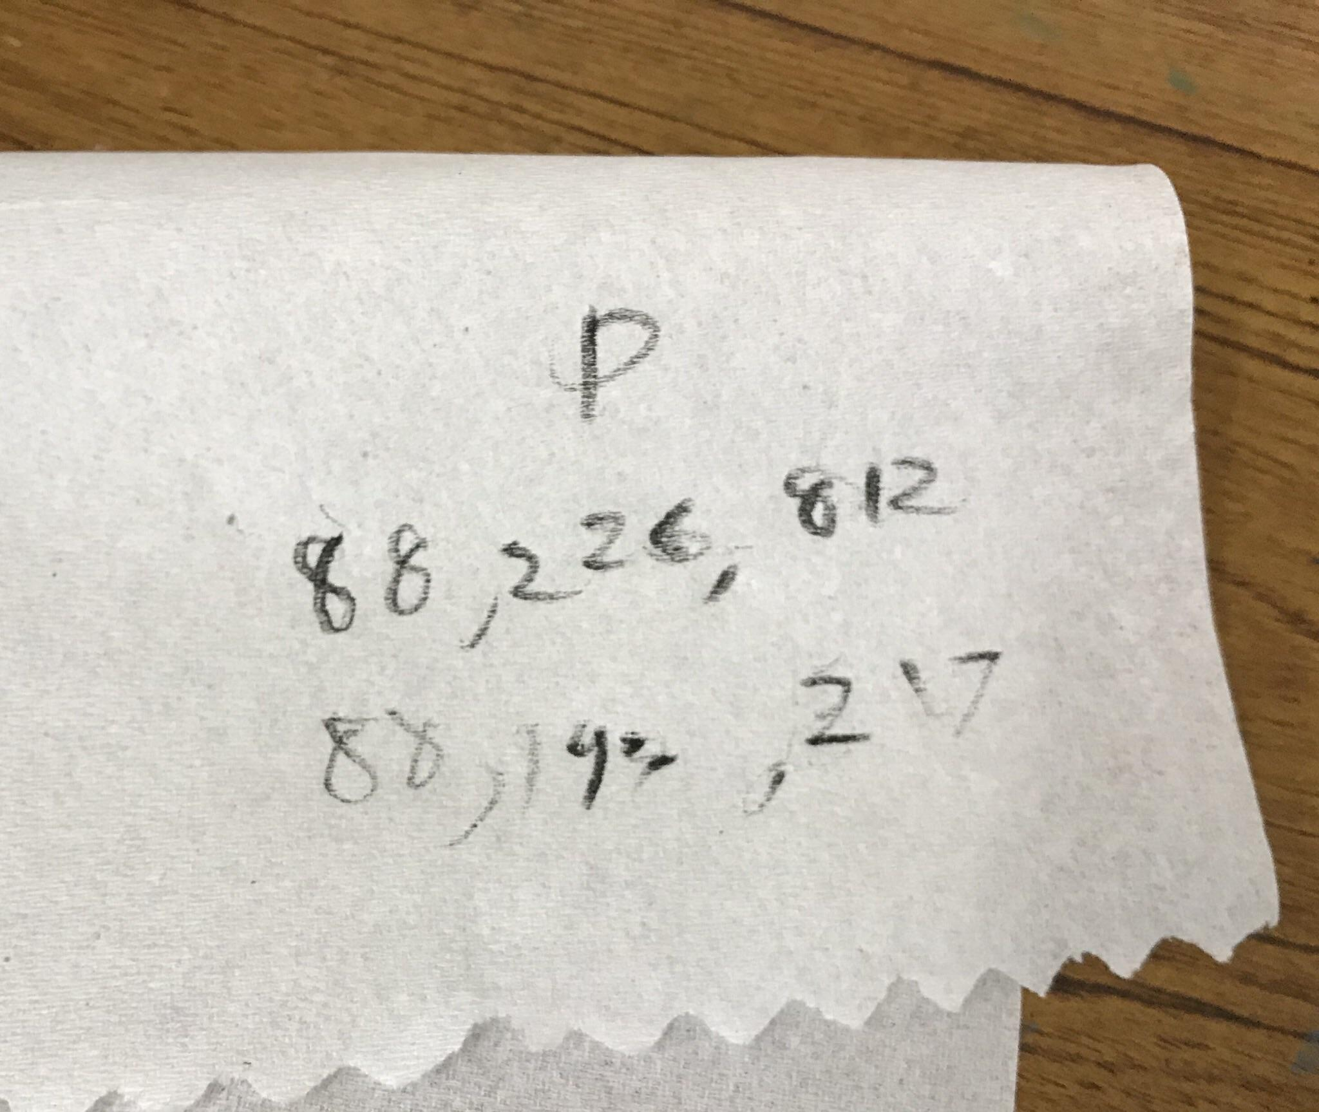
What documents comprise the QMS?
Standard Operating Procedures
Forms and Batch Records (go with a corresponding SOP)
Test records
Lab Notebooks
Equipment Certifications
Training records
Quality Manual
"If it wasn’t written down it didn’t happen"
- FDA
"Paper towels don't count"
- Me
Notes:
Discuss the different between Form versus batch record

Slide 30
What is an SOP?
Standard Operating Procedure
Documents your process
Has many sections
1 Purpose | 9 Materials
2 Principle | 10 Supplies
3 Scope | 11 Associated Documents
4 Responsibility | 12 Related Documents
5 Definitions | 13 Description
6 Training | 14 Procedure
7 Safety | 15 References
8 Equipment | 16 Appendices

Slide 31
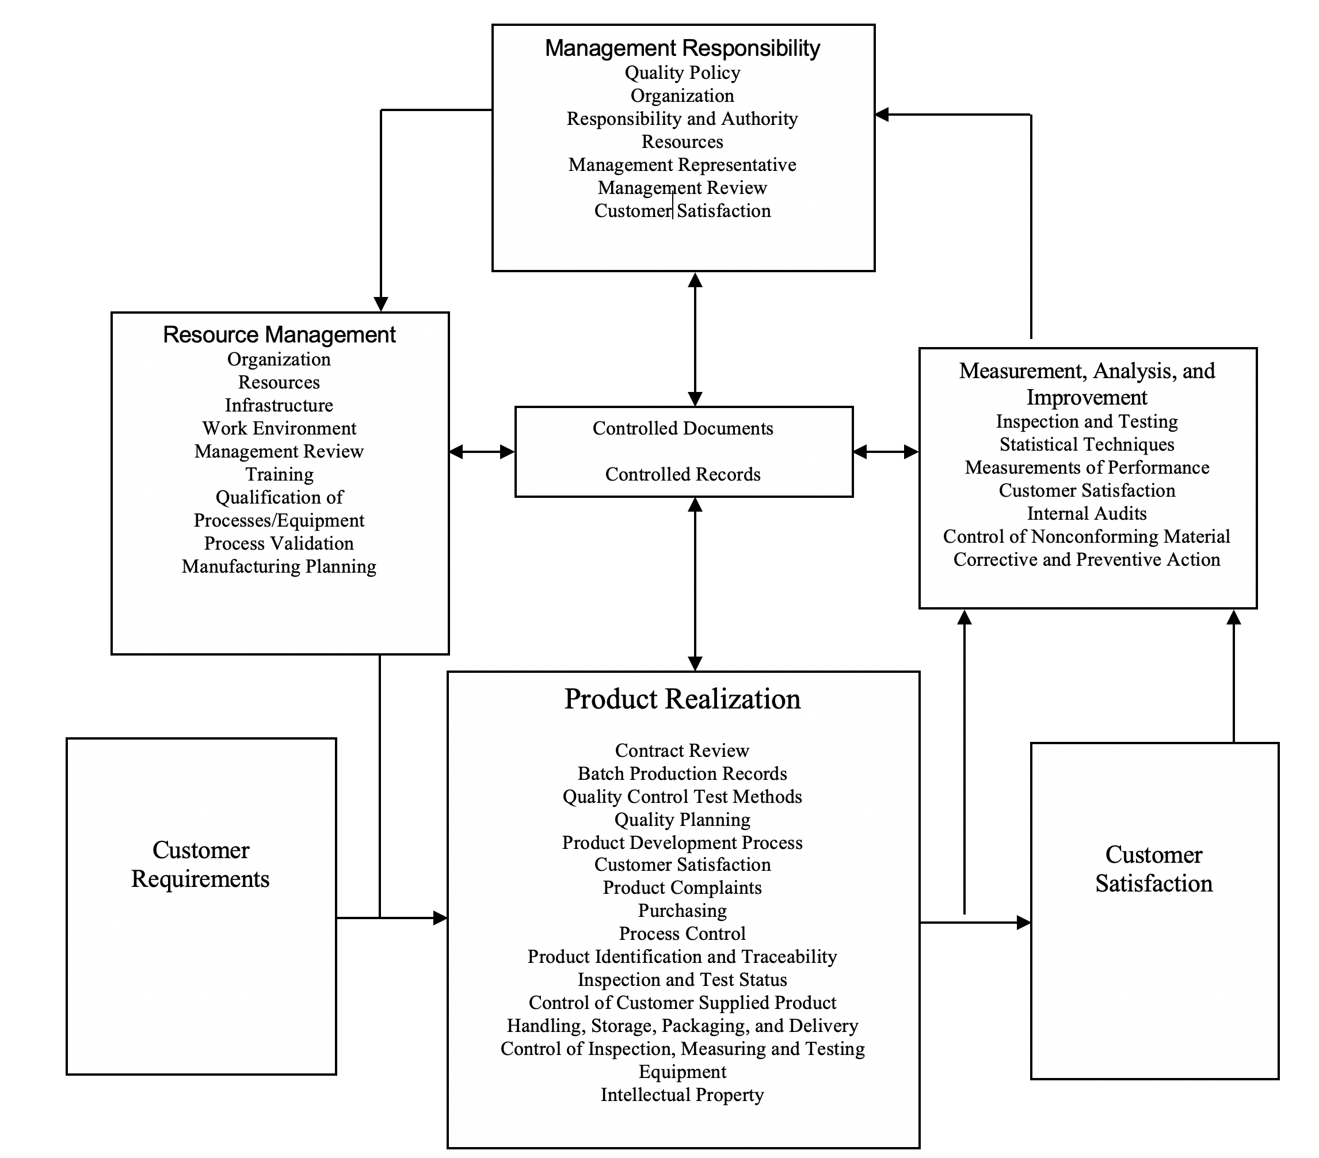
Key Components of the QMS
Process & Interactions

Slide 32
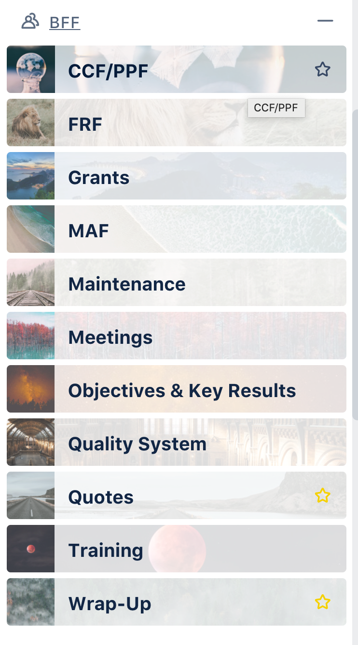
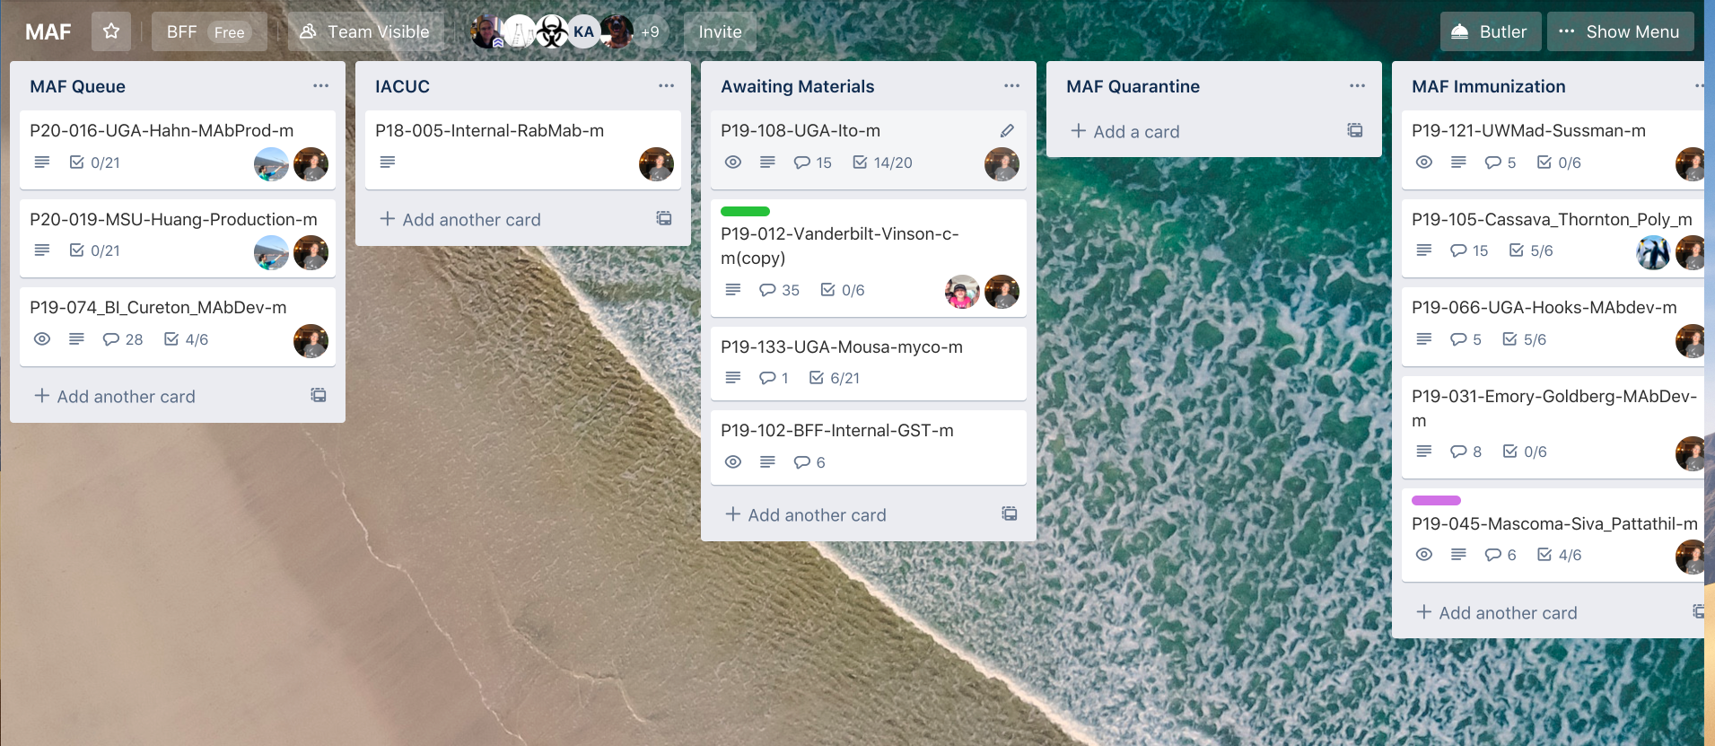
Trello – Kanban system

Slide 33

BFF Documents
Animal Handling
  Specific to working with animals for research
Quality
  Systemwide documents
Safety
  Safety procedures, forms, etc
Technical
  Equipment operation

Slide 34

History
Originally worked with consultants
Focus on document control first
Key SOPs
  Document control
  Initiation of documents
  Management of SOPs
  Signatures and notebooks
  Training
  Safety
  Good documentation practices

Slide 35

Challenges
How detailed do SOPs need to be?
How to ensure everyone follows SOPs?
Do we have to sign so many documents?
How to effectively train new employees?
What about students?

Slide 36
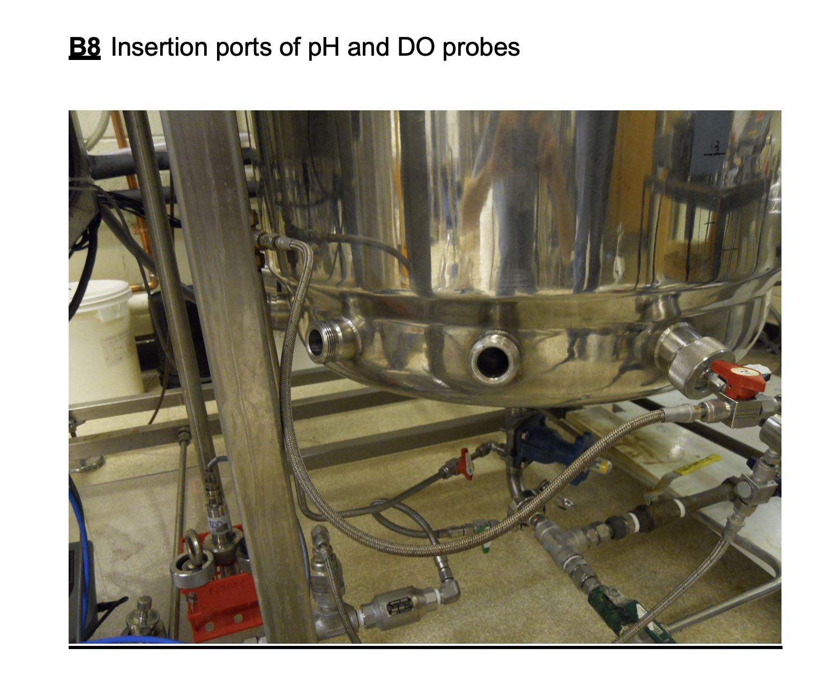
Case study – 250 L fermentor
17 pages long
21 figures
130 steps
Is this detail necessary?
What do operators need to know?
How do we accommodate experts versus novices?

Slide 37

Next steps
Continue adding SOPs
  CAPA
  Root Cause Analysis
Work on format – detail v simple
Go electronic
Leverage system
  Materials for Toxicology studies
  Food Trials
  GLP?
  GMP -> Future??

Slide 38
Building a Quality Management System (QMS) in a Core Facility:
A Genomics Core Case Study
Christopher W. Gregory, PhD
Associate Professor/Director of Research, Department of Genetics
Director, Office of Research Technologies, School of Medicine
www.slido.com, enter code P413

Slide 39
Continuous Improvement
CI
Identify Opportunities
Plan for Improvement
Execute the Changes
Measure the Results
-Ongoing effort to improve products, services or processes
-Incremental or breakthrough in nature
-Method for identifying opportunities for streamlining work and reducing waste
Notes:
-Incremental is small tweaks (on the fly)
-Breakthrough – team effort, many changes to current processes

Slide 40
Models and Systems for Continuous Improvement
Lean Management
Six Sigma
Lean Six Sigma
Agile Management
Total Quality Management
Just-in-Time
Kaizen (“change for better”)
Poka-Yoke (“mistake proofing”)
Design of Experiments
Process Excellence
ISO 9001
Lean Management – eliminates waste, focused on all work processes
Six Sigma – rigorous, focused and highly effective implementation of proven quality principles and techniques
ISO 9001 – specifies requirements for quality management system
Notes:
Lean Mngmt – Eli Whitney came up with idea of interchangeable parts and Henry Ford expanded into wider production. Toyota perfected lean
Six Sigma – 1987 at Motorola – methodology
TQM pioneered by US Navy in 1984, spread throughout US govt/DOD
Kaizen and poka-yoke (1960s Toyota)
DOE used more in natural sciences, engineering, social sciences (randomization, statistical replication, multi-factorial)

Slide 41
Overview
The Core
The Challenges
The Improvement Process
The Control Processes
The Outcomes
The Benefits

Slide 42
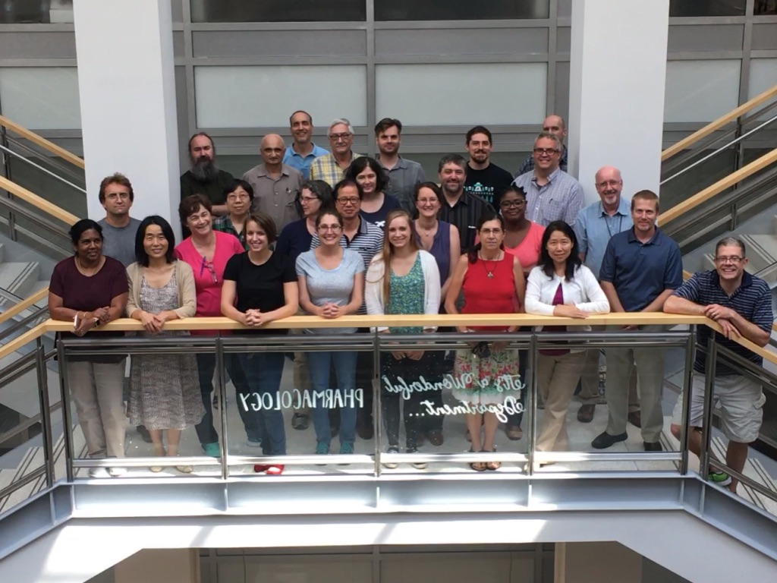
THE CORE
UNC High-Throughput Sequencing Facility (HTSF)
Established in 2007, grew through consolidation (Sanger sequencing, microarray, functional genomics)
>25 permanent and temporary employees in two locations
Technologies include Illumina, Oxford Nanopore, Perkin Elmer, Agilent, Affymetrix, 10X Genomics and BioNano Genomics
~135 internal and external users

Slide 43
THE CORE
UNC High-Throughput Sequencing Facility (HTSF)
Faculty Director
Technical
Director
Project
Manager
Research Spec
Project Mngmt
Research Spec
Library Prep
Research Spec
Seq (Illumina)
Research Spec
Seq (Non-Illumina)
Research Scient
Fnctl Genomics
Research Assoc
Microarrays
IT and Informatics
Leads
Customer
Service Team
Library Prep Team
Sequencing Team
Sequencing Team
IT and Informatics
Teams

Slide 44
THE CHALLENGES
“Growing Pains”
Customer Dissatisfaction & Failure to Recover Costs
New Management Structure
Slow Delivery
Poor Quality
Errors and Non-conformances
Resistance to Change

Slide 45
Quality Management in NGS and -Omics
Endrullat et al. Standardization and quality management in next-generation sequencing. Appl Transl Genomics 2016
  Use of NGS standardization from clinical diagnostics (GLP) as a guide for non-clinical sequencing labs
Kauffmann et al. Framework for the quality assurance of ‘omics technologies considering GLP requirements. Regul Toxicol Pharmacol 2017
  Use of GLP principles to ensure quality control, reproducibility and traceability
Lanati et al. Management at the service of research: ReOmicS, a quality management system for omics sciences. Palgrave Comm 2019
  Use of ReOmicS system to incorporate GLP-like QMS in NGS research environment

Slide 46
QMS
Why? What? How?
Why QMS?
  Most cores use best practices and provide services supporting rigorous and reproducible research but are not required to implement a formal QMS
  QMS can be a competitive differentiator (GLP-like system that is auditable)
What is QMS?
  Formalized system that documents processes, procedures and responsibilities that guide an organization’s activities to meet customer and regulatory requirements
  Based on Code of Federal Regulations (CFR) Title 21 (Food and Drugs); guided by Intl. Org. for Standardization (ISO) 9001
How is a QMS implemented?
  Six Sigma or Lean Management tools (or others) can be used to guide process improvement and control (including process mapping, training, root cause analysis, visual control boards, metrics tracking, voice of the customer meetings)

Slide 47
THE IMPROVEMENT PROCESS
Six Sigma-Based
Standard Six Sigma Framework
Adapted Framework for HTSF
Specific Tools Employed
DEFINE
DISCOVERY
INTERVIEWS
PROCESS MAPPING
TEAM BUILDING
FUNCTIONAL TALKS
SIPOC
MEASURE
ANALYZE
FORMAL TRAINING FOR GROUP AND 1:1
TRAINING
SOPs / QMS
SOP PREPARATION
SOP TRAINING
AUDIT TRAINING
MOCK AUDITS
IMPROVE
VOC / RCA
VOC / RCA MEETINGS
METRIC TRACKING
CONTROL
METRICS
Snee and Hoerl, Six Sigma-Beyond the Factory Floor, 2005
Jacka and Keller, Business Process Mapping, Improving Customer Satisfaction, 2009
Damelio, The Basics of Process Mapping, 2011

Slide 48
THE IMPROVEMENT PROCESS
Six Sigma-Based
Discovery
Structured Interviews
Staff and customers
Process Mapping
Functional area presentations
Functional area mapping
Training
QMS, SOPs, customer service
Communication
Performance Mngmt
SOPs and QMS
SOP drafting and training
Quality audit training

Slide 49
Discovery
Structured Interviews
Staff and customers
Conducted structured interviews with core management, including all supervisors/customer service staff and with selected customers
Gathered feedback on:
  Day-to-day core operations
  Challenges and barriers to success
  Ideas for improvement
  Level of satisfaction
  Timeliness and quality
Feedback used to design training and improvement plan

Slide 50
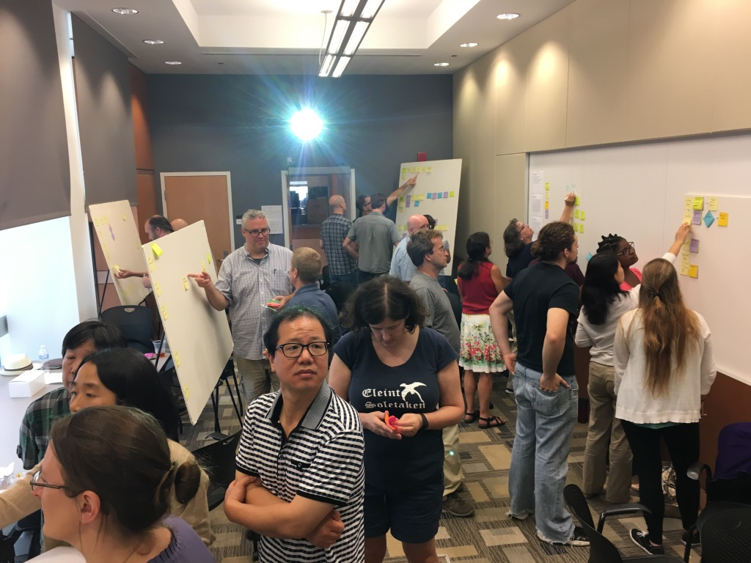
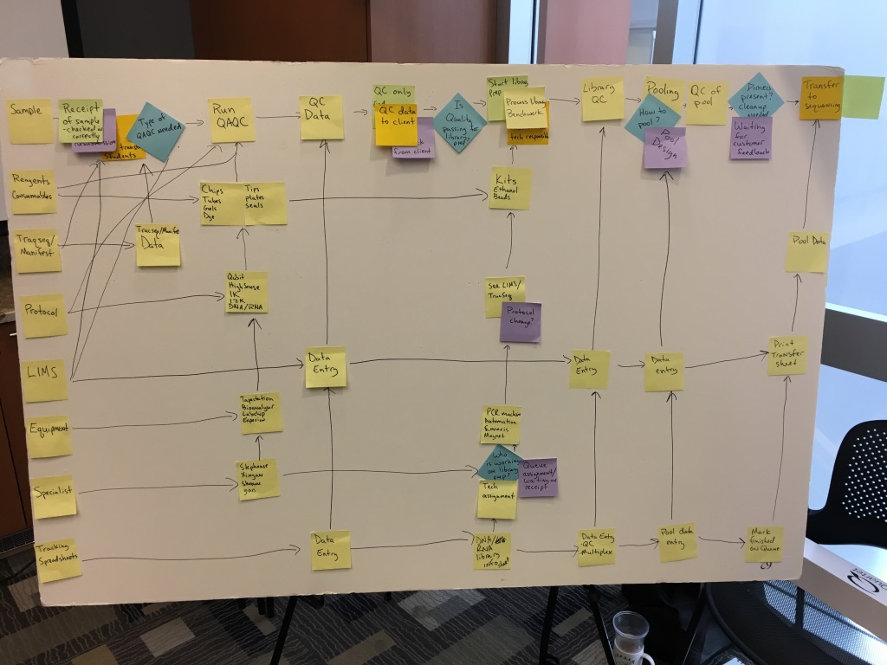
Process Mapping
Functional area presentations
Functional area mapping
Full day workshop for all core leaders and staff
Team building exercises
Presentations from each functional team
Training on SIPOC (supplier, input, process, output, customer) method for process mapping
Each team mapped their own process on white boards and then presented to group
Improvement opportunities identified and discussed by group

Slide 51
Process Mapping
Functional area presentations
Functional area mapping
SEQUENCING WORKFLOW
GREEN – Start or end
BLUE – Process step
RED – Potential “wait” time
DIAMONDS - handoffs
LIBRARY
PREPARATION
SAMPLE TRANSFER
SAMPLE CHECK-IN
FLOW CELL
DESIGN
WAIT TO FILL FLOWCELL
DESIGN FC
SET CYCLES, INDICES
UPDATE LIMS
FC DESIGN COMPLETE
TECHNICAL
STAFF
WAIT ON FLOWCELL
DESIGN
ENTER FC DESIGN IN TRACKER
ASSIGNED TO TECH STAFF
UPDATE SYSTEMS
CORRECTIONS
SEQ STATUS?
SAVE DATA
ADD COMMENTS
COMPLETE RUN
TRANSFER DATA
CLOSE PROJECT
SWIM LANES
SAMPLE PREP
CLUSTER GENERATION
RUN SAMPLE - WAIT
SEQUENCER
AVAILABLE?
WASHED?
FUNCTIONAL?
REAGENTS,
KITS & TECH
SUPPORT
ORDER KITS, WAIT
TROUBLESHOOT
TECH SUPPORT
QAQC / RE-HYB
Process improvement opportunities, including barriers and inefficiencies, identified and mitigation strategies discussed.

Slide 52
Training
QMS, SOPs, customer service
Communication
Performance Mngmt
Supervisors
Managers and staff
Managers and staff
Managers and staff
Subject matter experts
Managers and staff

Slide 53
SOPs and QMS
SOP drafting and training
Quality audit training
SOP Categories
  Organization
  Customer Focus
  Facilities and Safety
  Personnel
  Purchasing and Inventory
  Equipment
  Process Management
  Documents and Records
  Information Management
  Nonconforming Event Management
  Assessments
Training – all personnel were required to read SOPs related to their functional areas and certify completion in electronic database

Slide 54
SOPs and QMS
SOP drafting and training
Quality audit training
Quality audits performed by internal or external auditors involve a systematic review of QMS through interviews, lab tours, SOP reviews and compliance assessments
To prepare for an audit, Quality Audit Training was conducted:
  What is “fair game” for auditors?
  What is off limits?
  Management alignment to QMS
  Do’s and don’t’s, including what to say and what not to say
  Behavior during audit
Conducted “mock audit”

Slide 55
THE CONTROL PROCESSES
Voice of the Customer (VOC)
Customer dissatisfaction may result from poor reagent quality or lack of availability, technical errors, poor sample quality or equipment malfunction. To retain unhappy customers, cores must be willing to engage:
VOC Meeting Agenda
A customer provides feedback to gathered team of relevant core staff and managers
A facilitator records feedback on whiteboard, flipchart or computer
The participants agree to main themes related to issues with the project
The participants discuss possible improvements and brainstorm solutions
The team decides on action items and appropriate follow up and agrees on next steps
The facilitator provides meeting minutes and action items to participants and follows up with the core and the customer to ensure actions have been taken

Slide 56
THE CONTROL PROCESSES
Root Cause Analysis (RCA)
Agree on problem and desired outcomes
Conduct RCA using best tool
Identify root cause
Agree on mitigation strategy
Assign/complete action items, follow up with customer, document
RCA refers to a wide range of tools and techniques to uncover the cause of problems, including what, why and how
  Five Whys, Failure Mode and Effects Analysis (FMEA), Fault Tree Analysis, Fishbone Diagram, Current Reality Tree, etc.
Formalizes change management, increases operational excellence and improves customer satisfaction
Rooney and Vanden Heuvel. Root cause analysis for beginners. Qual Prog 2004
Heher. A brief guide to root cause analysis. Cancer Cytopathol 2017

Slide 57
THE OUTCOMES
Tracking Metrics that Matter
With QMS in place, HTSF was pre-qualified to apply for federally-funded contracts to provide RNA sequencing services. Successful quality audit qualified core for awards - >$10M since 2017. Two subsequent audits were successful.
Total revenue grew 74% between FY17 and FY19
Core performance metrics
 | FY17 | FY18 | FY19
Total # samples submitted | 7195 | 6538 | 10800
Total # libraries prepared | 5812 | 9474 | 11322
Total # sequencing runs | 2160 | 2494 | 2342*
Total # projects | 124 | 135 | 135
* Reflects 5x increase in use of NovaSeq 6000 platform

Slide 58
THE BENEFITS
Beyond the Metrics
Workflow improvements (inter- and intra-core)
Communication
Metrics tracking
Problem solving
Operational discipline
Competitiveness with outside vendors
Translatable to other cores, regardless of technology; especially highly transactional cores with multiple process steps and sample handoffs
QMS + Continuous Improvement Mindset = Rigorous and Reproducible Research

Slide 59
Summary
Rigor & Reproducibility
Improvement & Control
Quality Management System

Slide 60
Acknowledgements
HTSF Core leaders and staff
  Corbin Jones, Piotr Mieczkowski, Chris Barker, Hemant Kelkar, Amy Perou, Katie Berger, Erin Wallace, Rob Zelt, Amanda Gerringer, Chris Nagy, Tristan DeBuysscher, John McGee, Donghui Tan, Jalisa Cunningham, Jacob Day, Alyssa Charamut, Barbara Hindenach, Stephanie DeYoung, Shaowu Meng, Xinyan Li, Yan Shi, Nick Schuch, Tara Skelly, Uma Veluvolu, Michael Vernon, Ewa Malc, and Mike Mitchell

Slide 61

2020: Empowering Team Science
Feb 29 - Mar 3 | Palm Springs, CA

