Slide 1

Breaking Down Silos:
Sustainability of Scientific Cores in a Small IDeA State
Josh Baker, Ph.D.
Director NV INBRE
Chair Pharmacology
University of Nevada, Reno School of Medicine

Slide 2


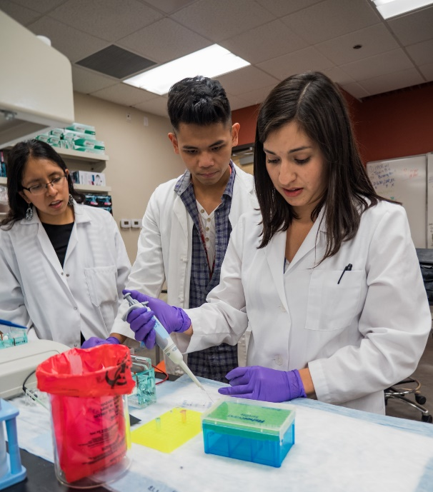
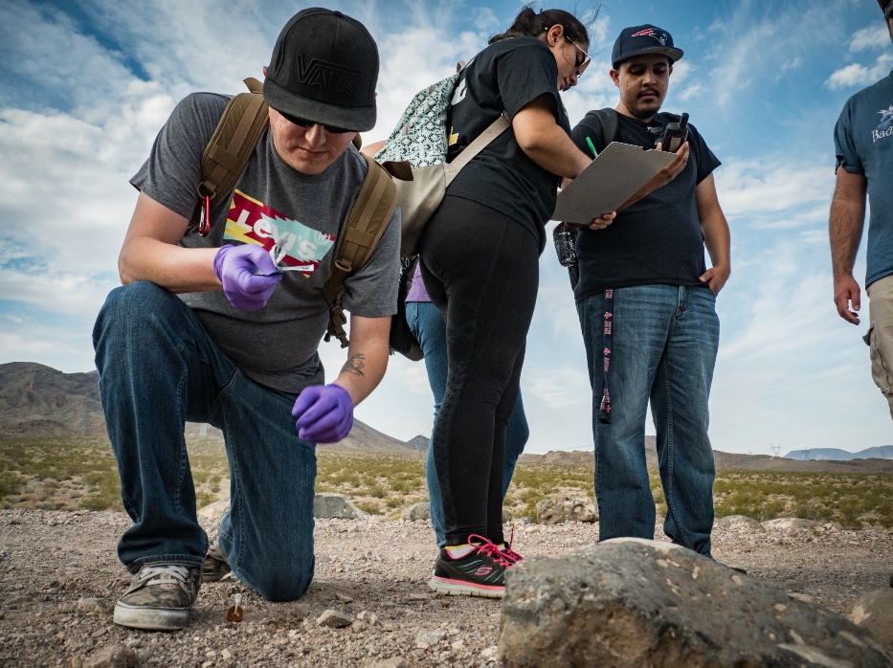
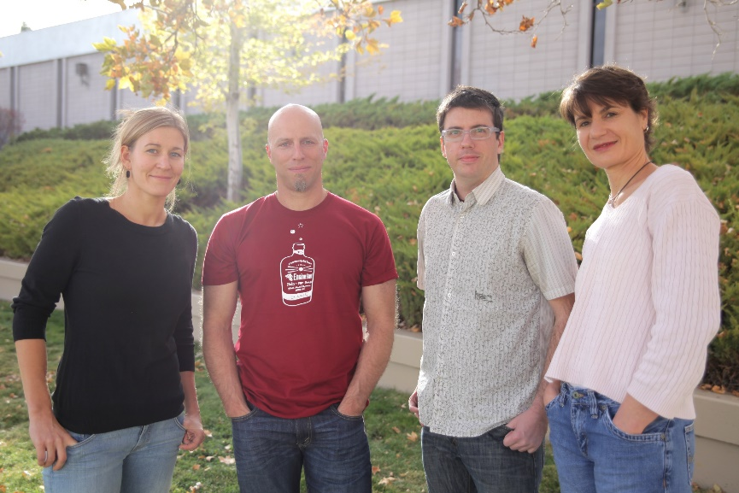

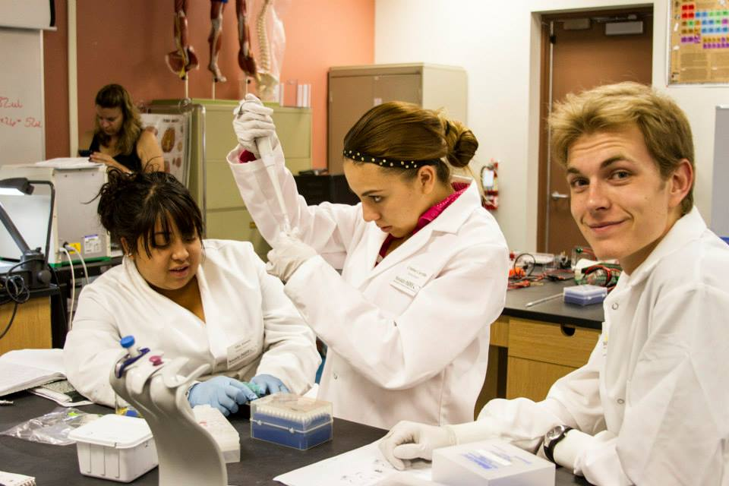
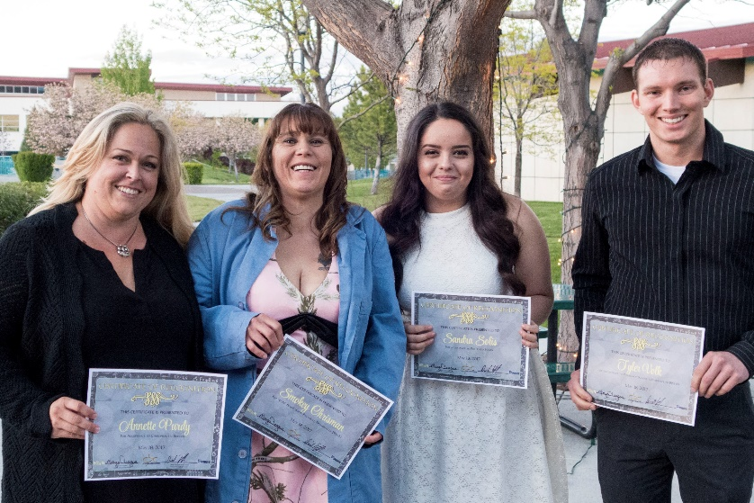
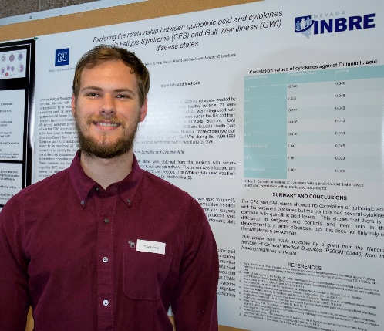

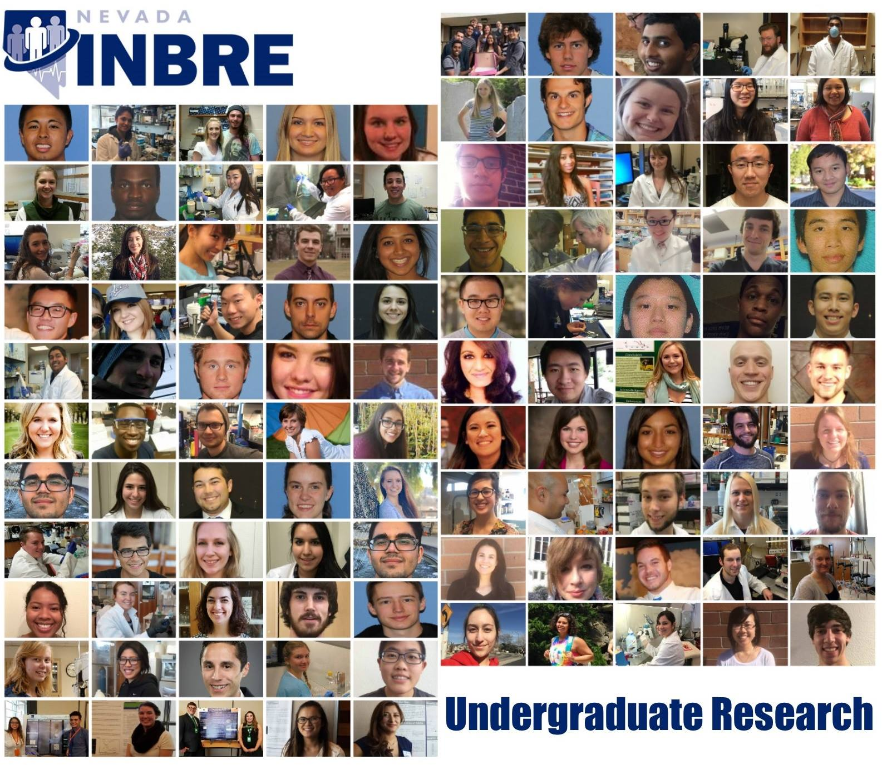

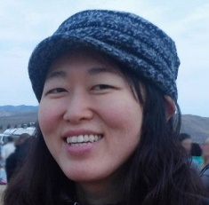
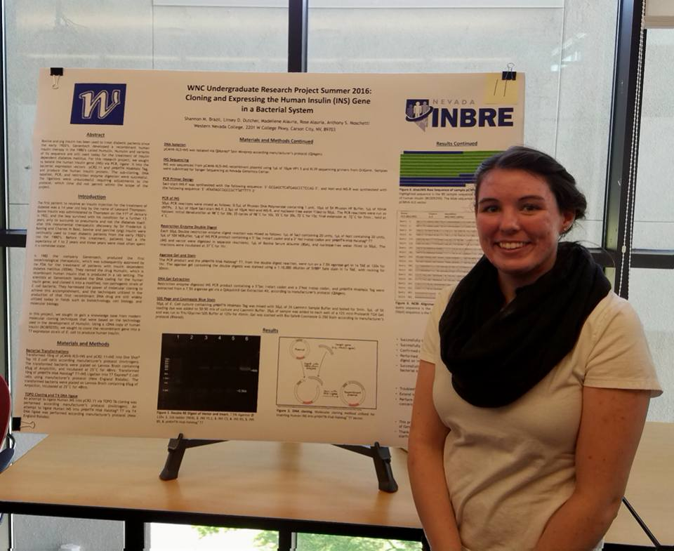
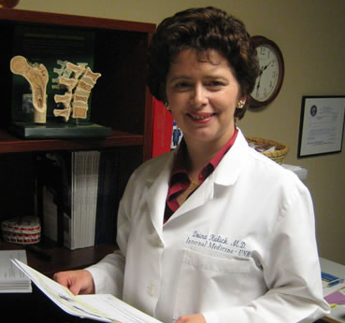
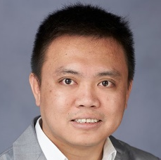
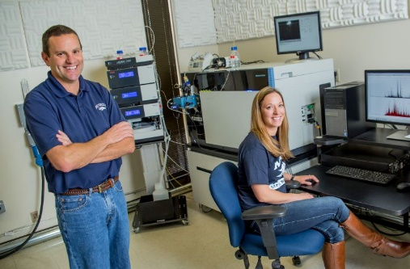
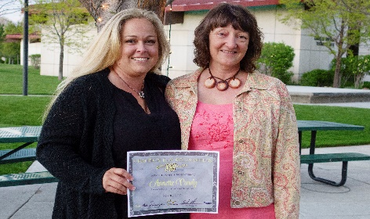

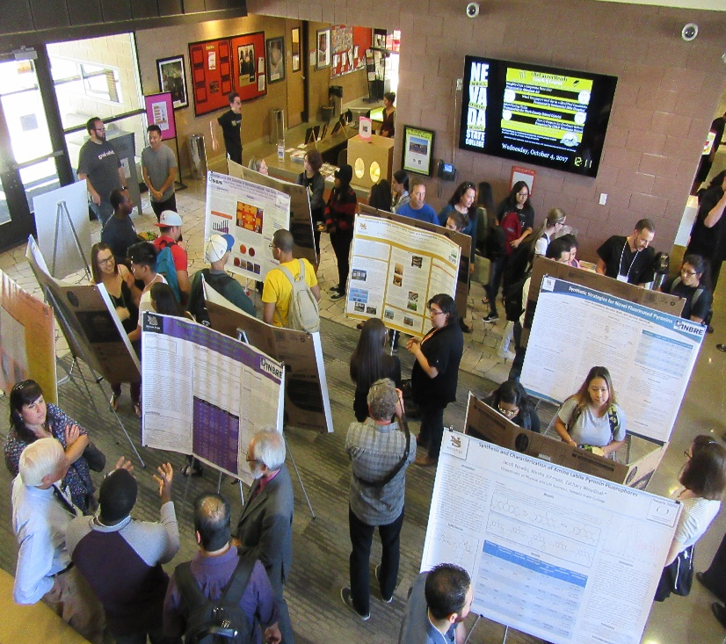
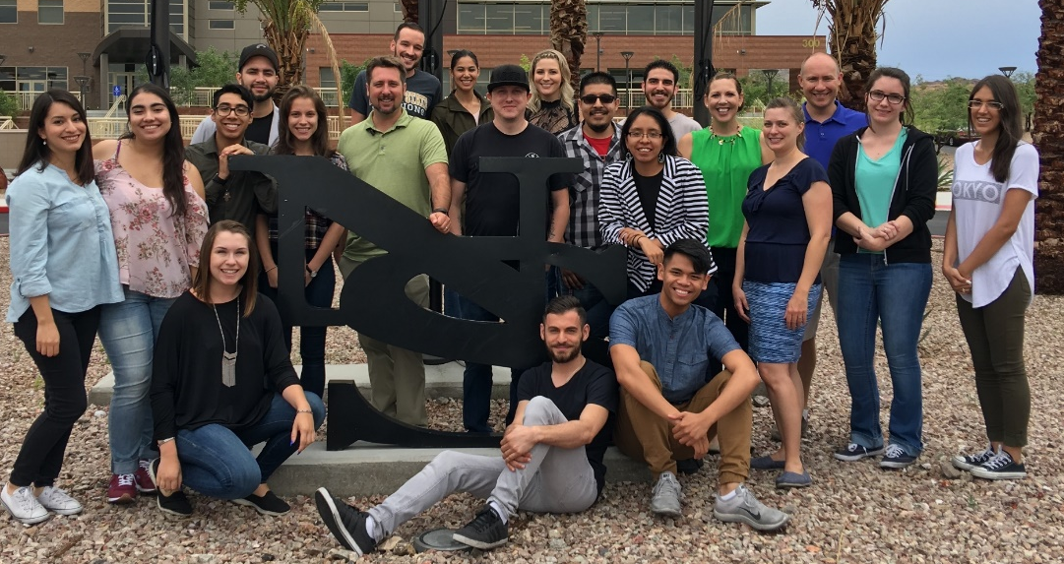

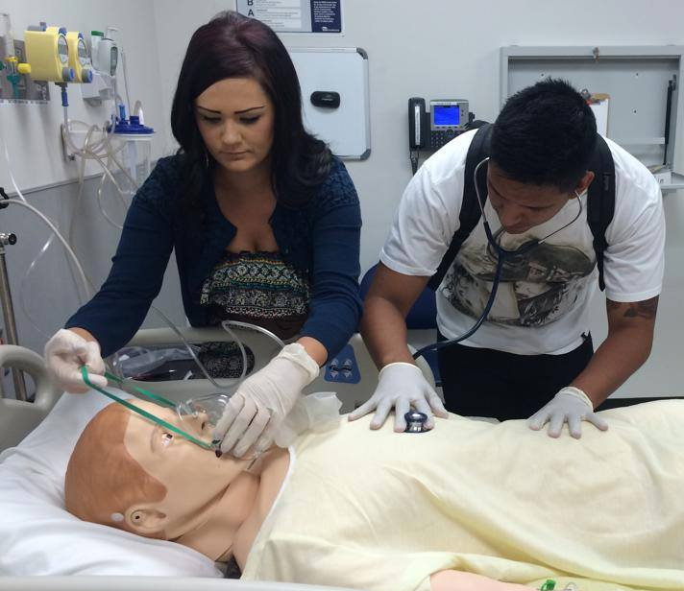
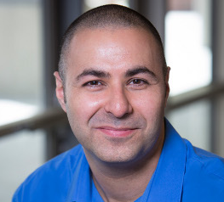

NV INBRE Goals:
Develop Scientific Cores
Minimize Redundancy in Core Services
Share Core Resources Statewide
Sustain Scientific Cores
Evaluate Cores

Slide 3
20 Years of Developing Scientific Cores in NV
Table I – Cores Established at UNR with NIH Support
Core | Support | Recharge
TEM | COBRE (VB) | No
Cell Metabolism | COBRE (VB) | No
Confocal Imaging | COBRE (VB) | No
Nevada Transgenic Center | COBRE (VB) | No
Tissue Culture Core | COBRE (VB) | No
Confocal Imaging | COBRE (VB) | No
Genomics Center | INBRE | Yes
Cell Sorting/Flow Cytometry | COBRE (Sanders) | Yes
Single Cell Molecular Expression | COBRE (Sanders) | Yes
Bioinformatics | INBRE | Yes
Proteomics | INBRE | Yes
In Vivo Imaging | INBRE | No
Neuroimaging Resources | COBRE (Webster) | No
Special Populations Database | COBRE (Webster) | No
Table II – Cores Established at UNLV with NIH Support
Core | Support | Recharge
Imaging | INBRE | No
Genomics | INBRE | Yes
Bioinformatics | COBRE (MS) | No
Proteomics | UNLV | No
Minimizing Redundancy Requires Significant Communication
Notes:
In a state the size of NV, need to make sure resources are complementary and not competing

Slide 4
Sustainability
Recharge
Scientific
Core
Core Support
User
Management
Service Contracts
Supplies
Salaries
Space
New Equipment
Sample Preparation
- Data Analysis
Consulting
Workshops
Paper/Grant Writing Help
Notes:
Recharge doesn’t cover it. Must decide the value. The fewer people its valuable to, the less core support there will be. Sell to the institution that it’s valuable, and the institution will support.

Slide 5
Our Scientific Cores Have Been Developed Locally but are More Sustainable Functioning Globally
Recharge
Scientific
Core
Core Support
User
Management
Service Contracts
Supplies
Salaries
Space
New Equipment
Sample Preparation
- Data Analysis
Consulting
Workshops
Paper/Grant Writing Help
Economy of Scale
Engage Stakeholders who Have Resources and Influence
Notes:
Recharge doesn’t cover it. Must decide the value. The fewer people its valuable to, the less core support there will be. Sell to the institution that it’s valuable, and the institution will support.

Slide 6

Challenges with Growth
Core Directors who have been using the core to support their own research enterprise.
Local Faculty Losing Time on Equipment.
Decreased Influence on Future Core directions/decisions
Diminished Ownership
If You Love it Let it Go

Slide 7
Local Core = Local Users = Local Core Support
Global Core = Global Users = Global Core Support
Recharge
Scientific
Core
Core Support
User
Management
Service Contracts
Supplies
Salaries
Space
New Equipment
Sample Preparation
- Data Analysis
Consulting
Workshops
Paper/Grant Writing Help
Notes:
Recharge doesn’t cover it. Must decide the value. The fewer people its valuable to, the less core support there will be. Sell to the institution that it’s valuable, and the institution will support.

Slide 8
NIH Administrative Supplement for Core Sustainability Awarded 2017
Specific Aims:
1. Centralize core administration at UNR. This will minimize administrative overhead for all UNR cores and will make all core services more accessible to INBRE outreach institutions and business and entrepreneurial partners alike. To maximize buy-in and support from different stakeholders, we have obtained state, business, and institutional commitment (Nevada Center For Applied Research, The Knowledge Fund, the Nevada Governor’s Office, and the office of the Vice President for Research and Innovation at UNR), and we have budgeted time and effort for key core administrators. The resulting one-stop menu for core services and educational outreach will improve visibility and accessibility for our NV INBRE core outreach program.
2. Consolidate Bioinformatics, Proteomics, and Genomics at UNR. This will coordinate efforts of these three cores, minimizing redundant processes (purchasing, budgeting, reporting, personnel, etc.), broadening expertise, and ensuring cohesive and coordinated management of common analytical pipelines.

Slide 9
NIH Administrative Supplement for Core Sustainability Awarded 2017

Slide 10
What Worked
UNR Office of the VPR Owned Centralized Cores
  Created three new Director positions for these cores.
  Assumed responsibility for Evaluating Cores
  Requested support from colleges/schools that use the cores.
  Improved Web Sites
  In general provide much more support for and promotion of these Cores
Recharge, Core Management Software, and Service Awards
  Improved Access by Users
  Improved Sustainability of Core
  Improved Time Management of Core Personnel
  Forced cores toward a culture of service

Slide 11
What Didn’t Work
Basic Existential Threats Still Exist
  Do the cores serve a need that can’t be met for less through external services?
  Is the cost of maintaining state-of-the-art genomics and proteomics equipment prohibitive?
Bioinformatics projects are difficult to manage.

Slide 12
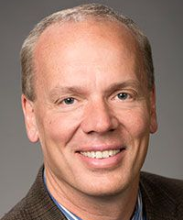

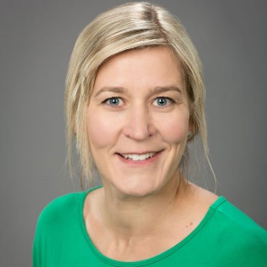

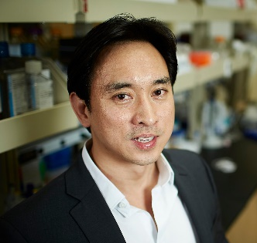
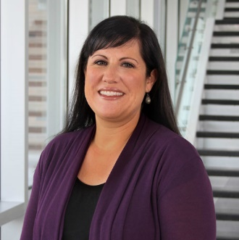
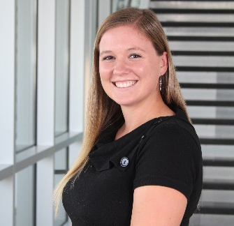
Dr. Josh Baker
Principal Investigator/Director
Dr. Eduardo Robleto
Project Coordinator
Dr. Juli Petereit
Bioinformatics Core Co-Director
Dr. Carolee Dodge Francis
Statewide Outreach Director
Dr. Edwin Oh
Bioinformatics Core Co-Director
Jessica Garfield, M.A.
Director of Operations
Alexandria Martinez
Administrative Specialist

