Slide 1
Light Microscopy Research Group Study 3: The Development and Implementation of New Tools for Microscope Quality Assurance Testing
Ben Abrams
University of California Santa Cruz
Life Sciences Microscopy Facility
Institute for the Biology of Stem Cells
Notes:
Hello, my name is Ben Abrams and I direct the Life Sciences microscopy facility at UC Santa Cruz. Today I will be speaking to you as a proud member of ABRF light microscopy research group, and I will be talking about some of the work we are doing towards creating standards for microscopy. I am honored to be able to speak to you today and would like to thank the organizers and the LMRG chair, Kris Kubow, for this opportunity.

Slide 2

Light Microscopy Research Group (LMRG)
Mission:
Promote scientific exchange between researchers, specifically those in core facilities in order to increase our general knowledge and experience.
We seek to provide a forum for multi-site studies exploring “standards” for the field of light microscopy.
Our Studies seek to:
Reach a broad and international audience of participants
Use samples that are affordable and readily available
Use protocols that are easy to follow and provide enough detail so that non-expert users can participate
Be applicable across multiple instrumentation platforms
Notes:
The LMRG is really an organization that holds rigor and reproducibility close to heart. Our mission is to promote…
And we seek to provide a platform for multi-site + multi-institution experiemt
And the studies that we’ve designed seek to….

Slide 3
A Brief History of Performance Standards for Light Microscopy
State of performance standards in light microscopy circa 2009
    vendor initiated – none / acceptance specs only
    National Institute of Standards and Technology (NIST) -- none
    imaging community at large – lab specific
Why ? – historically, simply observing a specimen was sufficient;
However, advances in microscope technology and it’s prevalence in modern research necessitate traceable standards & procedures
Development of performance standards (case study: mass spectrometry)
    started with minimal vendor-based tuning & MW calibration compounds
    NIST:
      - NIST Standard Reference Data Program -
      mass spectra for over 15,000 compounds
      - NIST Standard Reference Materials –
      performance standards & mixtures available for
      LC/MS, GC/MS, ICP-MS & Isotope-ratio MS
    The MS community:
      vendor standards are readily available
      standardized acceptance criteria are common
Notes:
So what was the impetuous for the this mission?...At the time the time the LMRG was formed…not much existed in the way of broad performance standards for light microscopy.
At the time, the LMRG was able to take some cues about what was possible in standards development from what was going on in Mass Spec. which started with…
and was followed with NIST’s Reference data and reference materials programs.
It is my understanding that lab specific acceptance criteria and

Slide 4
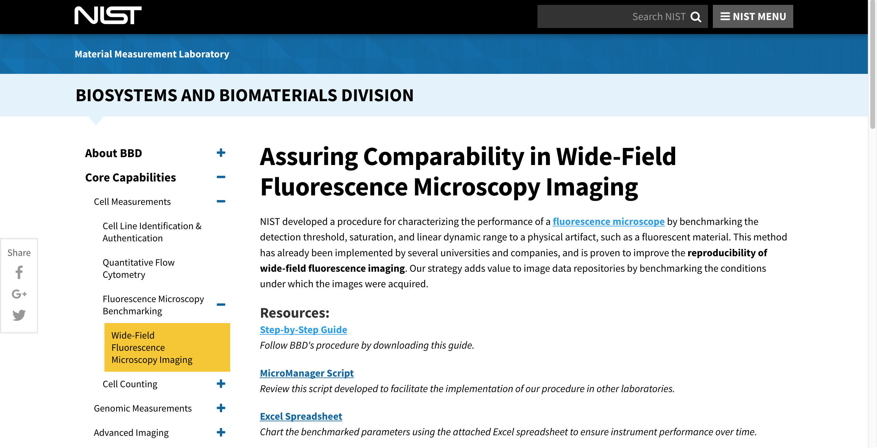
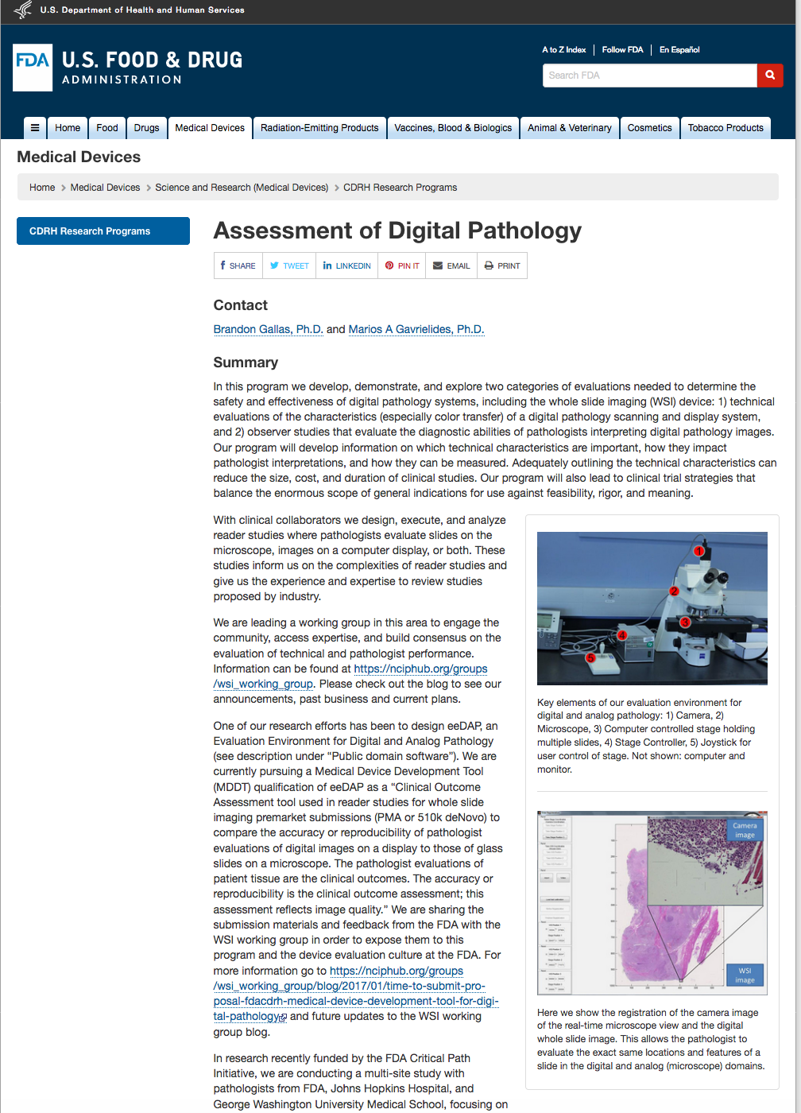
Today: NIST, FDA, are Participating in the Development of Standards for Microscopy
.
Notes:
Today things are changing and we have participation…from NIST and the FDA – especially for clinically relevant applications

Slide 5
The Aim of the First LMRG Studies has Been to:
Define and improve relative testing standards
Assess the current state of light microscope performance
Goal: Improve the validity of quantitative measurements
Notes:
The underlying theme of the first LMRG studies has been to
assess the current state of microscope performance, AND define and improve relative testing standards
with the goal of improving the validity of quantitative measurements.

Slide 6
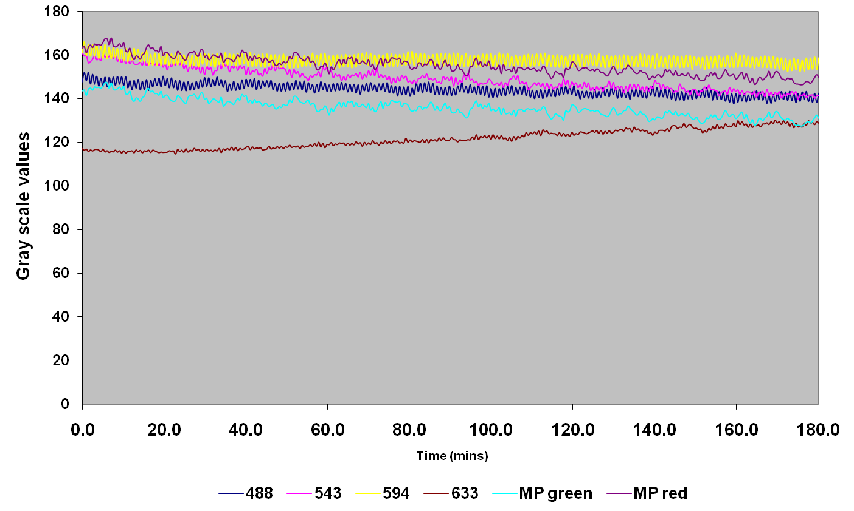
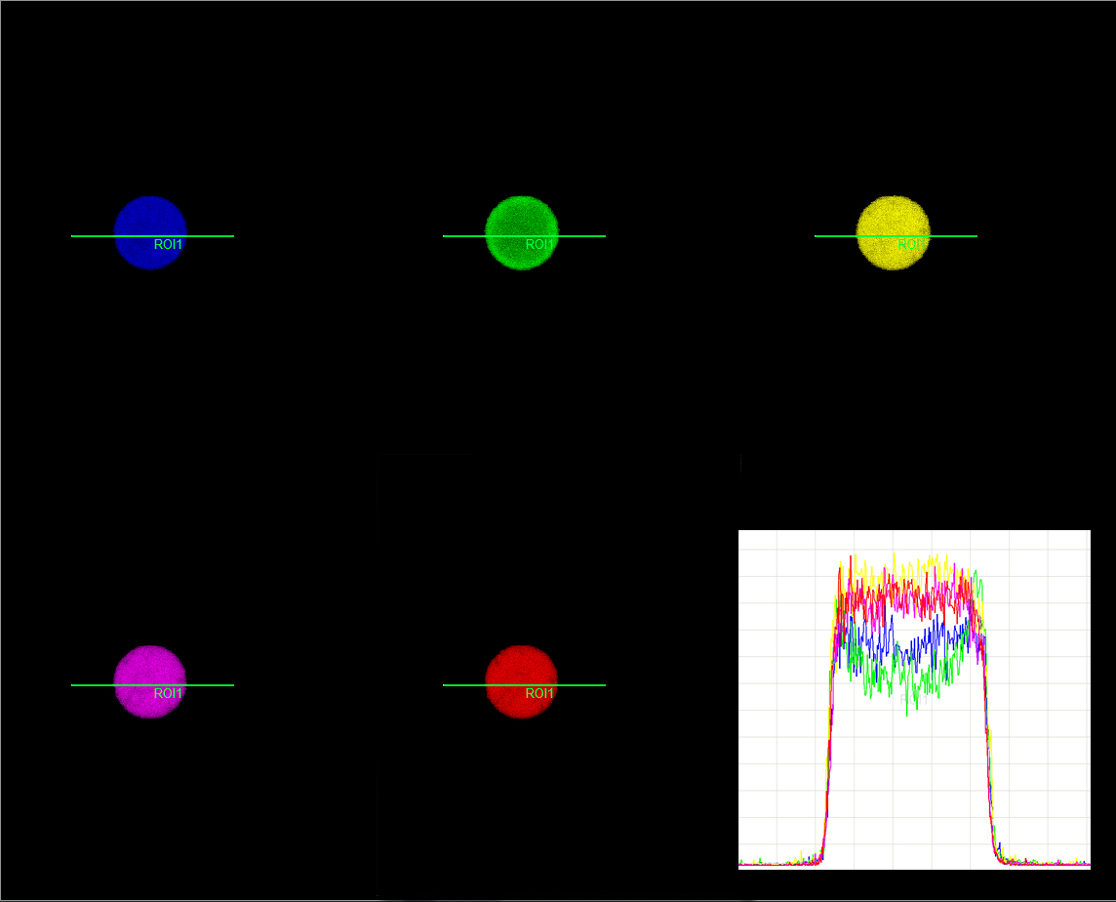
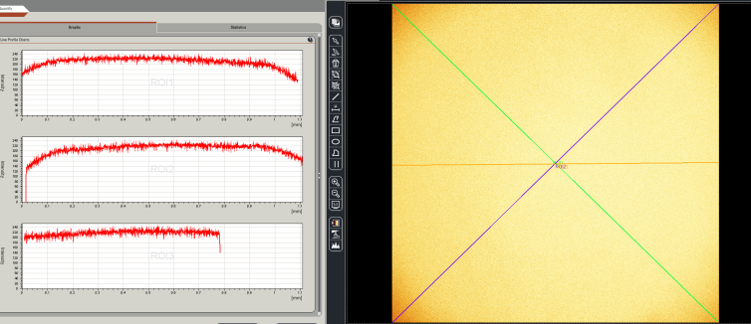
In Study 1 the LMRG Developed Tools to Benchmark Systems in Three Areas
Illumination stability during short (5 min.) and long (3 hr.) image acquisitions
Detector co-registration
Illumination uniformity across the entire scan field
Stack et al. Microscopy & Microanalysis 2011
Notes:
23 labs from 8 countries

Slide 7
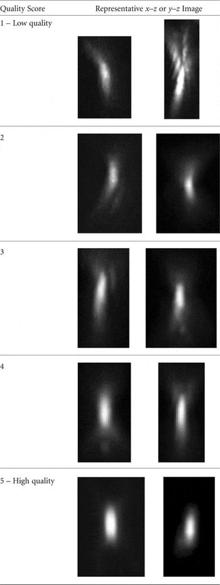
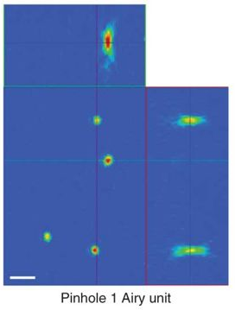
Study 2 Focused on Quality Determination in Four Areas of Laser Scanning Confocal Microscopy
Lens Quality
Resolution
Spectral detector accuracy
Spectral separation algorithms
Cole et al. Nat. Protoc. 2011
Cole et al. Microscopy & Microanalysis 2013
Notes:
Continued the theme of the first study and …

Slide 8
The Goal of LMRG Study 3 has been to Create 3D Biologically-Relevant Test Sample and Protocols to Evaluate Microscope Performance
Phase 1: Test sample development
  Phase 2: Data Acquisition and Analysis
    Intensity Analysis: determine if the ability to measure relative object intensity changed with depth
    Signal-to-noise (SNR): determine if the object SNR varied with depth
    Point Spread Function (PSF) Analysis: assess resolution and PSF distortions as a function of depth over a 100μm range.

Slide 9
The Goal of LMRG Study 3 has been to Create 3D Biologically-Relevant Test Sample and Protocols to Evaluate Microscope Performance
Phase 1: Test sample development
  Phase 2: Data Acquisition and Analysis
    Intensity Analysis: determine if the ability to measure relative object intensity changed with depth
    Signal-to-noise (SNR): determine if the object SNR varied with depth
    Point Spread Function (PSF) Analysis: assess resolution and PSF distortions as a function of depth over a 100μm range.

Slide 10

Sample Development: Two Different Test Slides were Developed for this Study
Each test slide consisted of:
Standard microscope slide
120μm thick double adhesive spacer
CyGELTM (refractive index, n=1.37) + Test bead slurry
  Intensity and SNR analysis - 2.5μm red and green beads
  PSF analysis – 0.1μm green beads
A #1.5 coverslip

Slide 11
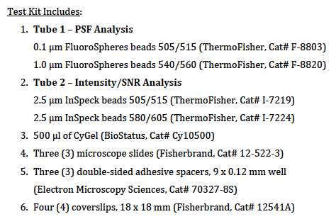

Sample Kits were Mailed Out
Microspheres, CyGelTM, and spacers

Slide 12
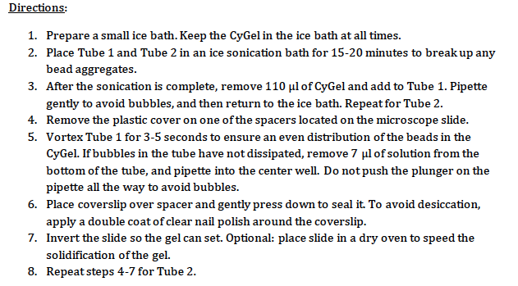
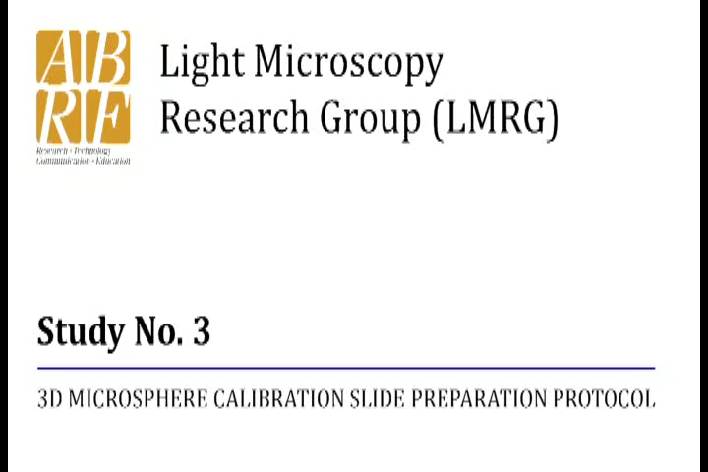
Detailed Protocols Were Sent out with Each Kit and Video Instructions Were Posted on the LMRG Website
Text:
Video:

Slide 13
We Received Image Data from 15 Countries

Slide 14
Image Data was Generated on Instruments from Four Different Manufacturers

Slide 15
We Received Data Generated on Different Models from Each Manufacturer

Slide 16
The Goal of LMRG Study 3 has been to Create 3D Biologically-Relevant Test Sample and Protocols to Evaluate Microscope Performance
Phase 1: Test sample development
  Phase 2: Data Acquisition and Analysis
    Intensity Analysis: determine if the ability to measure relative object intensity changed with depth
    Signal-to-noise (SNR): determine if the object SNR varied with depth
    Point Spread Function (PSF) Analysis: assess resolution and PSF distortions as a function of depth over a 100μm range.

Slide 17
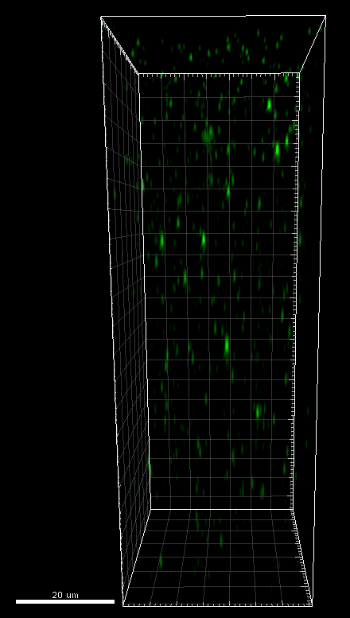
Example Data and Acquisition Conditions
Intensity & SNR Slide
Beads: Green(505/515) = 2.5 µm
  Red(580/605) = 2.5 µm
Voxel_{xyz} size of 0.2 µm ~ 0.3 µm x 0.2 µm ~ 0.3 µm x 1.0 µm
Beads: Green(505/515) = 0.1 µm
Voxel_{xyz} size: 0.07µm x 0.07µm x 0.2 µm
PSF Slide

Slide 18
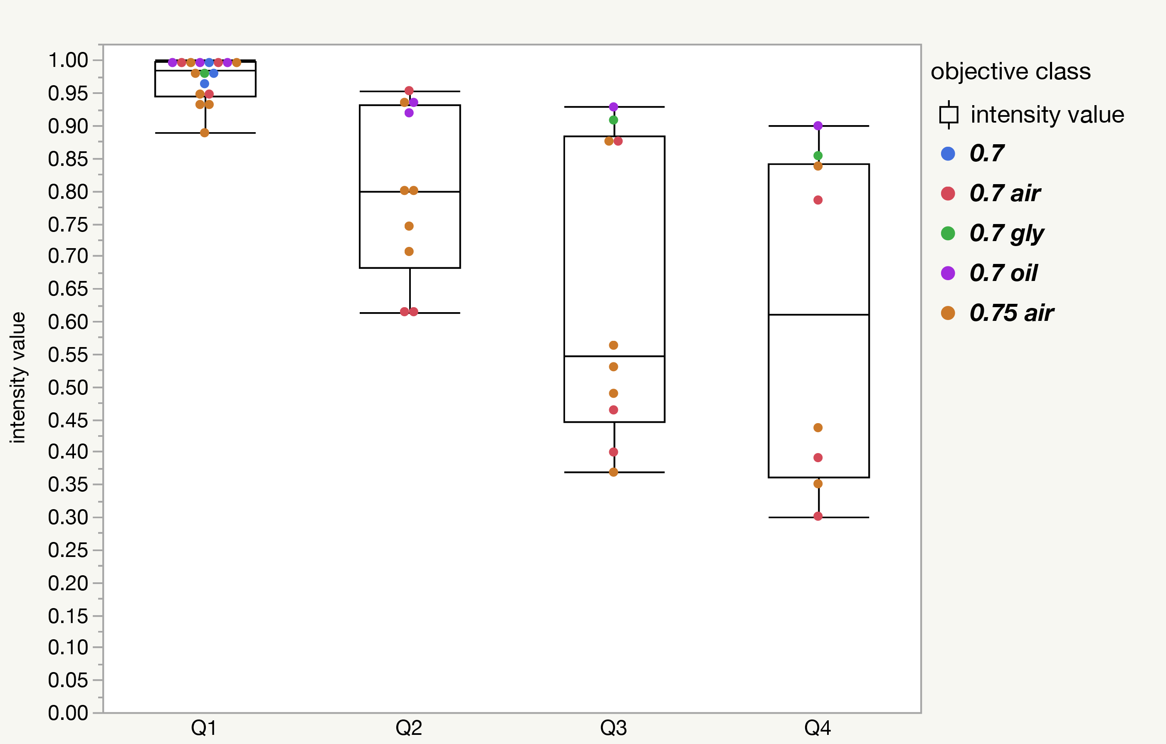
Intensity vs. Depth for High Intensity Red Beads
Q1 = 0-25μm
Q2 = 26-50μm
Q3 = 51-75μm
Q4 = 76-100μm

Slide 19
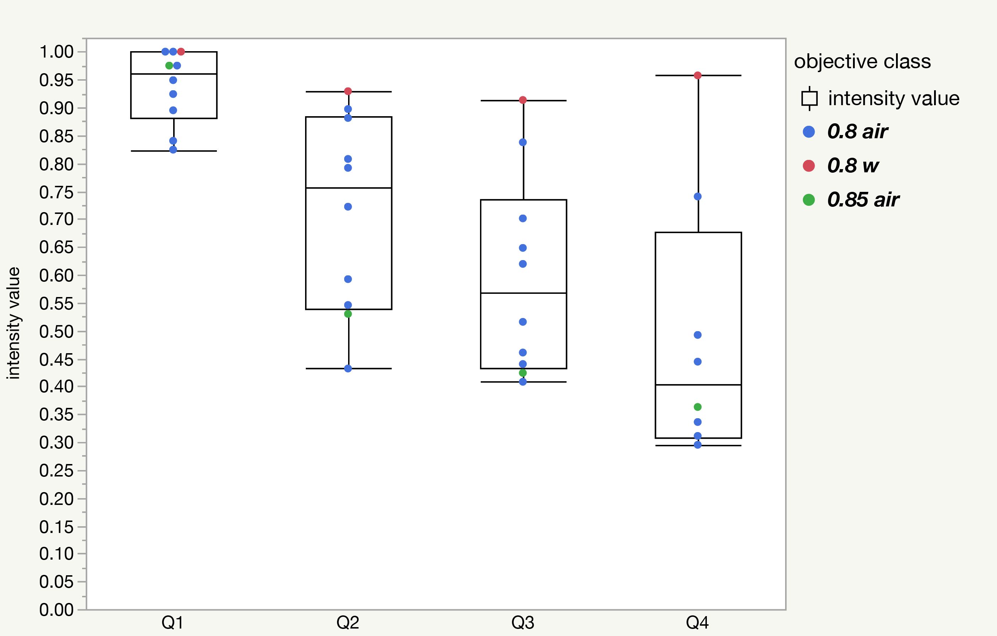
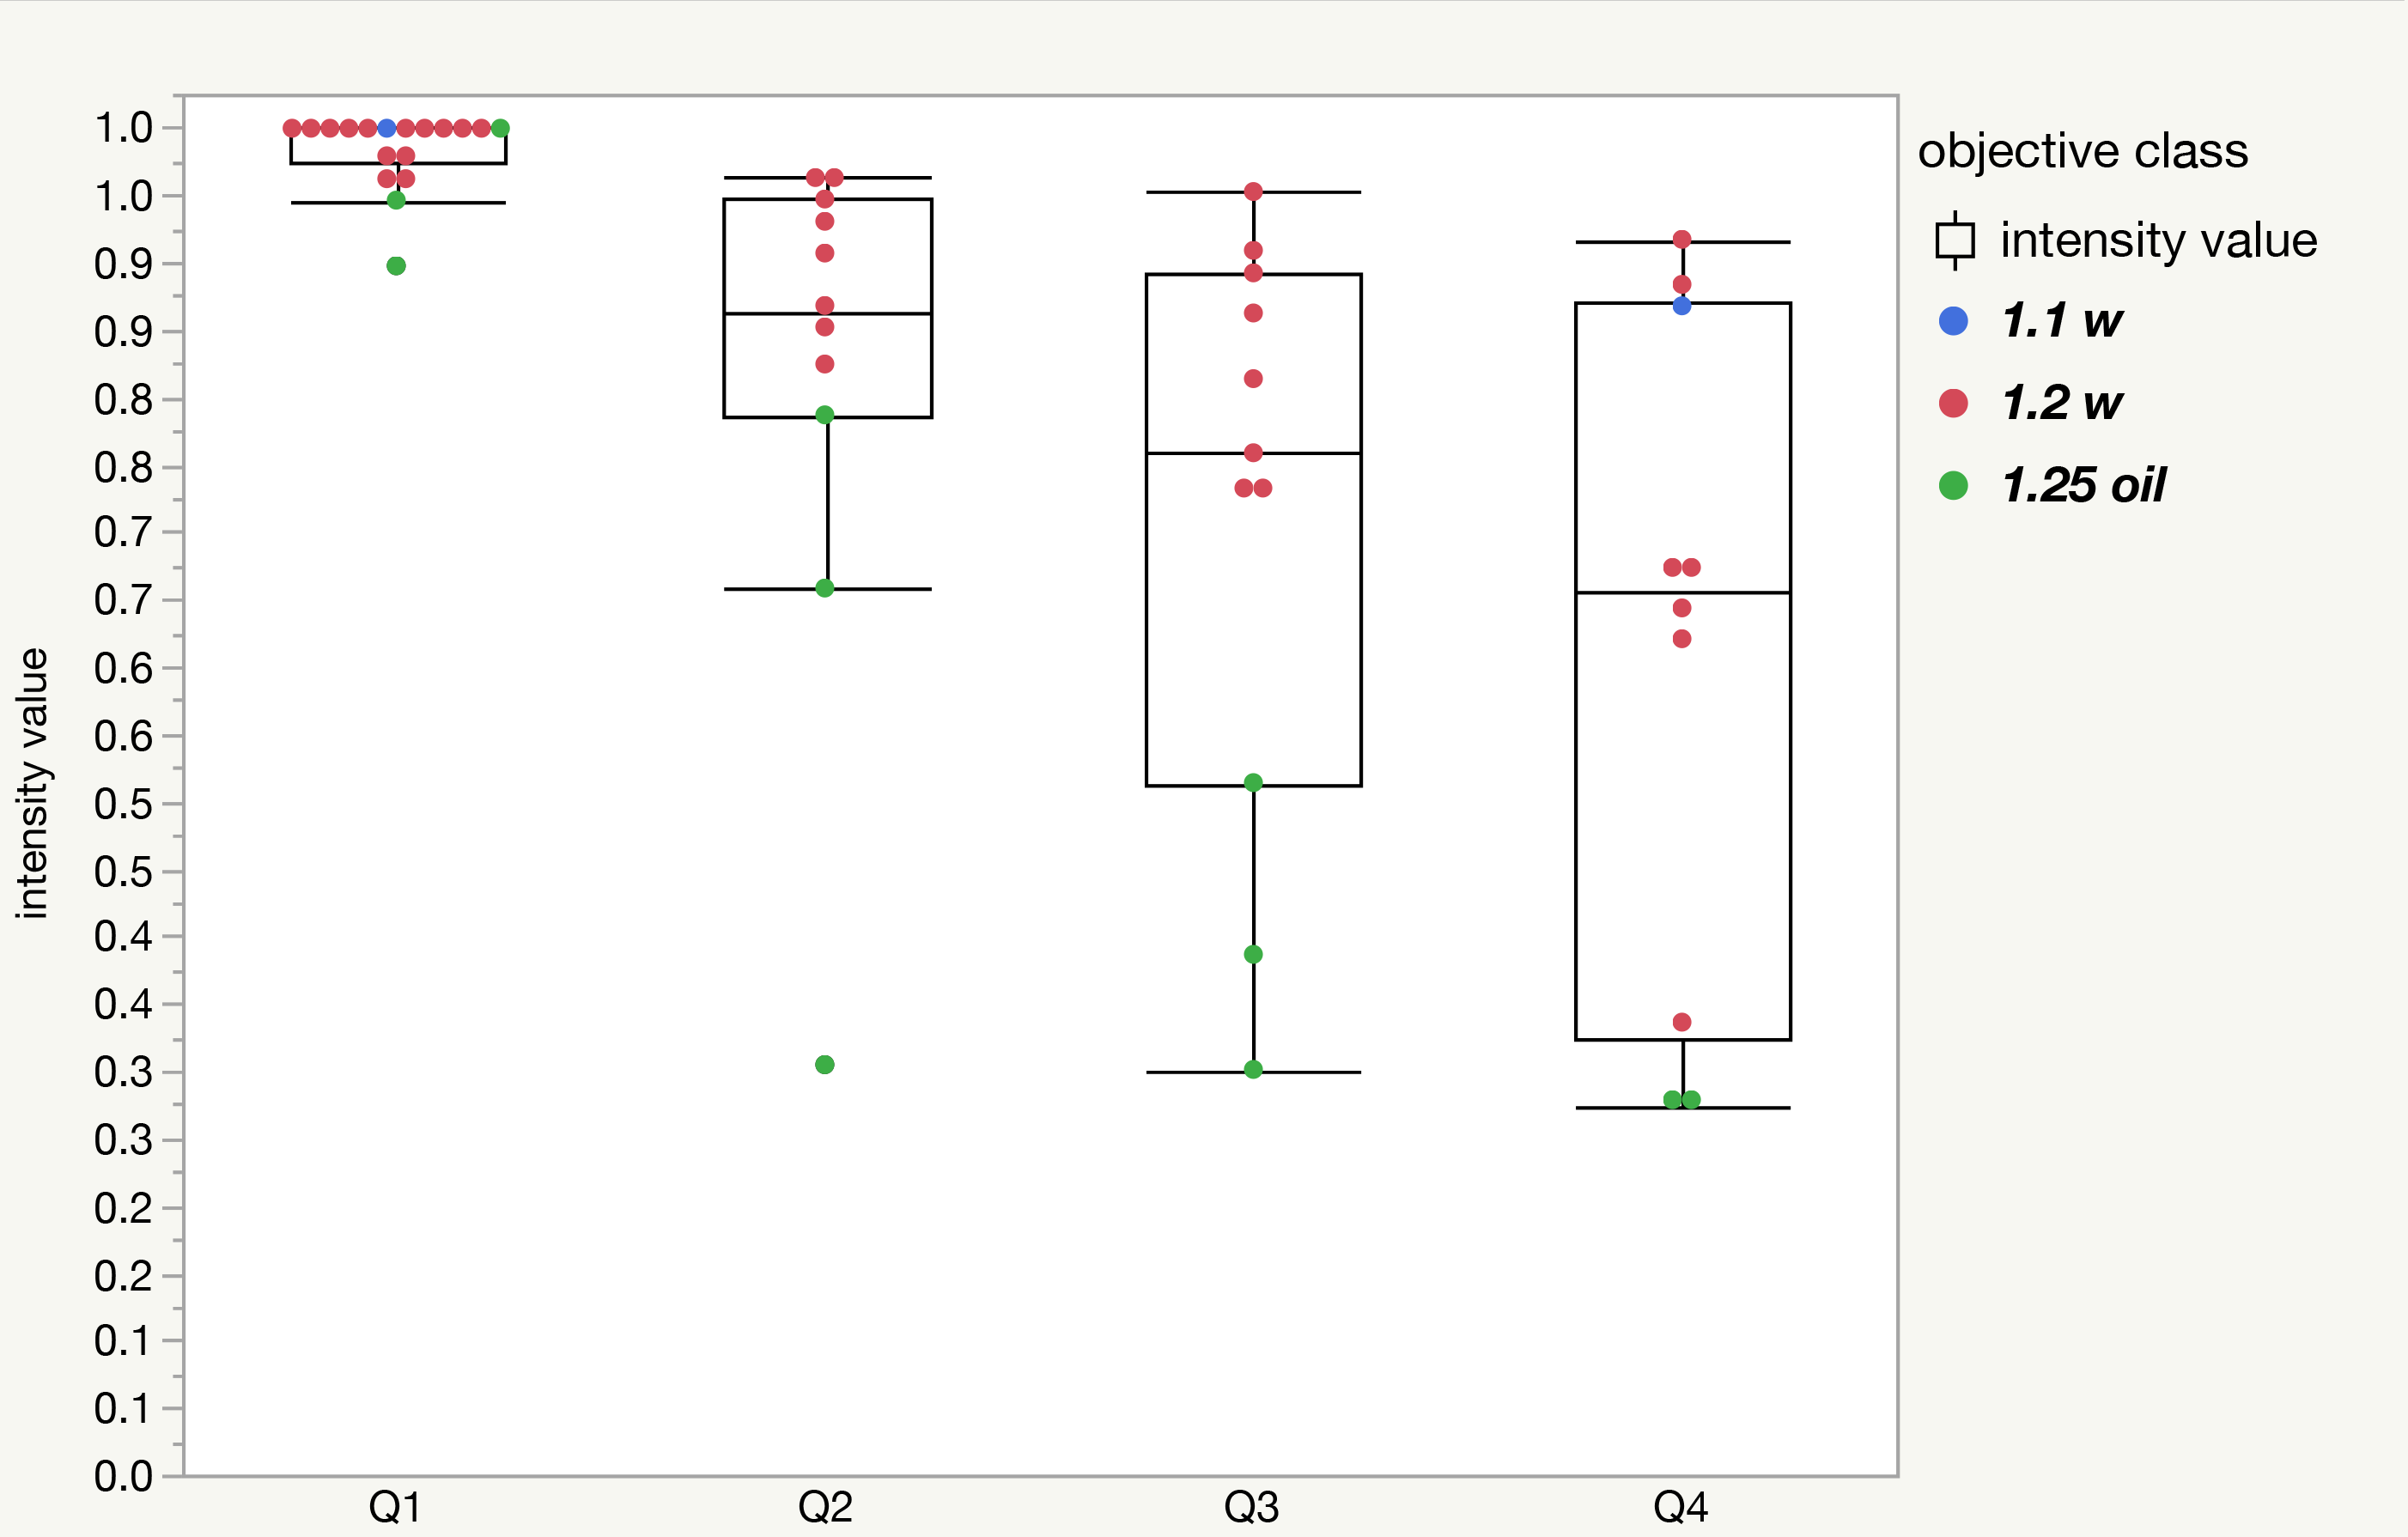
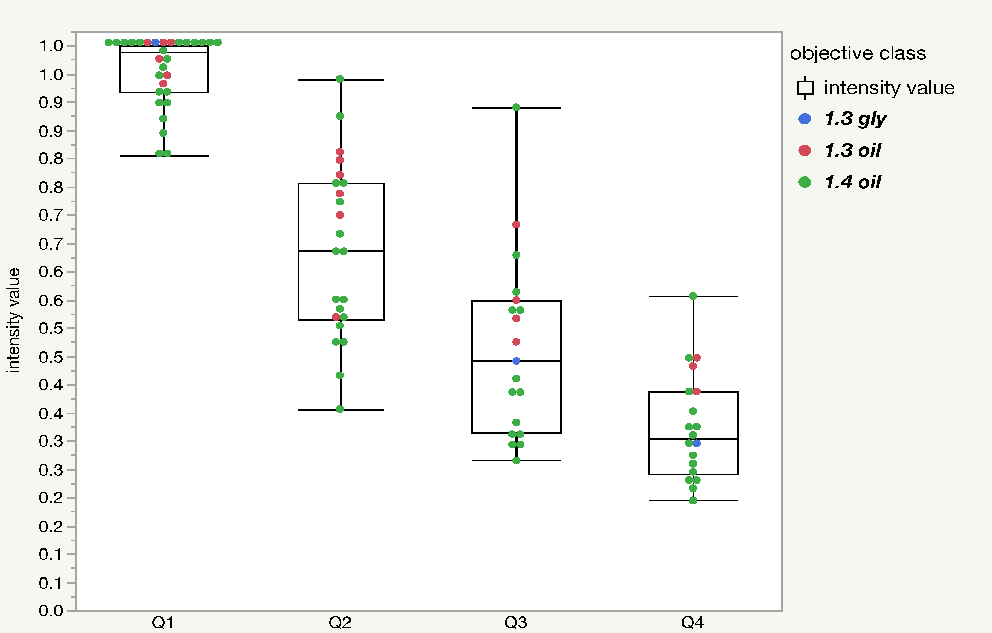
Intensity vs. Depth for High Intensity Red Beads
n=17 datasets. All pairwise t-tests gave p < 0.05, except Q3:Q4.
n=10 datasets. All pairwise t-tests gave p < 0.05, except Q2:Q3, Q3:Q4.
n=18 datasets. All pairwise t-tests gave p < 0.05, except Q2:Q3, Q3:Q4.
n=30 datasets. All pairwise t-tests gave p < 0.05.

Slide 20
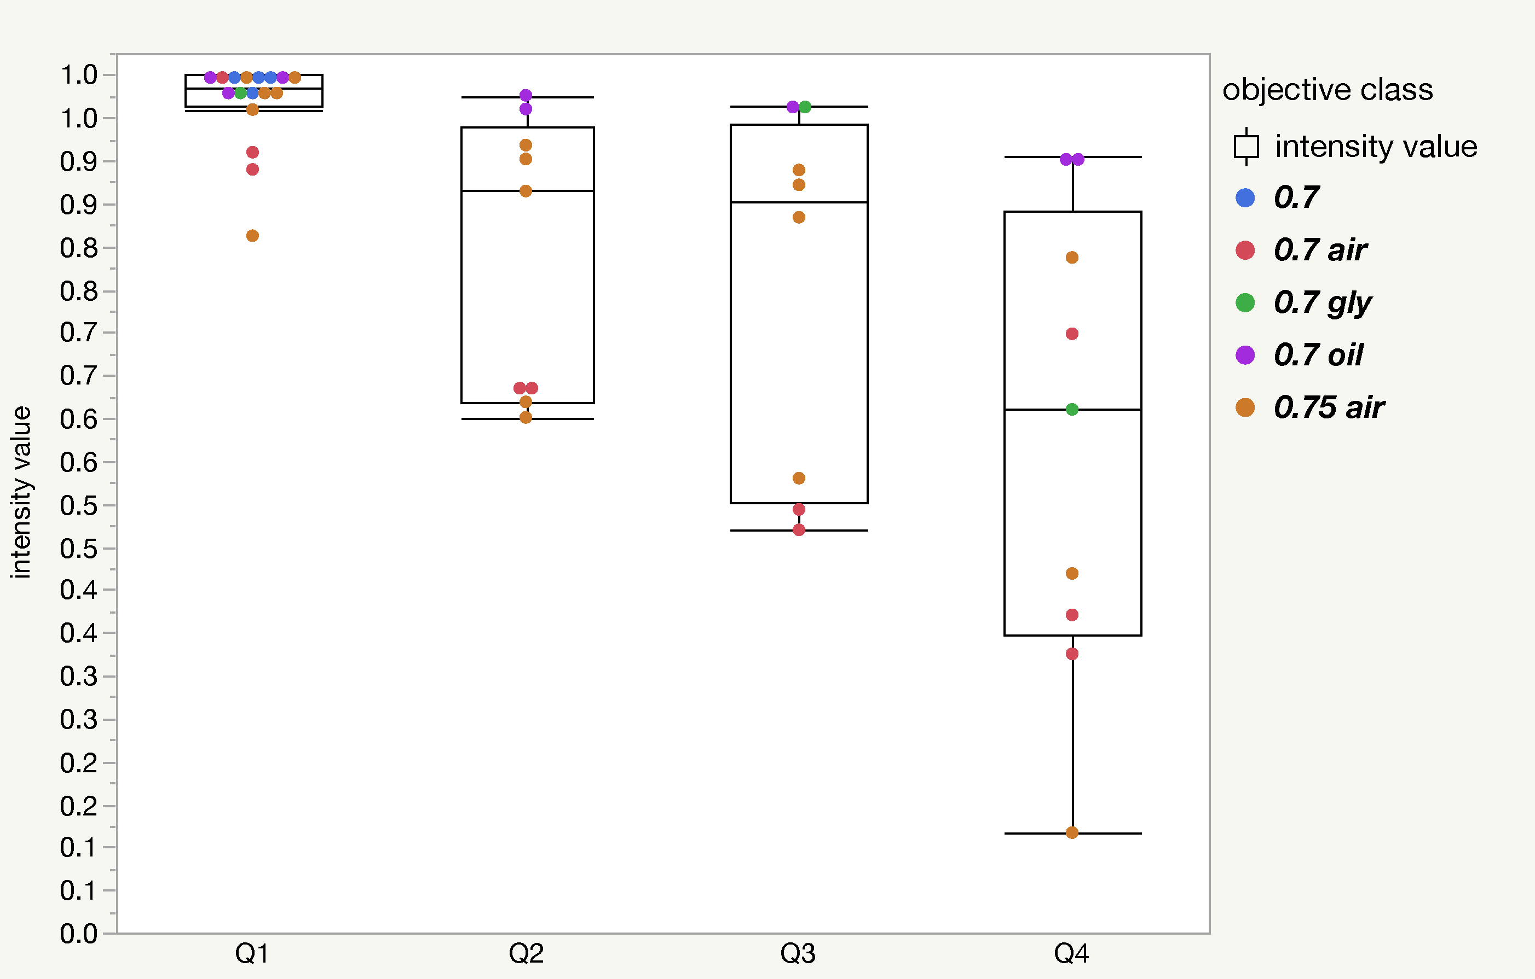
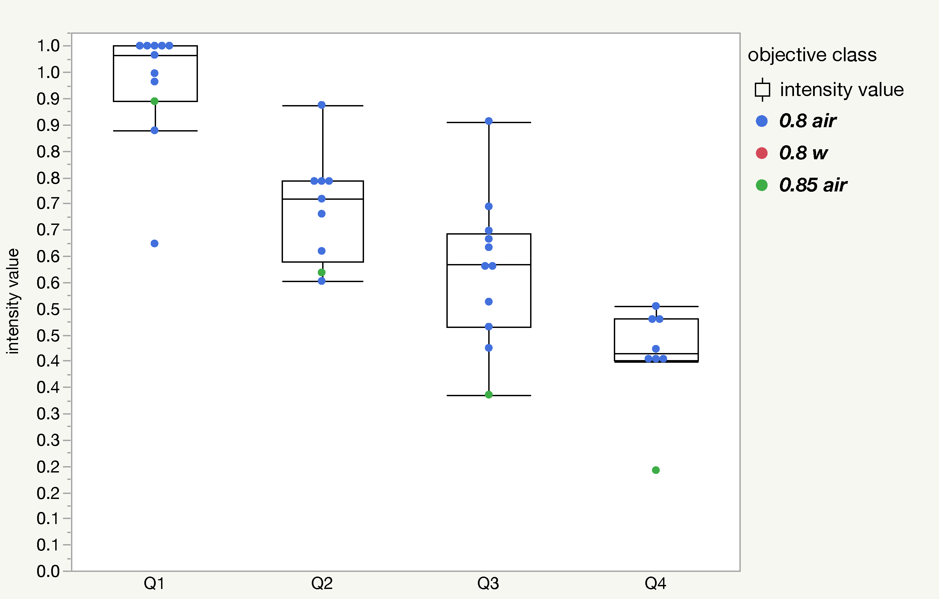
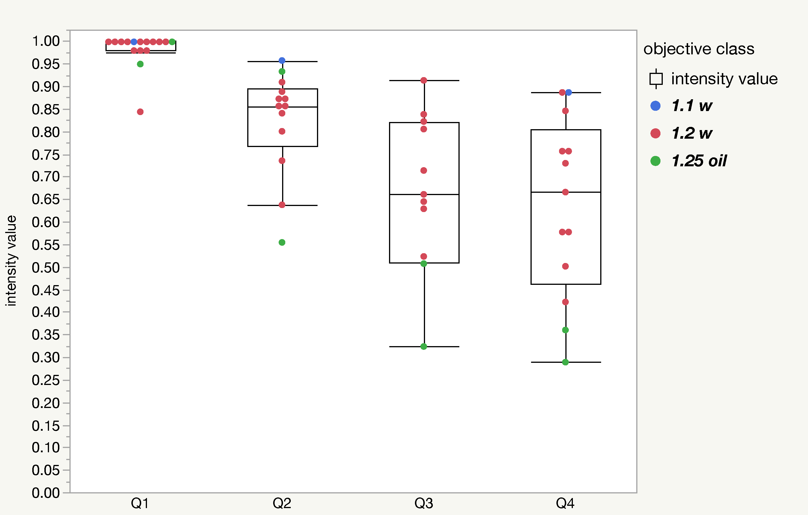
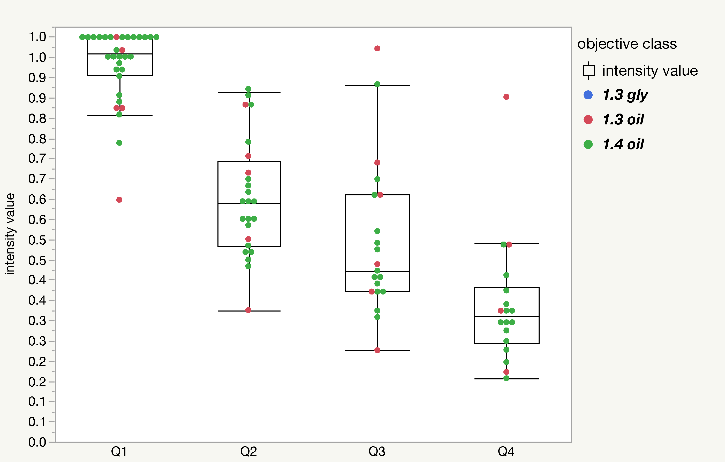
Intensity vs. Depth for Low Intensity Red Beads
n=18 datasets. All pairwise t-tests gave p < 0.05, except Q2:Q3.
n=14 datasets. All pairwise t-tests gave p < 0.05.
n=23 datasets. All pairwise t-tests gave p < 0.05, except Q3:Q4.
n=44 datasets. All pairwise t-tests gave p < 0.05.

Slide 21
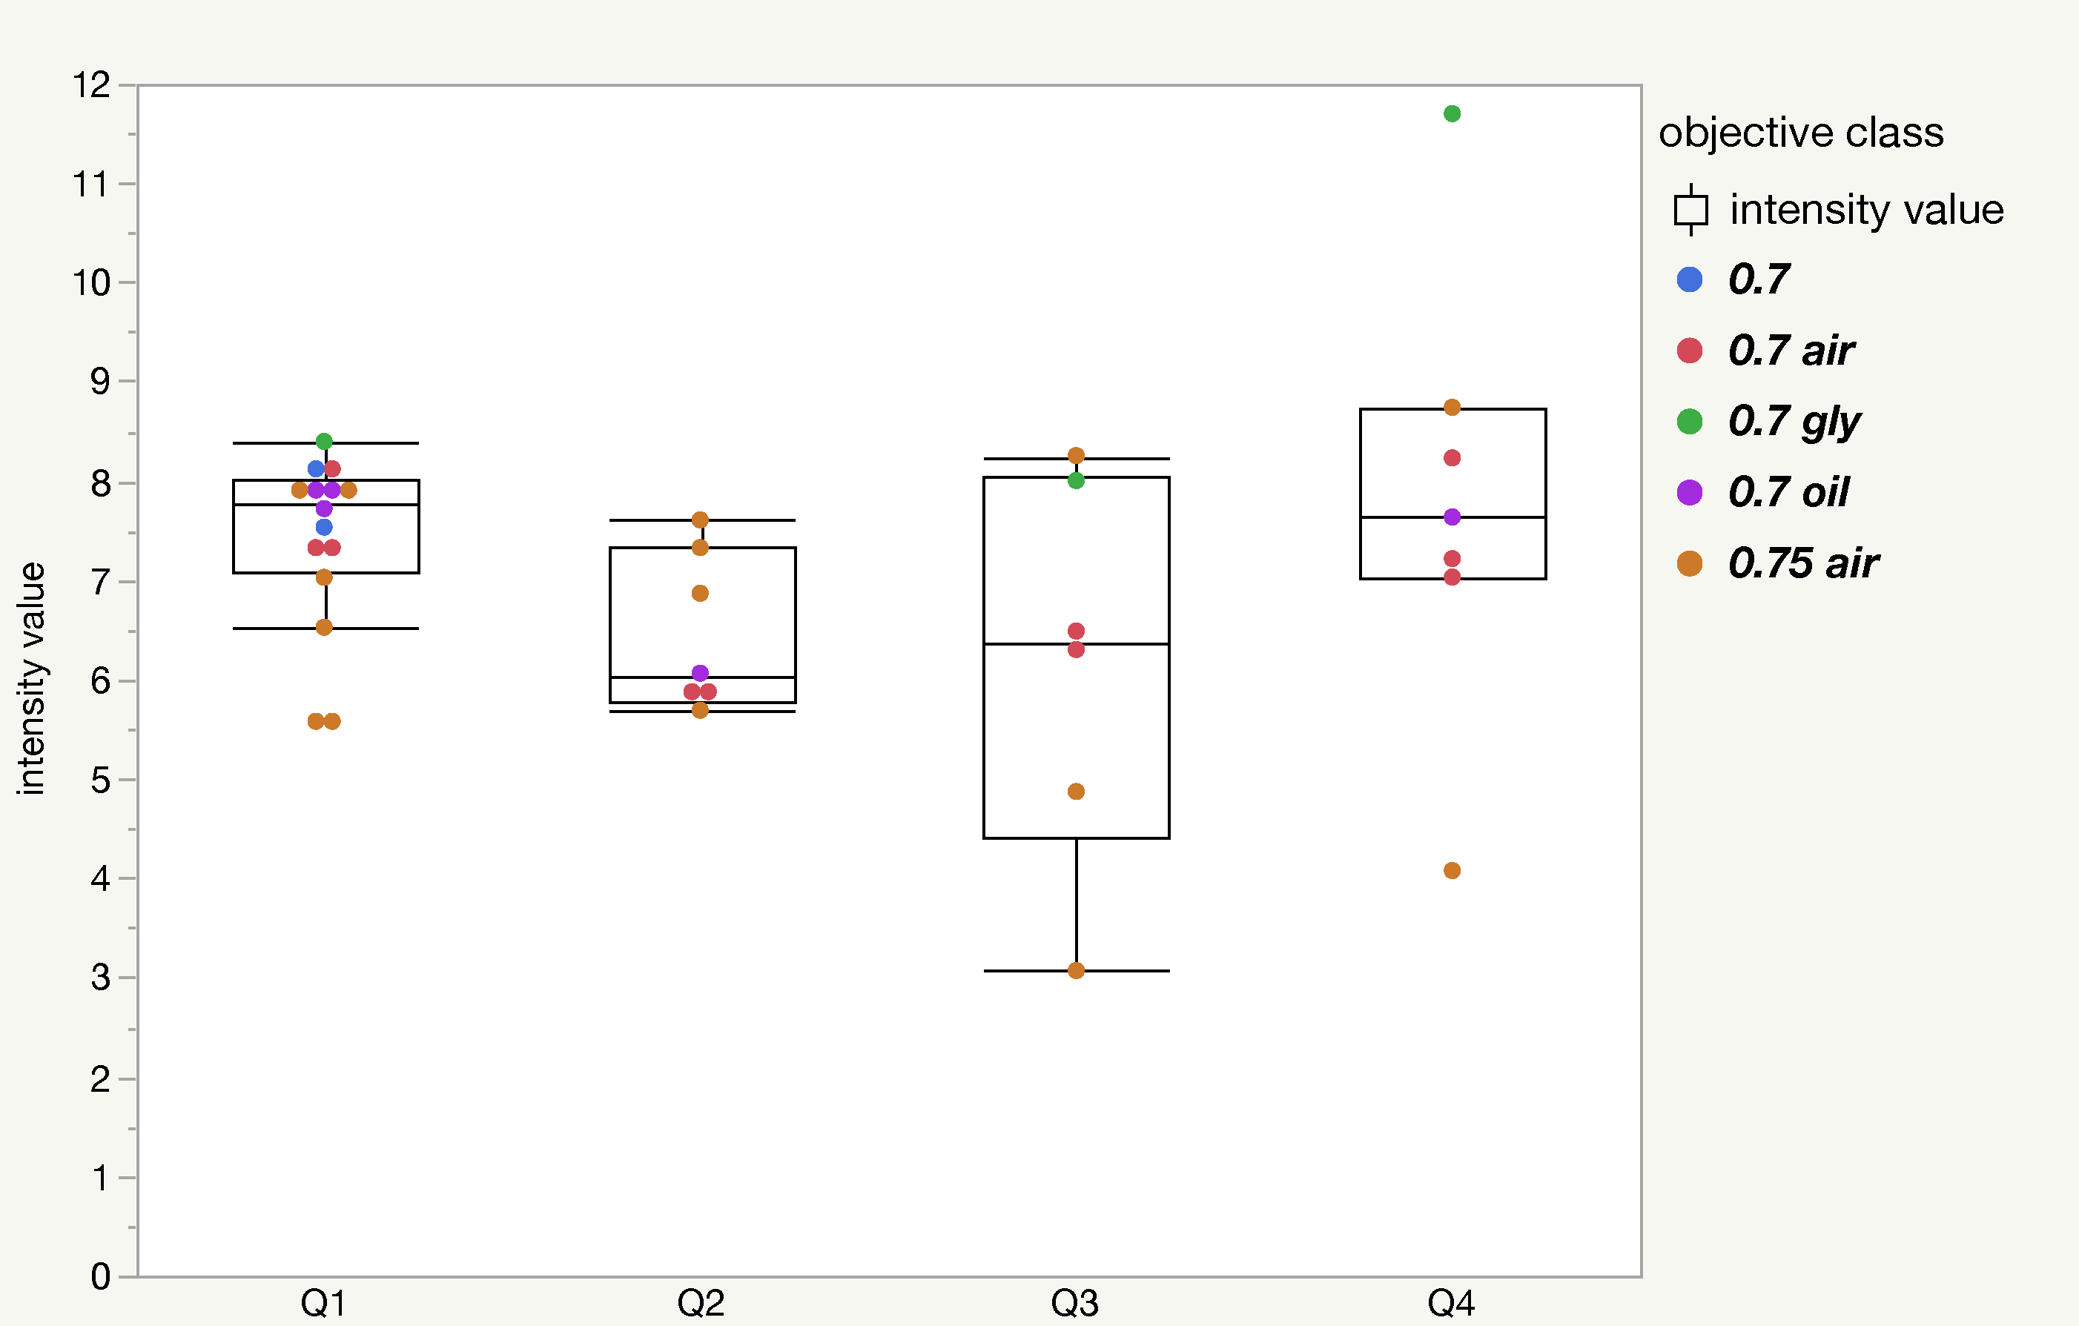
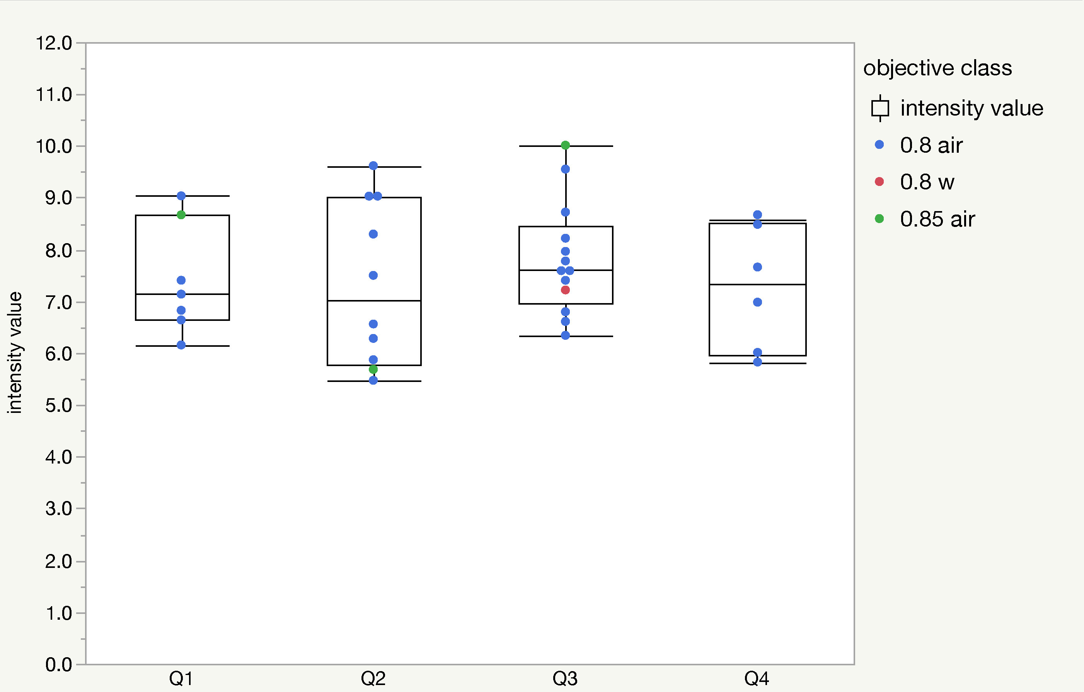
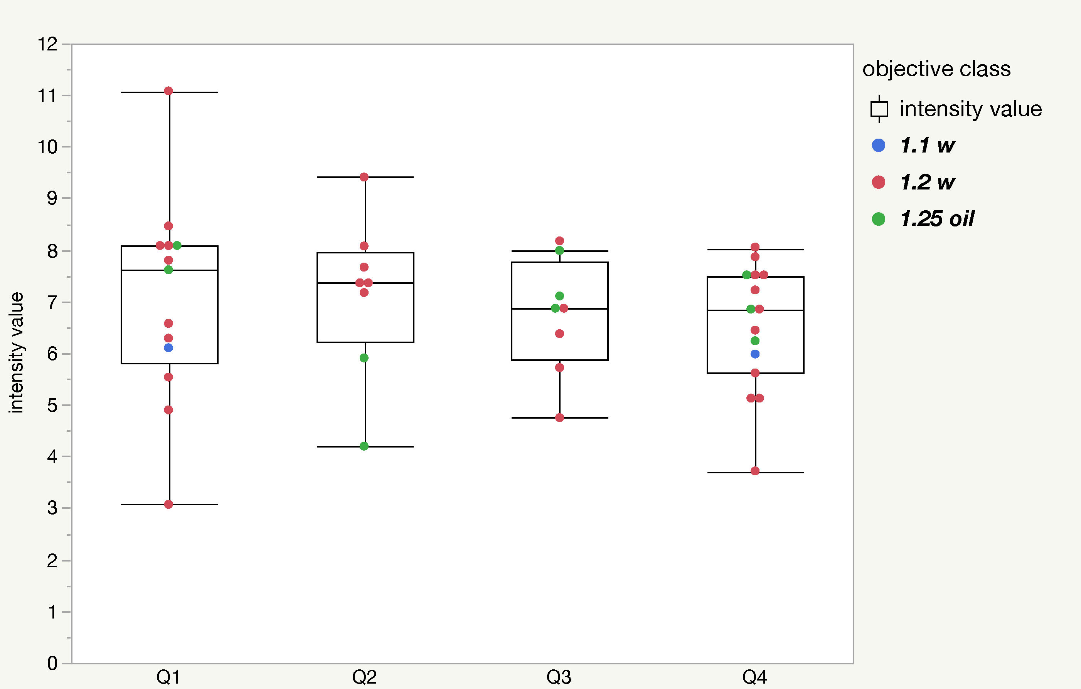
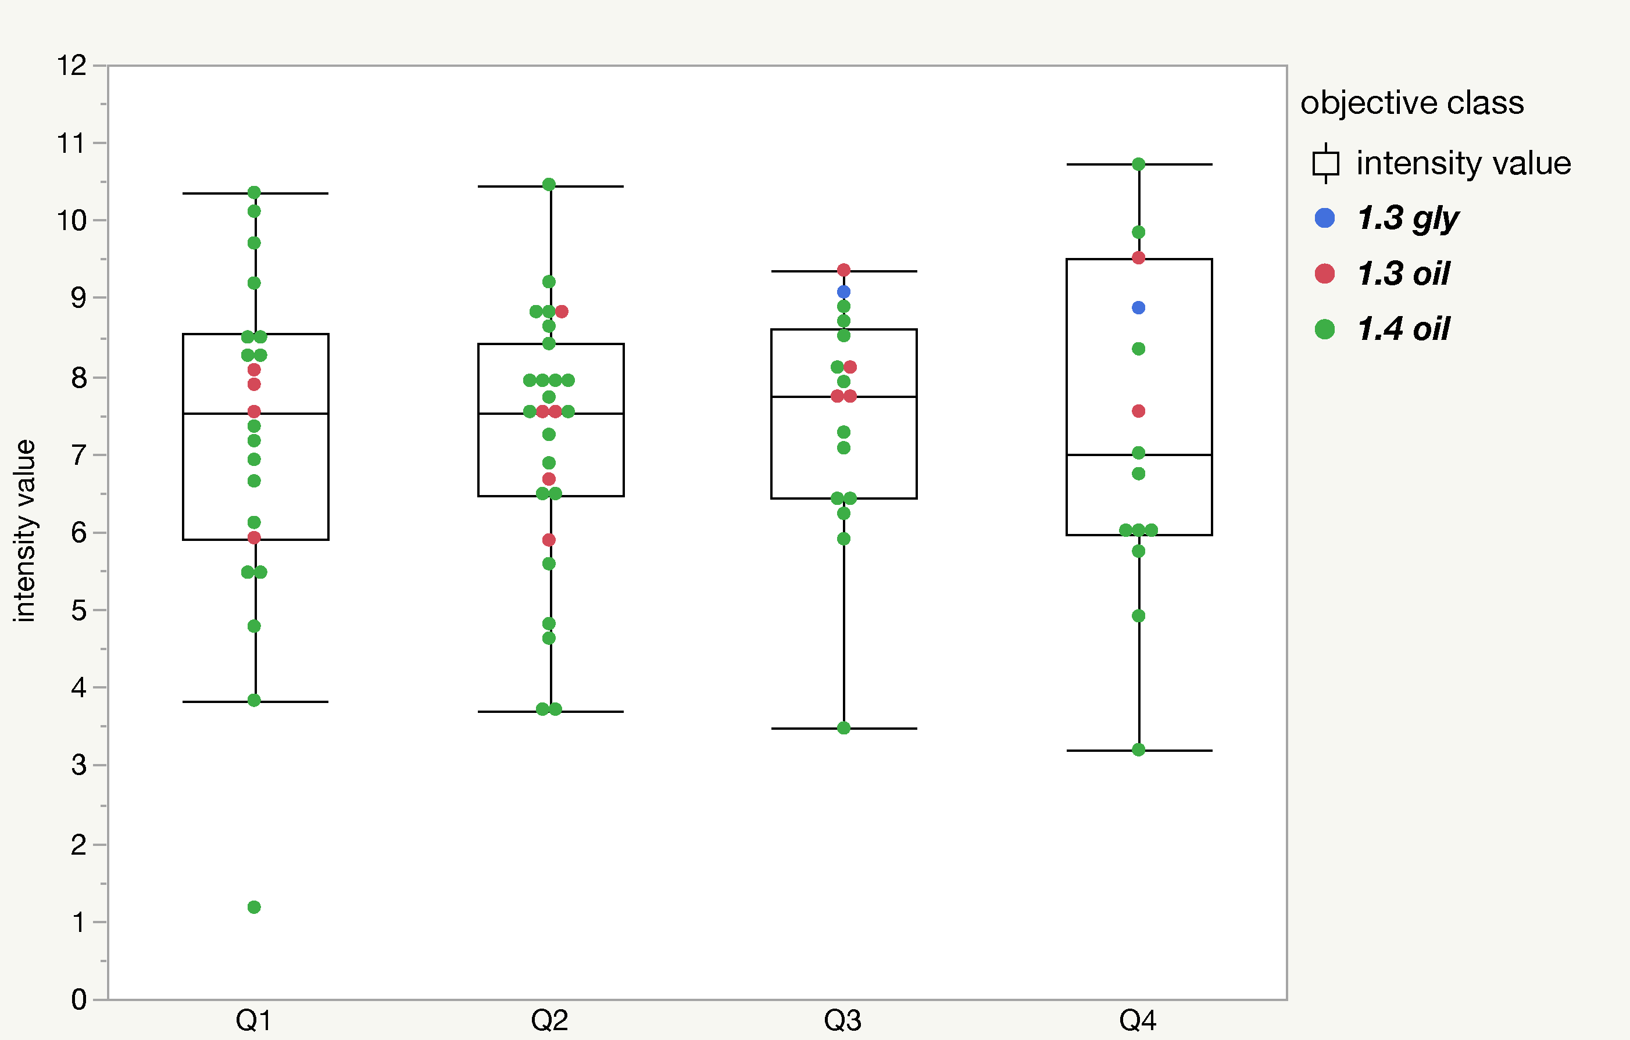
High/Low Intensity Ratio vs. Depth for Red Beads
All pairwise t-tests within each of the objective class groups gave p > 0.05.

Slide 22
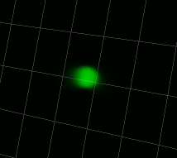
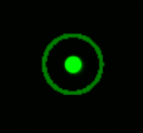
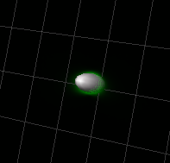
Analysis 2: SNR vs. Imaging Depth
The signal was defined as the fluorescence inside an oval volume that had a diameter 2x the diameter of the test bead.
The noise was defined as the fluorescence inside a volume whose diameter extended from 3.5x-4x the diameter of the bead
Signal
Noise
Notes:
Spots 1: XY = 2.5 Z = 5.0
Spots 2: XY = 8.75 Z = 17.5
Spots 3: XY = 10 Z = 20

Slide 23
The Signal to Noise Ratio Did Not Change Over the Depth Tested

Slide 24
Conclusions From the Intensity and Signal-to-Noise Ratio Part of Study:
Even though the overall intensity of objects decreased with depth, the ability to discriminate and quantify high intensity vs. low intensity objects was not compromised in most datasets tested.
The signal-to-noise ratio was not affected over the depth tested.

Slide 25
Analysis 3: Characterize Changes in Point Spread Function (PSF) as a Function of Imaging Depth
Cole et al. Nat. Protoc. 2011

Slide 26
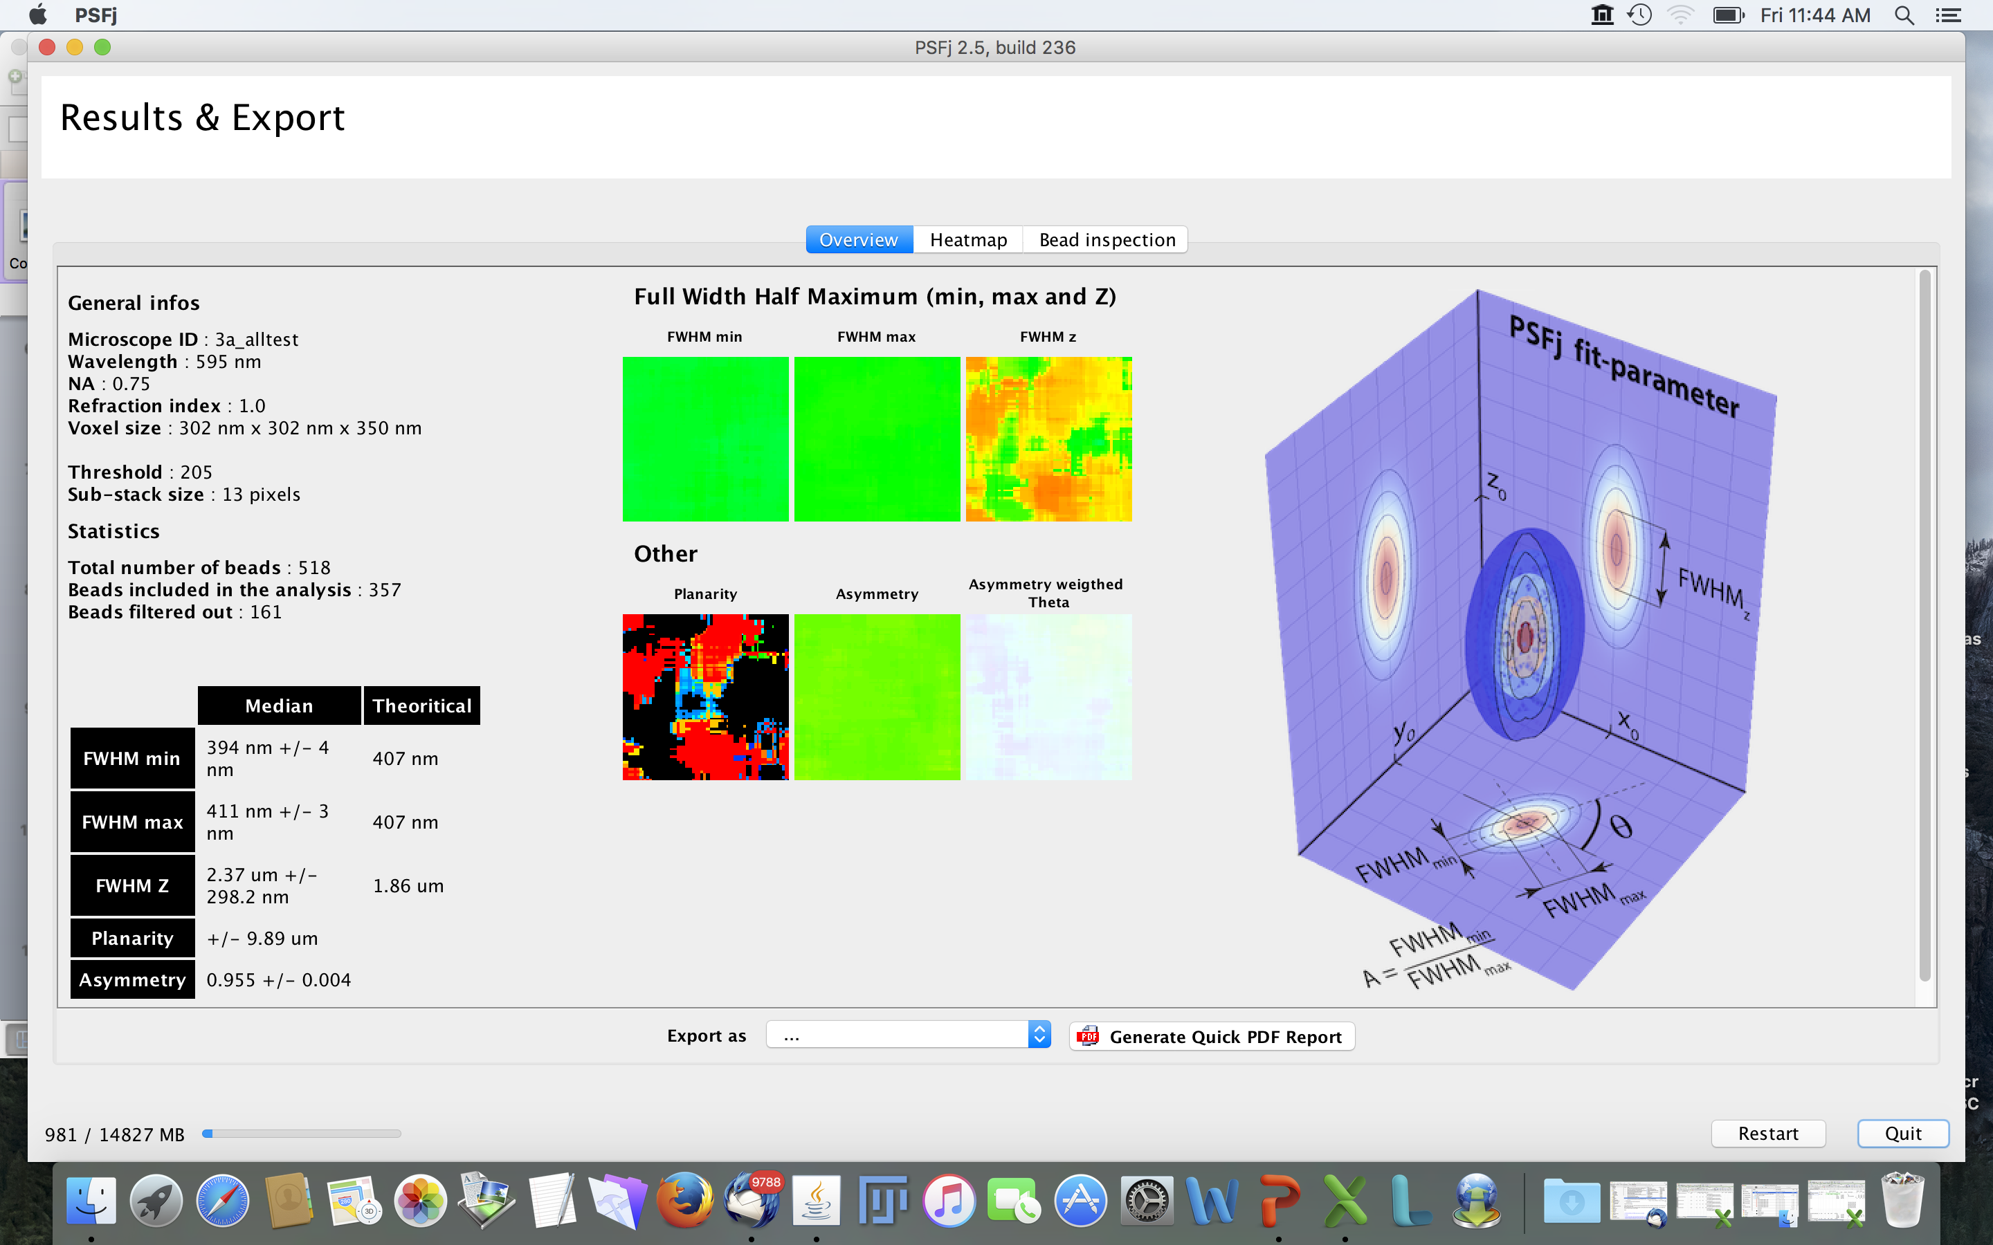
Analysis 3: Characterize Changes in Point Spread Function (PSF) as a Function of Imaging Depth
- Now in a 3D sample and across different types of objectives
Cole et al. Nat. Protoc. 2011
“PSFj”- Theer et al. Nat. Methods 2014 vol. 11 (10) pp. 981-982

Slide 27
Analysis 3: Characterize Changes in Point Spread Function (PSF) as a Function of Imaging Depth
- Now in a 3D sample and across different types of objectives
Thomas Pengo (Univ. MN)
re-implemented the code in MATLAB
Cole et al. Nat. Protoc. 2011

Slide 28
Analysis of Lateral PSF Shape Showed Small Changes Over Depth
 | Lateral FWHM vs. Q
NA | Mean Difference Over 100μm (Q1:Q4) | Theoretical Resolution *
0.7 | 0.008 | 0.360
1.2 | -0.017 | 0.210
1.25 | 0.039 | 0.200
1.3 | 0.018 | 0.190
1.4 | 0.040 | 0.180
*As in Cole et al. 2011, Wilhelm et al. 1997

Slide 29
Analysis of Axial PSF Shape Showed Only Small Changes Over Depth
 | Axial FWHM vs. Q
NA | Mean Difference Over 100μm (Q1:Q4) | Theoretical Resolution *
0.7 | 0.178 | 1.5
1.2 | 0.242 | 0.57
1.25 | 0.970 | 0.65
1.3 | 0.728 | 0.54
1.4 | 0.956 | 0.46
*As in Cole et al. 2011, Wilhelm et al. 1997

Slide 30
We Also Assessed Performance by NA Category
 | Lateral FWHM |  | Axial FWHM
NA | Mean | Std Dev | Mean | Std Dev
0.7 | 0.426 | 0.042 | 2.276 | 0.280
1.2 | 0.281 | 0.063 | 1.020 | 0.255
1.25 | 0.280 | 0.032 | 1.252 | 0.395
1.3 | 0.265 | 0.036 | 1.139 | 0.338
1.4 | 0.288 | 0.040 | 1.211 | 0.419

Slide 31
Observations and Conclusions From the Point Spread Function Part of Study:
Axial changes in PSF were great than lateral changes
Many of the changes in PSF shape that we measured were below the limit of resolution for the NA category over the depth analyzed.
It appeared that immersion to sample refractive index matching was the strongest predictor of performance.

Slide 32

Additional Resources from the LMRG Can Be Found at Our Website
https://abrf.org/research-group/light-microscopy-research-group-lmrg

Slide 33
Thank you Current LMRG Members!
Amanda Ammer – West Virginia University
Constadina Arvanitis - Northwestern University
Linda Callahan - University of Rochester Medical Center
Richard Cole - (EB Liaison) - Wadsworth Center
Joseph Dragavon - University of Colorado
Michelle Itano – University of North Carolina
Kristopher Kubow (Chair) - James Madison University
Valeria Mezzano - New York University School of Medicine
Thomas Pengo - University of Minnesota
James A Powers - Indiana University
Joshua Zachary Rappoport - Northwestern University
Mark Sanders - University of Minnesota
Erika Wee - McGill University

Slide 34
Thank you Study 3 Cohort!
Carol Bayles –Cornell University
Claire Brown - McGill University
Linda Callahan - University of Rochester Medical Center
Lisa Cameron - Duke University
Richard Cole - Wadsworth Center
Rebecca Deagle – McGill University
Joseph Dragavon - University of Colorado
Anne-Marie Girard – Oregon State University
Kristopher Kubow (Chair) - James Madison University
Kary Oakleaf – ThermoFisher Scientific
Cynthia Opansky – University of Wisconsin
Thomas Pengo - University of Minnesota
Joshua Zachary Rappoport - Northwestern University
Mark Sanders - University of Minnesota
Katherine Schulz - University of Wisconsin
Megan Smith – McGill University
Nelly Vuillemin - McGill University
Erika Wee - McGill University

